Slide 1
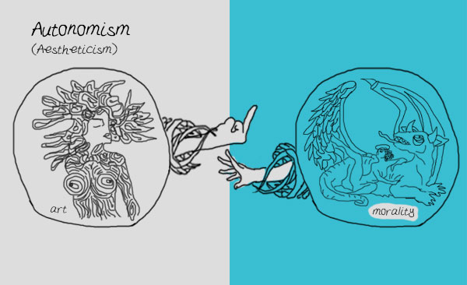
Autonomism

Slide 2
EXTREME AUTONOMISM
PRIME
IMMORAL

Slide 3
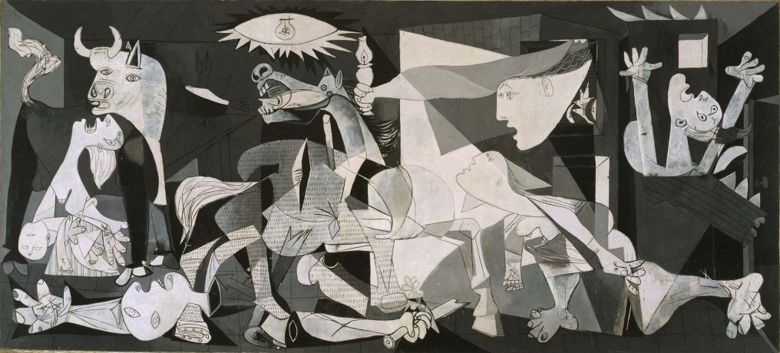
EXTREME AUTONOMISM
DYNAMIC
MORAL

Slide 4
POLL
What do you think of extreme autonomism (the view that it doesn’t make sense to morally evaluate works of art)?
I am inclined to agree with extreme autonomism.
I am inclined to disagree with extreme autonomism.

Slide 5
MODERATE AUTONOMISM
While it makes sense to morally evaluate artworks, the moral flaws (or successes) of artworks are never aesthetic flaws (or successes) in them.
“When it seems that ethical flaws in works are aesthetically relevant, it is in fact not their ethical badness, but some other features of the expression of these flaws that is relevant” (Gaut 2011, 433).

Slide 6
ARGUMENT FROM CASES
Some works of art are both extremely immoral and aesthetic masterpieces.
If some works of art are both extremely immoral and aesthetic masterpieces, then the immorality of an artwork is irrelevant to its aesthetic value.
So: the immorality of an artwork is irrelevant to its aesthetic value.

Slide 7
POLL
Which premises do you reject (if any)?
(1) Some works of art are both extremely immoral and aesthetic masterpieces.
(2) If some works of art are both extremely immoral and aesthetic masterpieces, then the immorality of an artwork is irrelevant to its aesthetic value.
Both premises (1) and (2).
I accept both premises: autonomism is true!

Slide 8
ARGUMENT FROM CASES
Premise (2) might be true if the moralist held that moral merits are the only aesthetic merits that there are.
But we should be pluralists about aesthetic value.
Triumph of the Will is aesthetically flawed insofar as it is immoral.
Nonetheless, all things considered, it may still be an aesthetic masterpiece.
Notes:
Leo Tolstoy
“we praise works for a wide variety of features, such as their beauty, unity, complexity, profundity, etc., features which may have no necessary relation to morality” (433).

Slide 9
ARGUMENT FROM INSEPARABILITY
If moralism is true, then there is a moral flaw of a work that is also an aesthetic flaw of that work.
If so, then if that moral flaw were to be removed, the aesthetic value of the work would improve.
That’s implausible.
So: moralism is false.
Notes:
“Some aesthetically good features of a work may depend on its moral flaws: for instance, Riefenstahl’s film is great not just because of the formal beauty of its images, but also because of the continuity of its political and aesthetic ideas, the unity of its form and content. ‘The moral defects of the film are not aesthetic blemishes, because they are inseparable from the work’s aesthetic value’ (Jacobson 1997: 192–3)” (436).
“Moralists may sometimes seem to suppose that removing a moral flaw in a work would invariably lead to a better work, but there is no need for them to make so strong a claim” (436).

Slide 10
ARGUMENT FROM INSEPARABILITY
all things considered good
GOOD-MAKER
BAD-MAKER
kind
deceptive
F, G, …
ACTION

Slide 11
ARGUMENT FROM INSEPARABILITY
all things considered bad
GOOD-MAKER
BAD-MAKER
F, G, …
ACTION

Slide 12
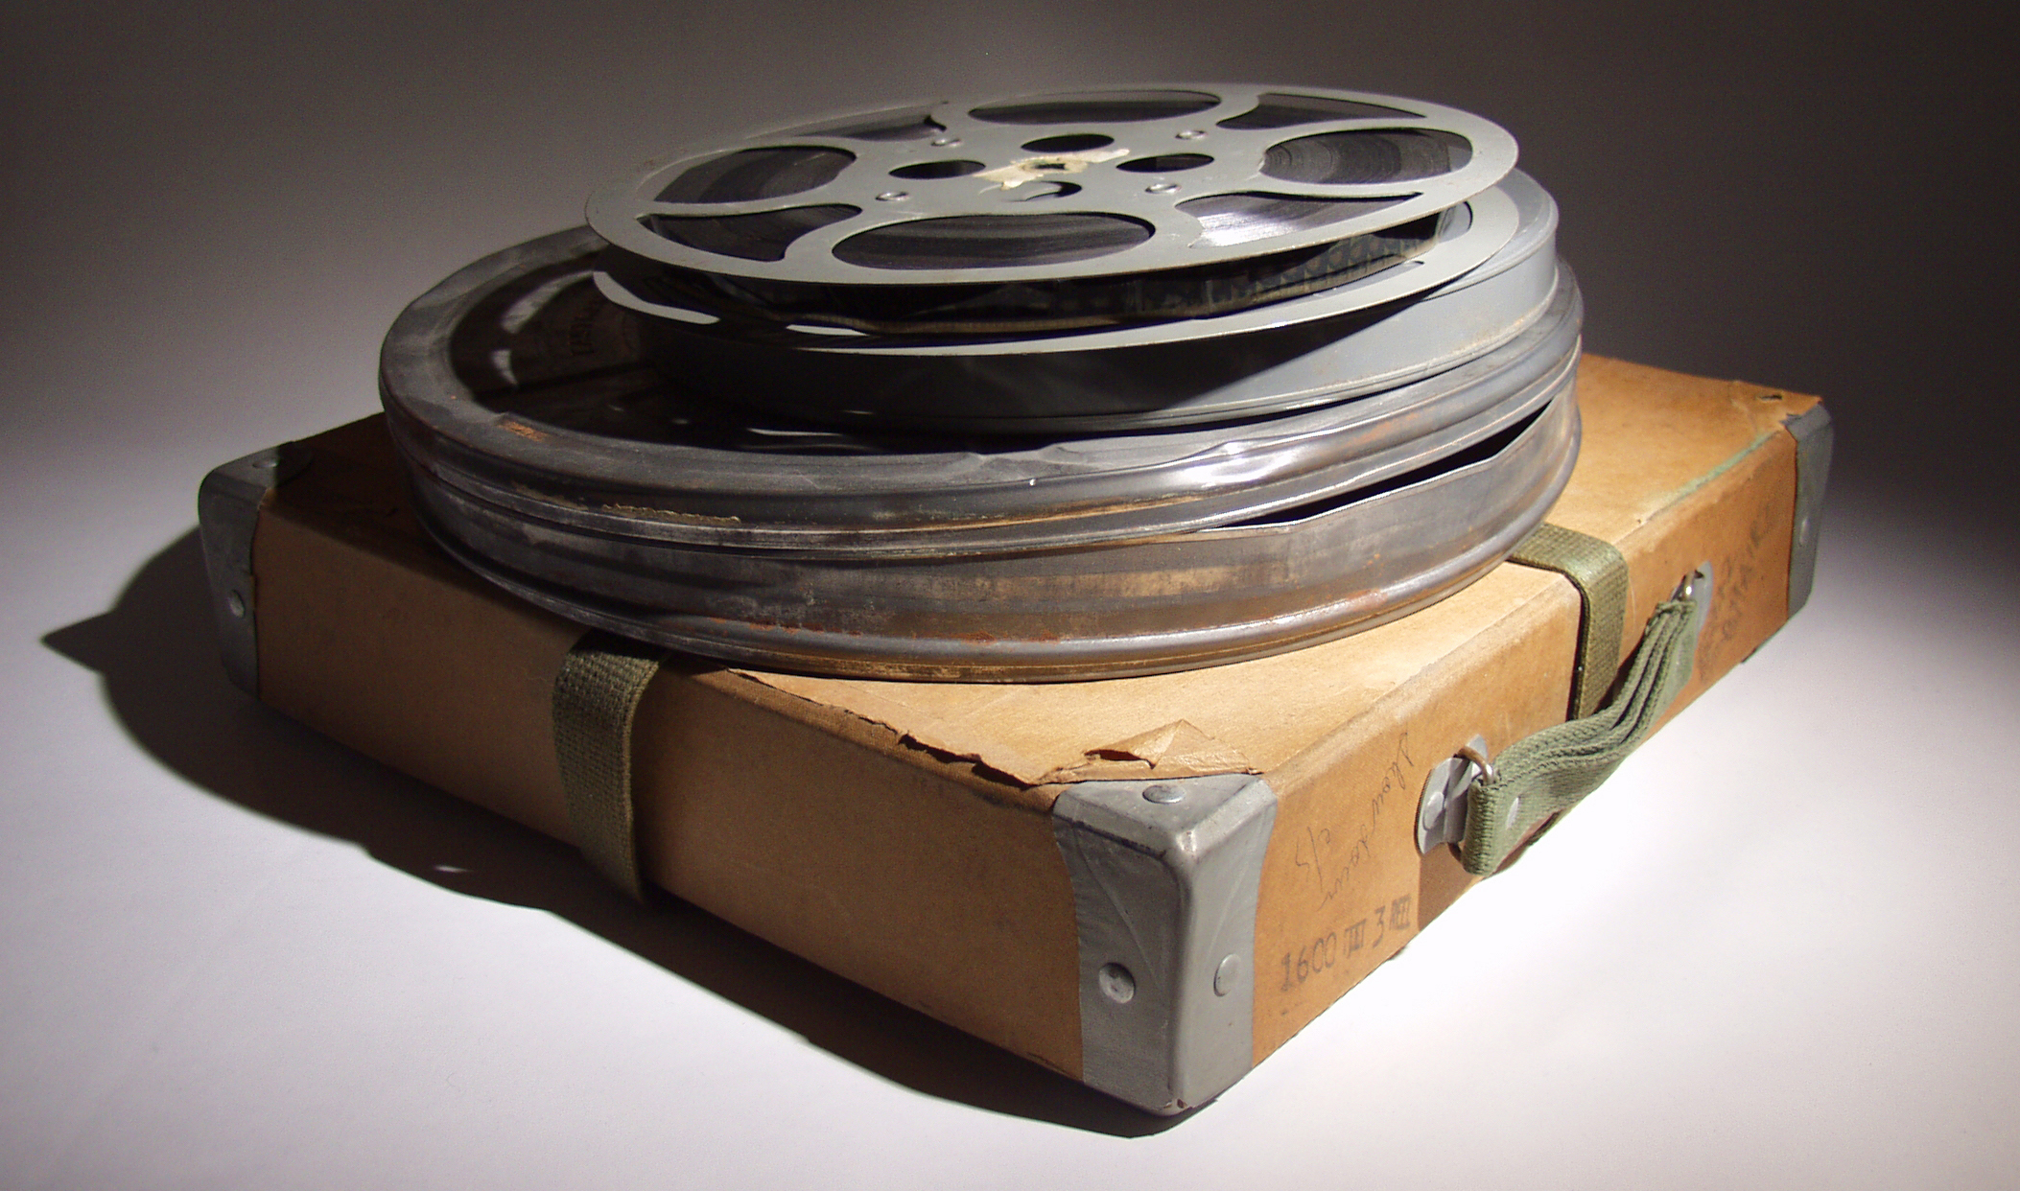
ARGUMENT FROM INSEPARABILITY
all things considered aesthetically good
GOOD-MAKER
BAD-MAKER
racist
formally beautiful, etc.
F, G, …

Slide 13
ARGUMENT FROM INSEPARABILITY
all-things-considered aesthetically bad
GOOD-MAKER
BAD-MAKER
F, G, …

Slide 14
ARGUMENT FROM FORMALISM
The aesthetic value of a work is wholly determined by the directly perceivable formal features of that work.
But if that is right, then moderate autonomism is true.

Slide 15
ARGUMENT FROM FORMALISM
If one only paid attention to the lines and colors of Picasso's Guernica, failing to see how Picasso uses those lines and colors to convey something about the horror of war, then one would be missing something about the aesthetic value of that piece.

Slide 16
POLL
Moderate autonomism: the moral flaws of artworks are never aesthetic flaws in them.
What do you think of moderate autonomism?
I lean toward accepting it
I lean toward rejecting it

Slide 17
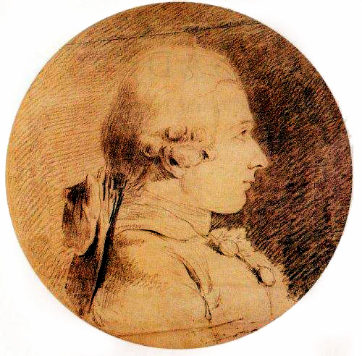
IMMORALISM

Slide 18
MODERATE IMMORALISM
“[T]he ethical flaws of works are sometimes aesthetic merits in them . . . depending on the artistic context in which they occur” (Gaut 2011, 435).
Moderate immoralists reject the “valence constraint.”

Slide 19
ARGUMENT FROM CASES
Artworks are sometimes praised for their “transgressive” or “subversive” qualities.
That gives at least some evidence to think that those qualities are aesthetic successes in those works.

Slide 20
ARGUMENT FROM CASES
We must distinguish between the attitudes a work represents and the attitudes a work endorses.
There are also more than one way for a work to be “transgressive”—inviting us to question our moral views by showing us morally bad ones versus prescribing morally bad views.
Notes:
If the first sense, that isn’t an ethical flaw in the work.
By contrast, if a work is transgressive in the sense that it shares a morally bad point of view, why should we count it as an aesthetic merit?

Slide 21
ARGUMENT FROM COGNITIVISM
If cognitivism is true, then cognitive merits are sometimes aesthetic merits.
If cognitive merits are sometimes aesthetic merits, then if the immoral perspectives of certain artworks can communicate truths to us, then immoralism is true.
Cognitivism is true.
The immoral perspectives of certain artworks can communicate truths to us.
So: immoralism is true.
Notes:
“For instance, we can come to understand how bullying, and more generally evil acts, can be enjoyed and be seductive by reading a story that invites us to take up the bully’s perspective, to want the bullying to succeed and so to respond in ways that are immoral (Kieran 2003: 68–9)” (438).

Slide 22
ARGUMENT FROM COGNITIVISM
If some work communicates, e.g., that bullying is morally good, then it communicates a falsehood—and that is not a cognitive merit.
But if the work communicates, e.g., that we can be seduced into finding bullying attractive, then that may be true—but then the work appears to be criticizing immorality (not endorsing it)!
Notes:
Make the point that immoralism collapses into cognitivism

Slide 23
ARGUMENT FROM THE ROUGH HERO
Works that fall into the genre of the rough hero have immoral perspectives in that they prescribe positive attitudes toward morally abhorrent characters.
This is an both a moral failing and aesthetic achievement of these works.
A. W. Eaton

Slide 24
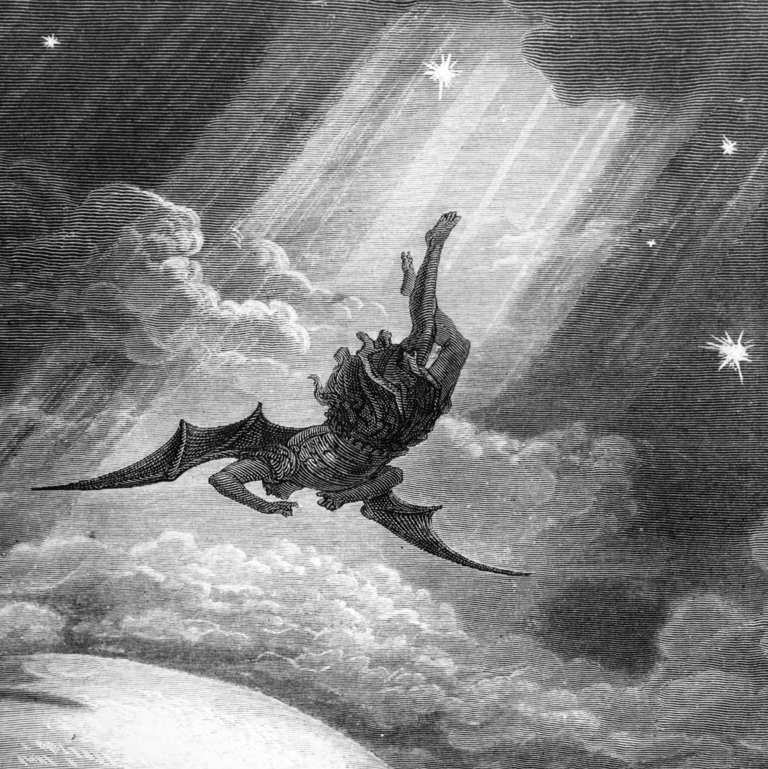
ARGUMENT FROM THE ROUGH HERO
Milton’s Satan

Slide 25
ARGUMENT FROM THE ROUGH HERO
Judge Holden

Slide 26
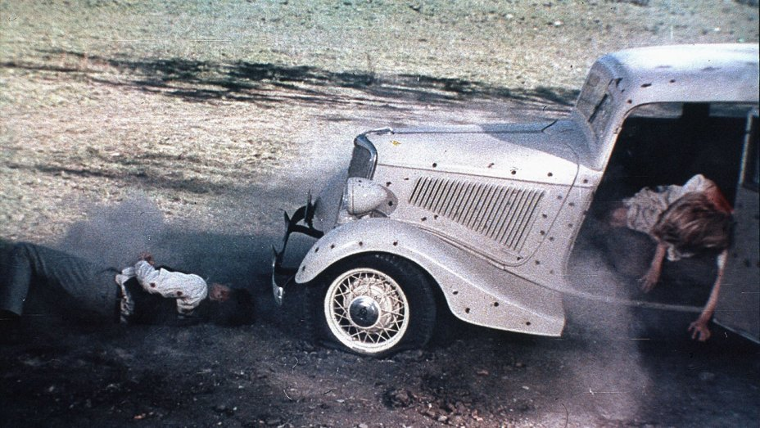
ARGUMENT FROM THE ROUGH HERO
“[A]t the film’s Hollywood premier, at the point where Bonnie and Clyde are gunned down, one viewer reportedly stood up and loudly yelled, ‘Fucking cops!’” (285).
Bonnie and Clyde (1967)

Slide 27
ARGUMENT FROM THE ROUGH HERO
A work in the rough hero genre invites our moral disapproval of a central character whose “flaws are . . . grievous: he is usually a sociopath, an outlaw, a murderer, a sex criminal, a sadist, or Satan incarnate” (Eaton 2012, 284).
It also morally undermines itself by simultaneously prescribing positive (and immoral!) attitudes toward that character.
This prompts an aesthetically valuable experience, one of ambivalence that makes the work compelling.
This is an aesthetic achievement.
So: “[A]n intrinsically immoral artwork that succeeds in making its target audience adopt its immoral perspective is to this extent morally flawed and also for this reason, and to this extent, aesthetically good” (290).

Slide 28
ARGUMENT FROM THE ROUGH HERO
aesthetically successful
morally flawed
prescribes immoral attitudes toward a rough hero

Slide 29
POLL
Moderate immoralism: the moral flaws of artworks are sometimes aesthetic successes in them.
What do you think of moderate immoralism?
I lean toward accepting it
I lean toward rejecting it

Slide 30
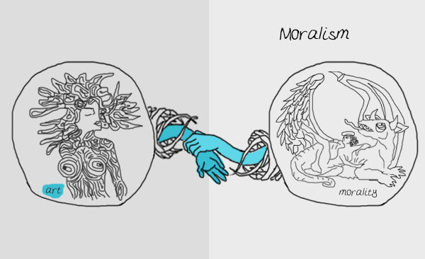
MORALISM

Slide 31
MODERATE MORALISM
Aesthetically relevant moral flaws of artworks are always aesthetic flaws in them.
That is consistent with saying that there are other moral flaws of works (the aesthetically irrelevant ones) that aren’t aesthetic flaws in them.

Slide 32
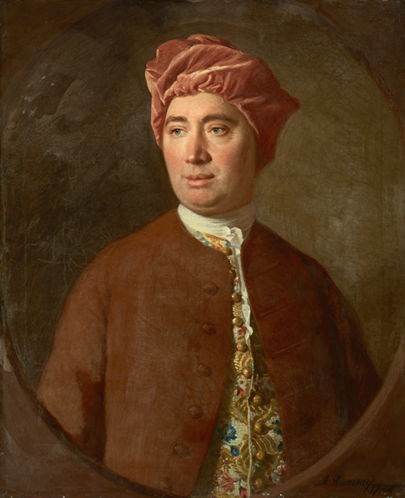
THE MERITED RESPONSE ARGUMENT
“[W]here vicious manners are described, without being marked with the proper characters of blame and disapprobation; this must be allowed to disfigure the poem, and to be a real deformity. I cannot, nor is it proper I should, enter into such sentiments” (Hume 1987, 246).
David Hume

Slide 33
THE MERITED RESPONSE ARGUMENT
If a work of art prescribes a response we have moral reason to resist, then that is a moral flaw in the work.
If a work of art prescribes an unmerited response, then that is an aesthetic flaw in the work.
A response we have moral reason to resist is also unmerited.
Some works prescribe responses we have moral reason to resist.
So: some works have moral flaws that are also aesthetic flaws—moderate moralism is true.
Notes:
Show The Room clip for Premise (1)
“Failure to warrant a prescribed response is one kind of aesthetic defect; for instance, the thriller that does not warrant a sudden and sharp feeling of excitement fails to this extent and on its own terms” (285).
“Moralism shows only that a work’s aesthetically praiseworthy features can be rendered inaccessible by its moral flaws, not that a work’s moral flaws yield or amount to aesthetic blemishes” (286).

Slide 34
THE MERITED RESPONSE ARGUMENT
all things considered moral value
all things considered aesthetic value
morally flawed
aesthetically flawed
[prescribes morally bad response] = [prescribes unmerited response]
Notes:
“Moralism shows only that a work’s aesthetically praiseworthy features can be rendered inaccessible by its moral flaws, not that a work’s moral flaws yield or amount to aesthetic blemishes” (286).

Slide 35
POLL
Moderate moralism: aesthetically relevant moral flaws of artworks are always aesthetic flaws in them.
What do you think of moderate immoralism?
I lean toward accepting it
I lean toward rejecting it
Notes:
“Moralism shows only that a work’s aesthetically praiseworthy features can be rendered inaccessible by its moral flaws, not that a work’s moral flaws yield or amount to aesthetic blemishes” (286).

