Slide 1
TRANSPARENCY ELUCIDATED

Slide 2
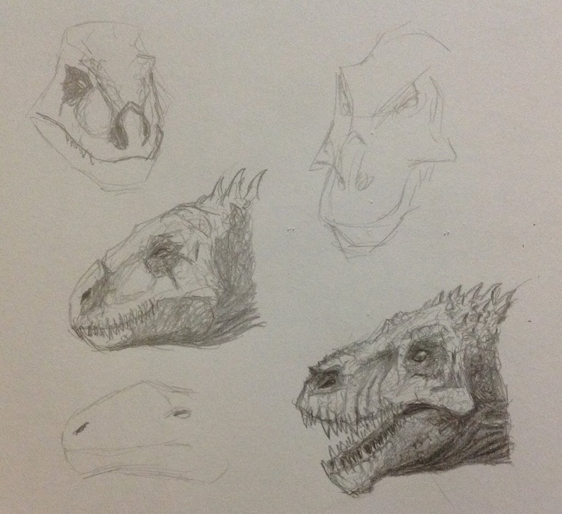
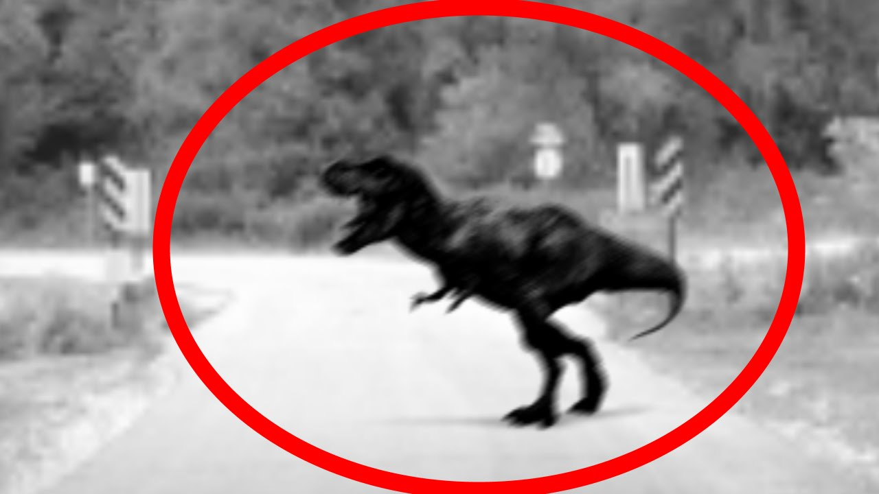
TRANSPARENCY VS. OPACITY
Notes:
“The pictures (together with background information) may convince us that there is a dinosaur lurking in the jungle” (262).
“Perhaps the photographs are more convincing than the drawings, but they needn’t be. That is not the crucial difference between them; we might have better reason to trust the drawings than the photographs” (263).

Slide 3
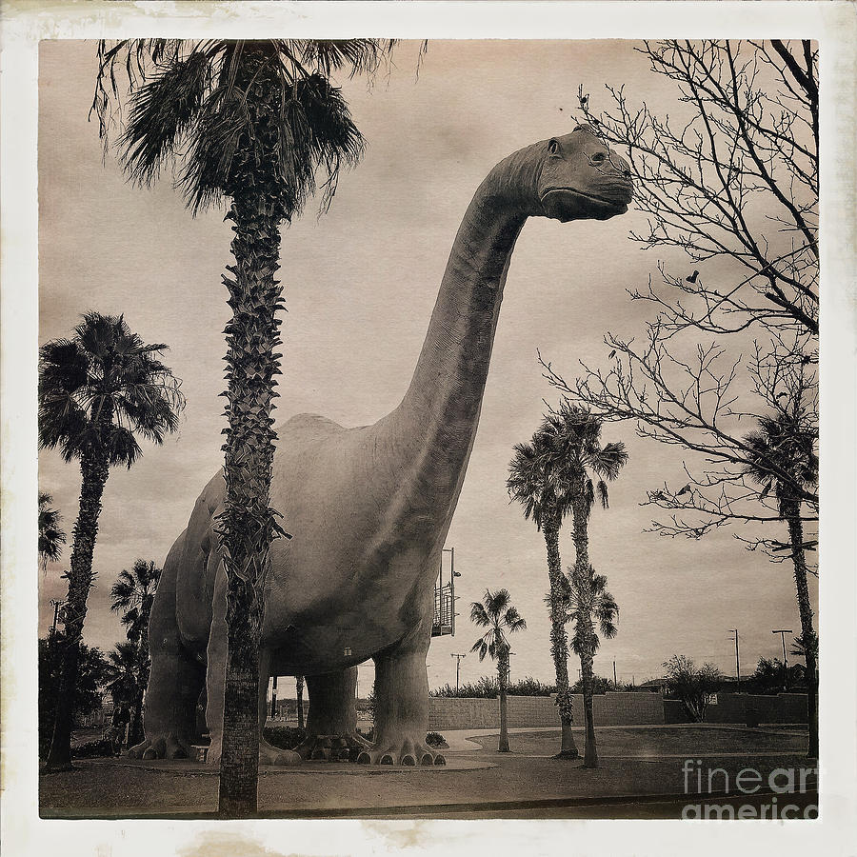
TRANSPARENCY VS. OPACITY
Notes:
“The pictures (together with background information) may convince us that there is a dinosaur lurking in the jungle” (262).
“Perhaps the photographs are more convincing than the drawings, but they needn’t be. That is not the crucial difference between them; we might have better reason to trust the drawings than the photographs” (263).

Slide 4
TRANSPARENCY VS. OPACITY
“The important difference is that, in the case of the sketches, we rely on the picture maker’s belief that there is a dinosaur in a way in which we don’t in the case of the photographs” (Walton 1984, 262).
We treat the sketches as evidence that the artist thought he saw dinosaurs in the jungle.
If the artist is reliable and trustworthy, we treat his belief that there dinosaurs in the jungle as evidence that there are dinosaurs in the jungle.
With photographs, by contrast, we do not need to rely on the photographer’s thoughts in this way.
“In fact, if the photographs do convince us that he believed in the dinosaur, they do so because they convince us that there was a dinosaur, not the other way around” (263).
Notes:
The intuitive idea is…
Transition: “We do need to make certain assumptions if we are going to trust the photographs: that the camera was of a certain sort, that no monkey business was involved in the processing, and so on. These may require our according the say-so of the photographer; we may have to trust him” (263).
Transition: it is no different with ordinary perception.

Slide 5
TRANSPARENCY VS. OPACITY
Notes:
“I might rely on someone else’s word in making these assumptions; I might consult a beneficent doctor. If he assures me that the system is operating normally, and it is, then I am seeing (or perceiving), notwithstanding my reliance on him” (263).
Transition: Walton will make this precise by appealing to counterfactuals.

Slide 6
COUNTERFACTUAL DEPENDENCE
Counterfactual conditionals are “if-then” statements of the following forms:
If P were the case, then Q would be the case.
If P were the case, then Q would not be the case.
If P were not the case, then Q would be the case.
If P were not the case, then Q would not be the case.
Etc.
Examples in ordinary English include:
If I were to start writing my paper a month before the deadline, then I would get an A.
If I hadn’t drank tequila from a plastic bottle last night, then I wouldn’t have a hangover right now.

Slide 7
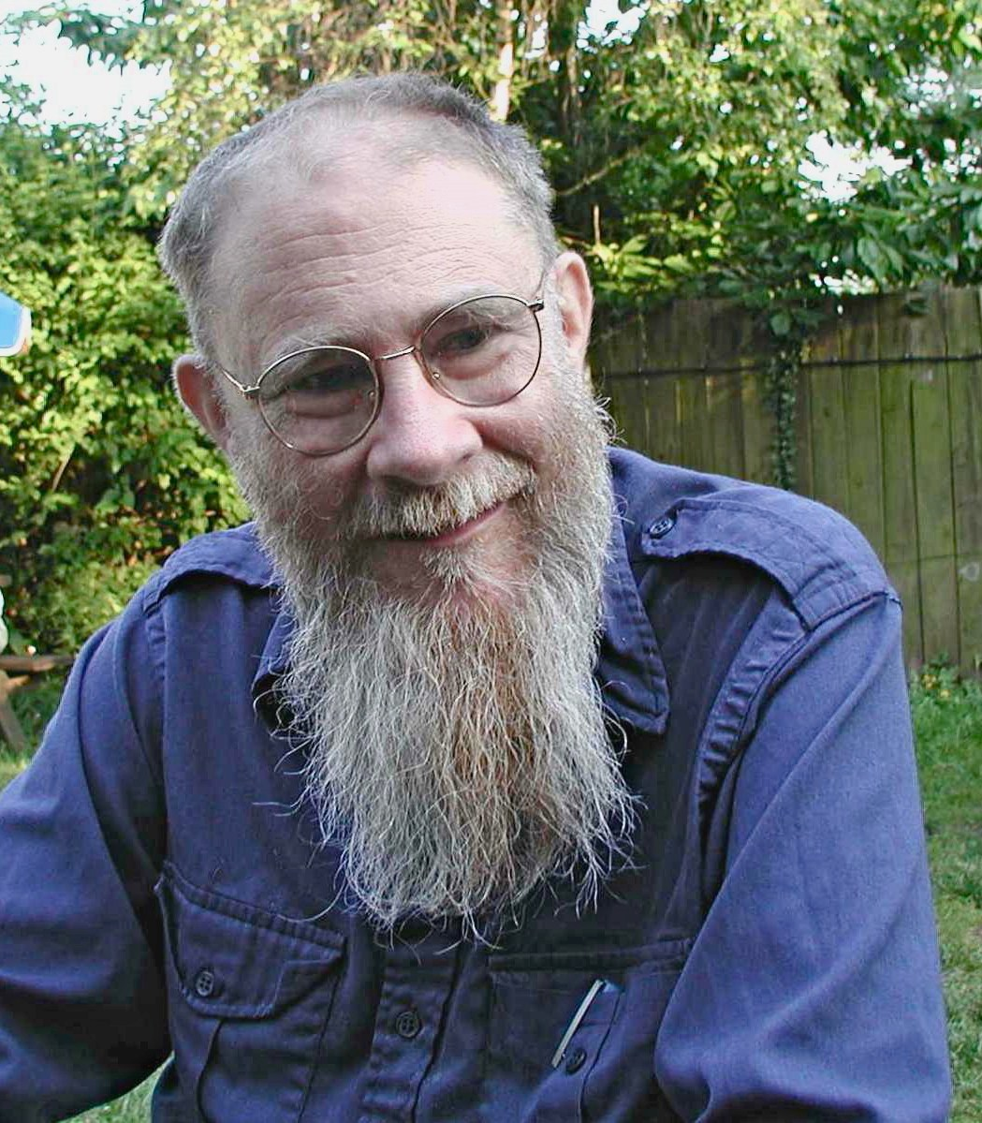
COUNTERFACTUAL DEPENDENCE
David Lewis

Slide 8
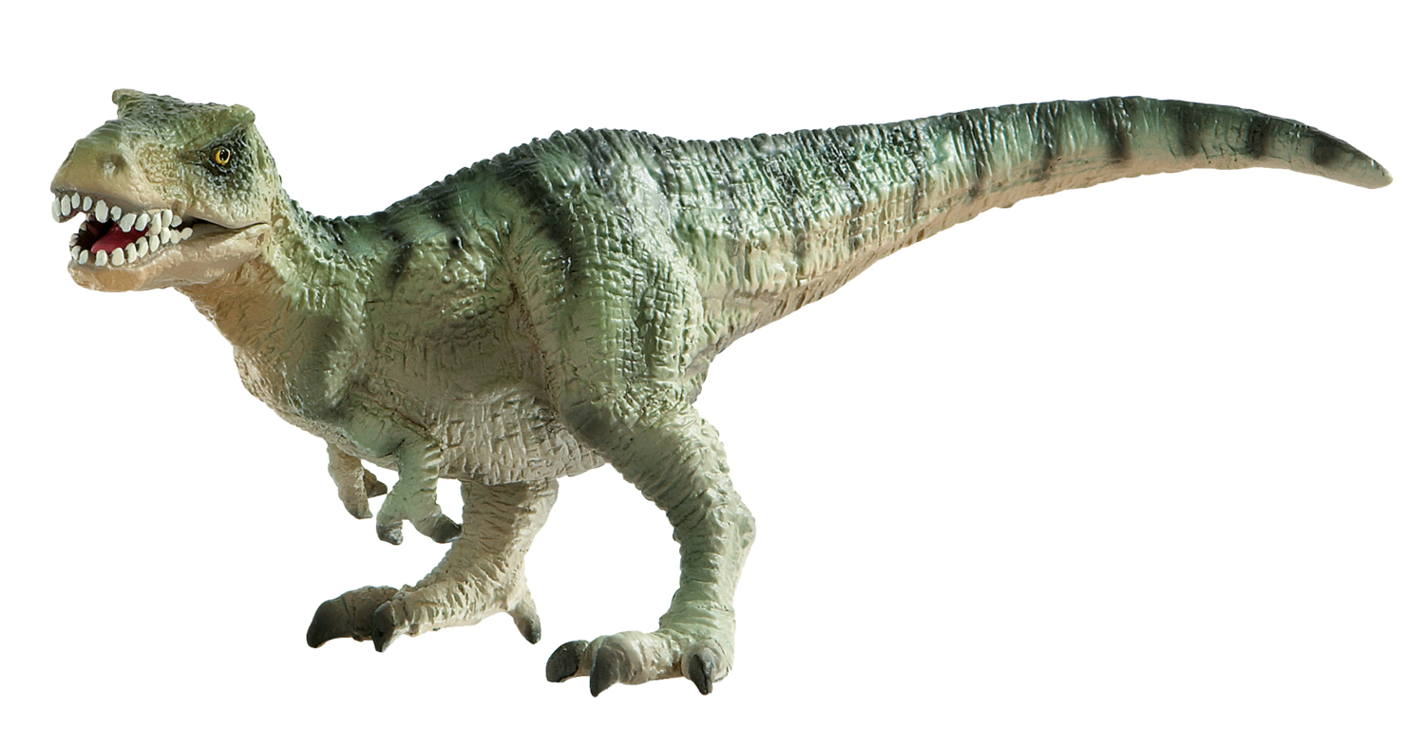
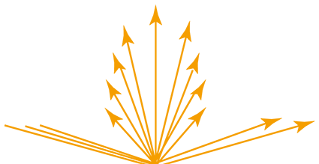
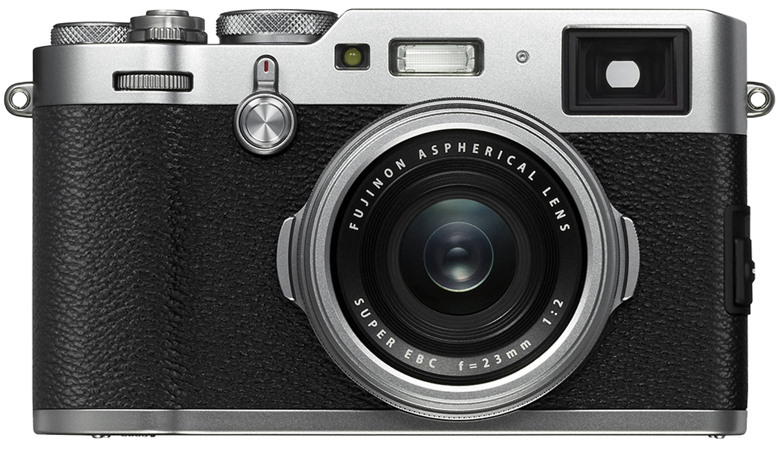
COUNTERFACTUAL DEPENDENCE
Dinosaur!
Dinosaur!

Slide 9
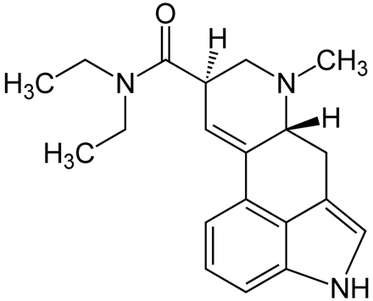
COUNTERFACTUAL DEPENDENCE
Uninhabited jungle :(
Dinosaur!
Scenario A: if the scene had been different, the sketch would have been different.
Scenario B: if the scene had been different, the photograph would have been different.
[Laura believes that there is no dinosaur]
[a distinct pattern of light reaches the lens]
[there is no dinosaur]
[there is no dinosaur]
Notes:
“Suppose that the picture maker—artist or photographer—is hallucinating the dinosaur which he attempts to portray. The artist’s sketches will show a dinosaur nonetheless, but the photographs will not” (264).

Slide 10
COUNTERFACTUAL DEPENDENCE
Uninhabited jungle :(
Dinosaur!
What an existence-entailing non-photographic image shows depends on what the artist thinks she sees, regardless of whether or not she is correct.
Holding the artist’s attitudes fixed, an existence-entailing non-photographic image is not counterfactually dependent on the scene.
What a photographic image shows depends on what is really in front of the photographer, regardless of what she thinks she sees.
Holding the photographer’s attitudes fixed, the photographic image is counterfactually dependent on the scene.
Notes:
“Suppose that the picture maker—artist or photographer—is hallucinating the dinosaur which he attempts to portray. The artist’s sketches will show a dinosaur nonetheless, but the photographs will not” (264).
“In order to see through the picture to the scene depicted, the viewer must have visual experiences which do not depend on the picture maker’s beliefs in the way that paintings do” (264).

Slide 11
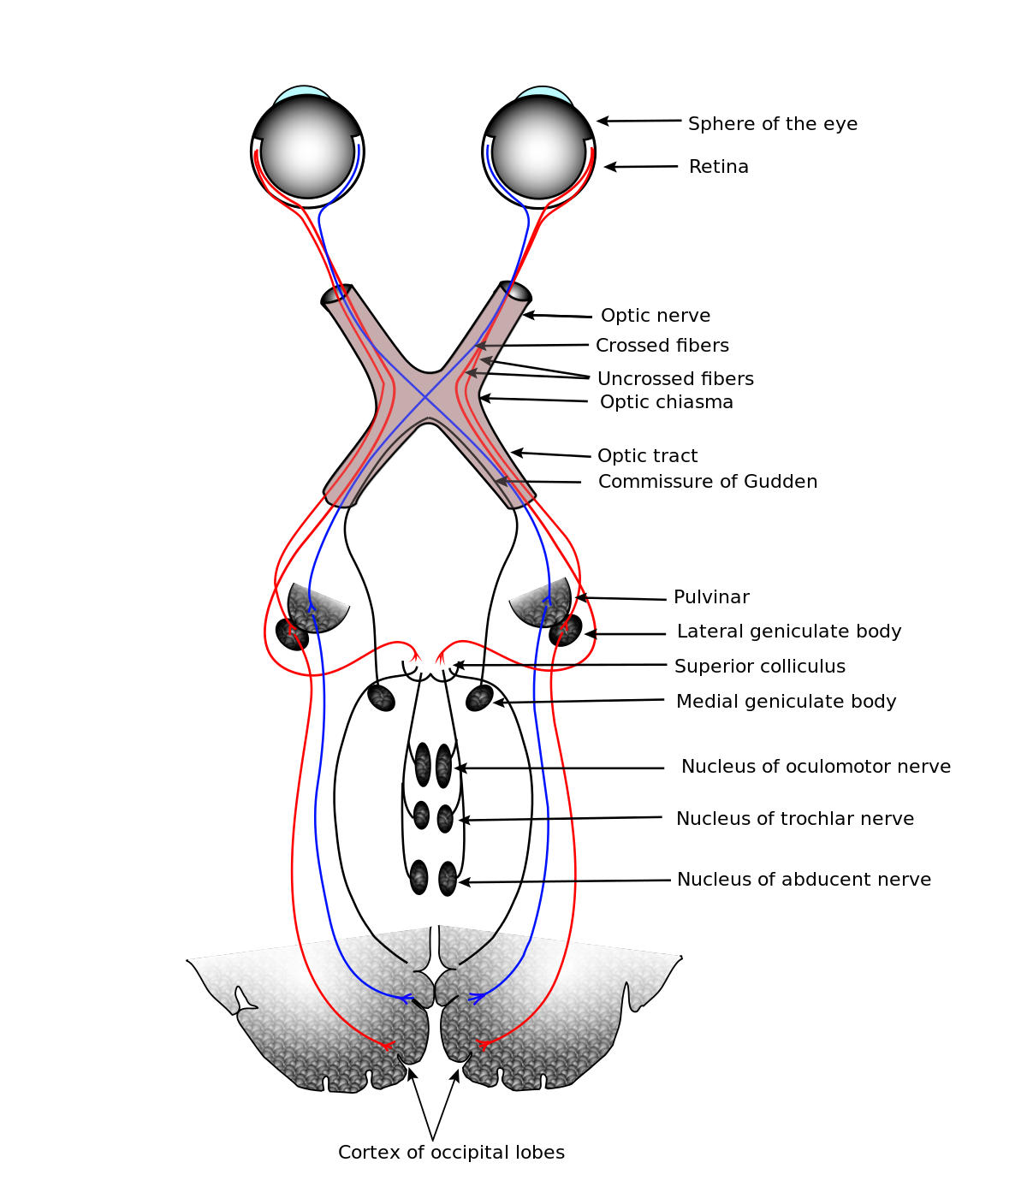
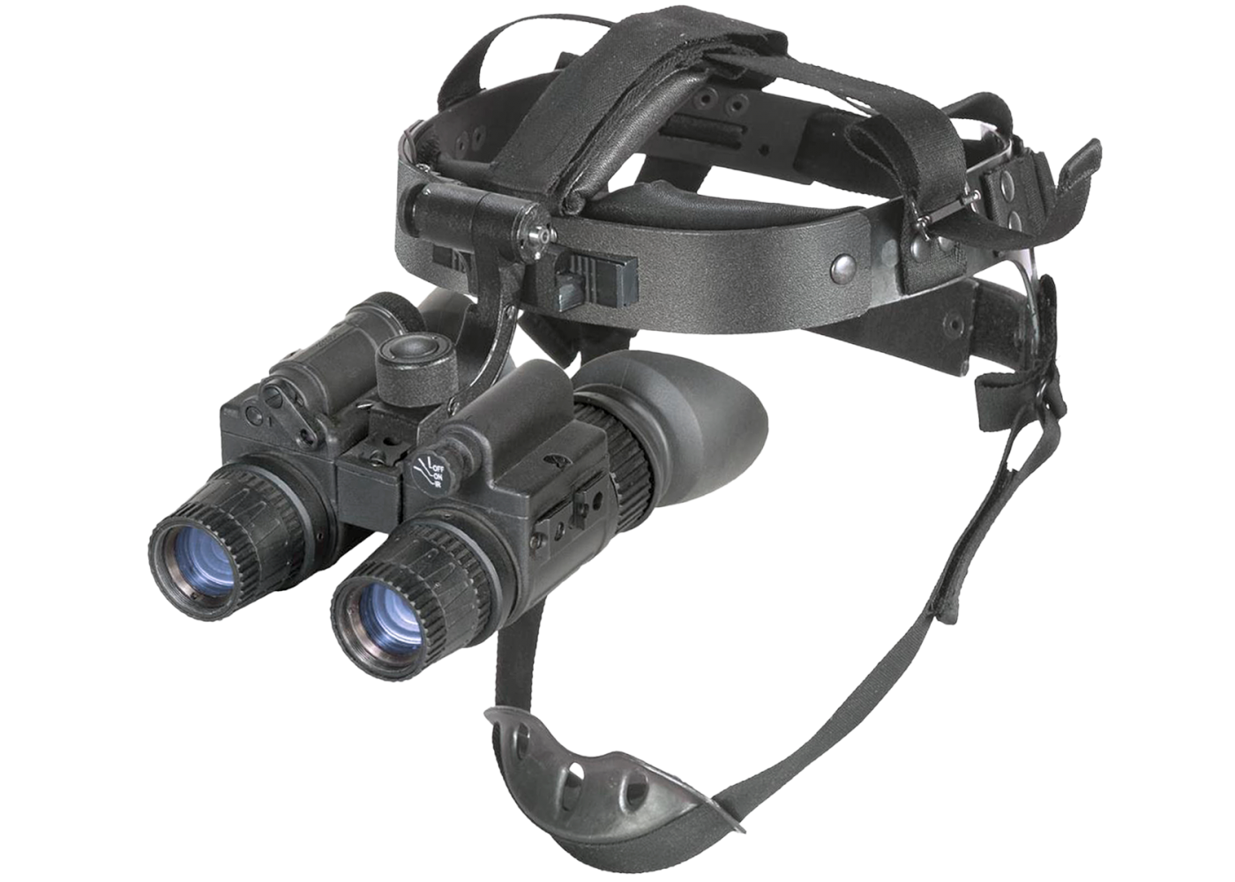
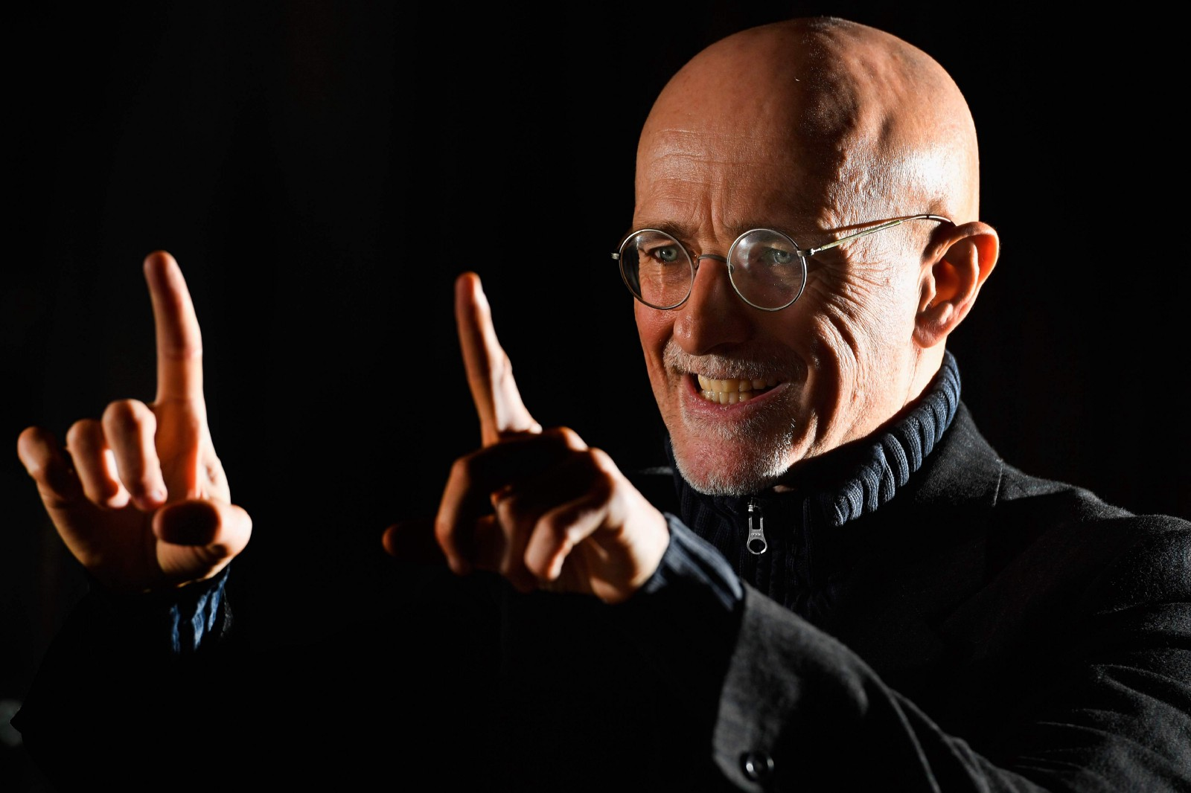
COUNTERFACTUAL DEPENDENCE
Notes:
Sergio Canavero, Italian neurosurgeon – https://en.wikipedia.org/wiki/Sergio_Canavero
“Helen seems to be seeing things, and her visual experiences are caused by the things which she seems to see. But she doesn’t really see them; the doctor is seeing for her. This is because her visual experiences are based on his in the way I described. It is only because differences in scenes make for differences in the doctor’s beliefs that they make for differences in her visual experiences” (265).

Slide 12
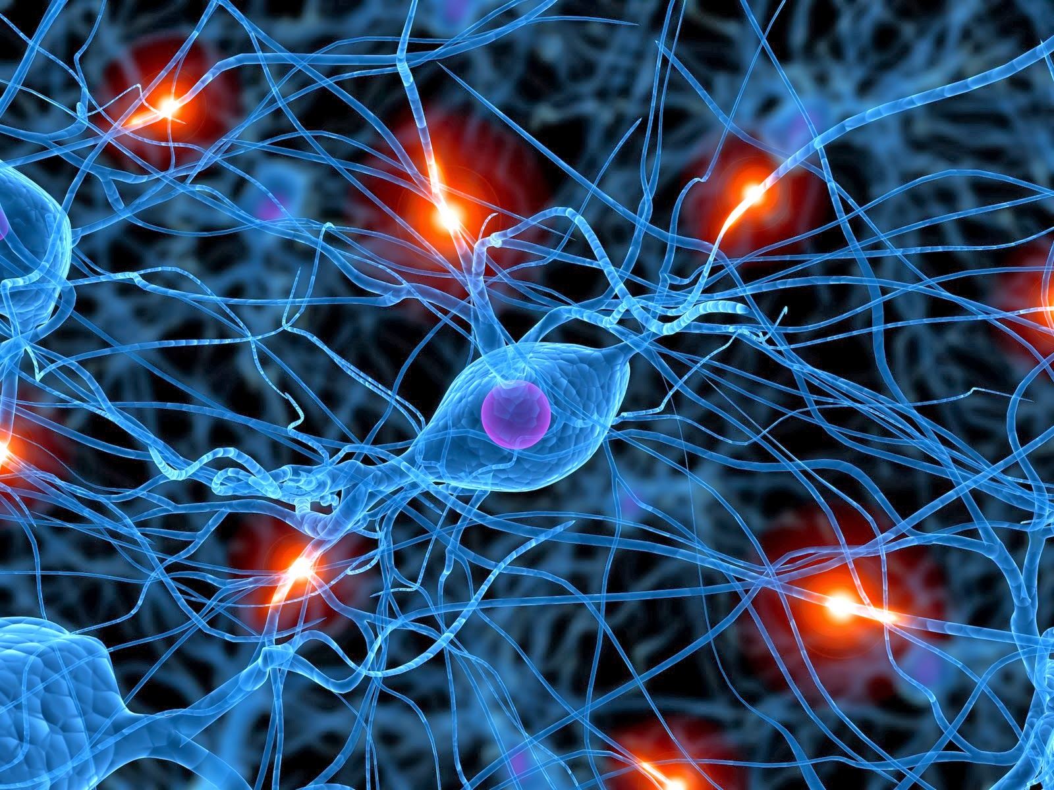
COUNTERFACTUAL DEPENDENCE
Notes:
Sergio Canavero, Italian neurosurgeon – https://en.wikipedia.org/wiki/Sergio_Canavero
“Helen seems to be seeing things, and her visual experiences are caused by the things which she seems to see. But she doesn’t really see them; the doctor is seeing for her. This is because her visual experiences are based on his in the way I described. It is only because differences in scenes make for differences in the doctor’s beliefs that they make for differences in her visual experiences” (265).

Slide 13
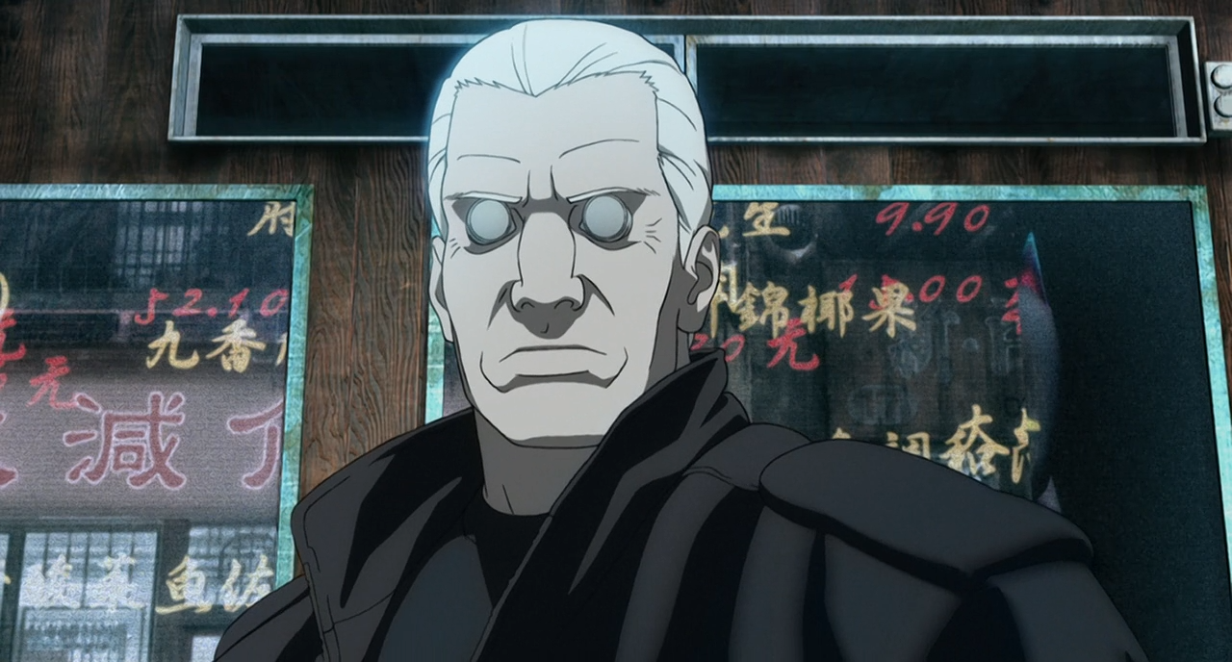
COUNTERFACTUAL DEPENDENCE

Slide 14
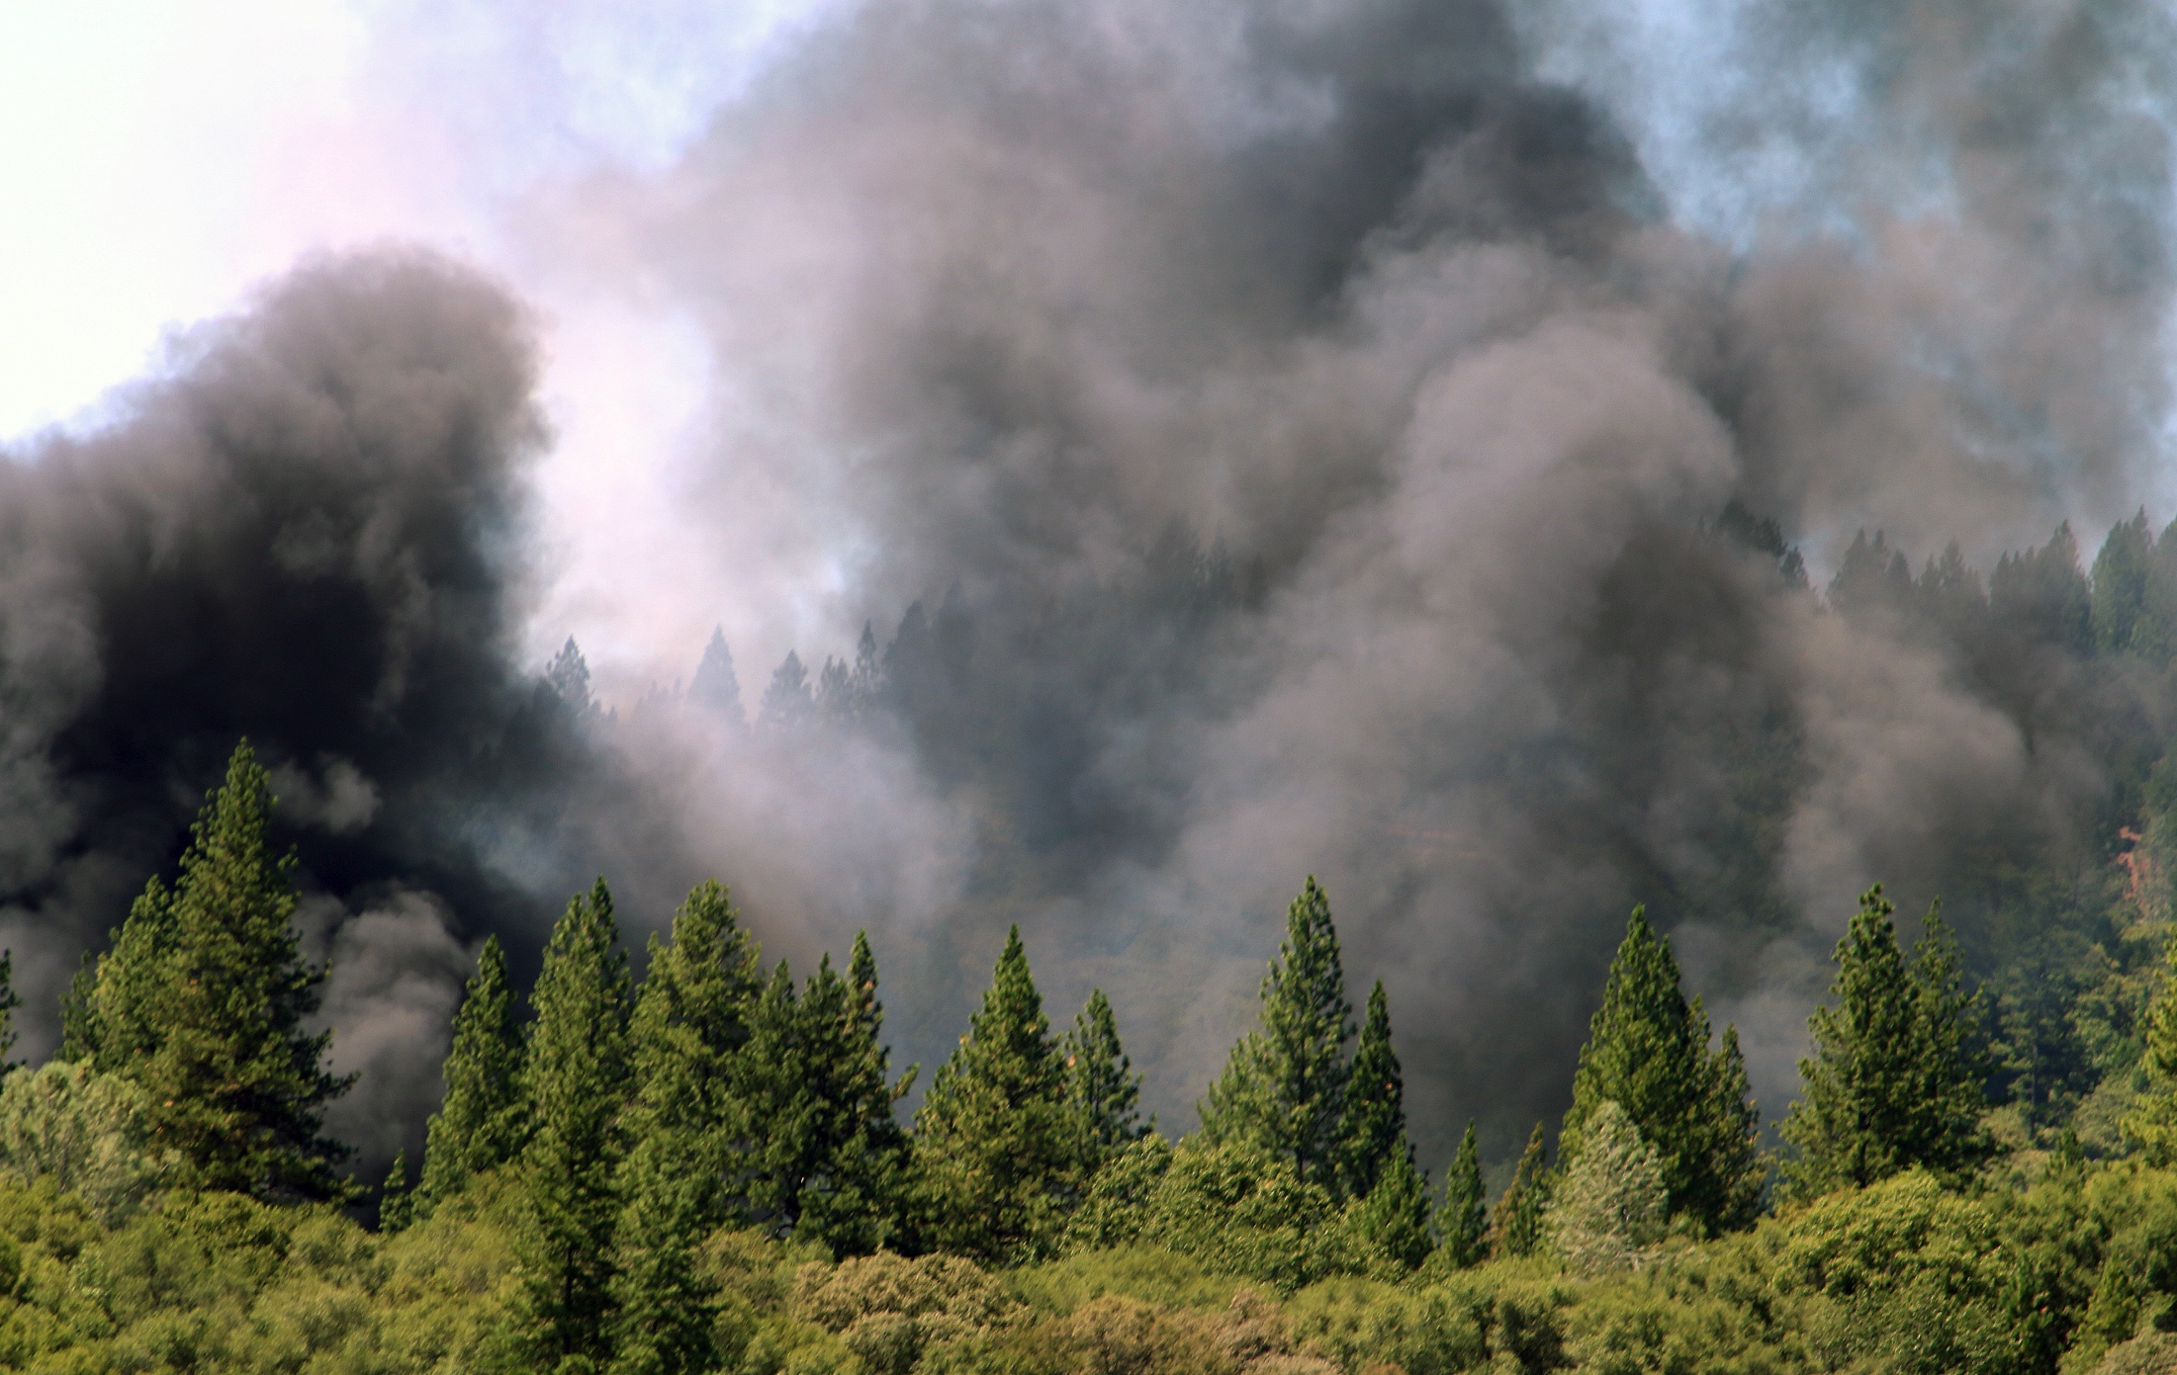
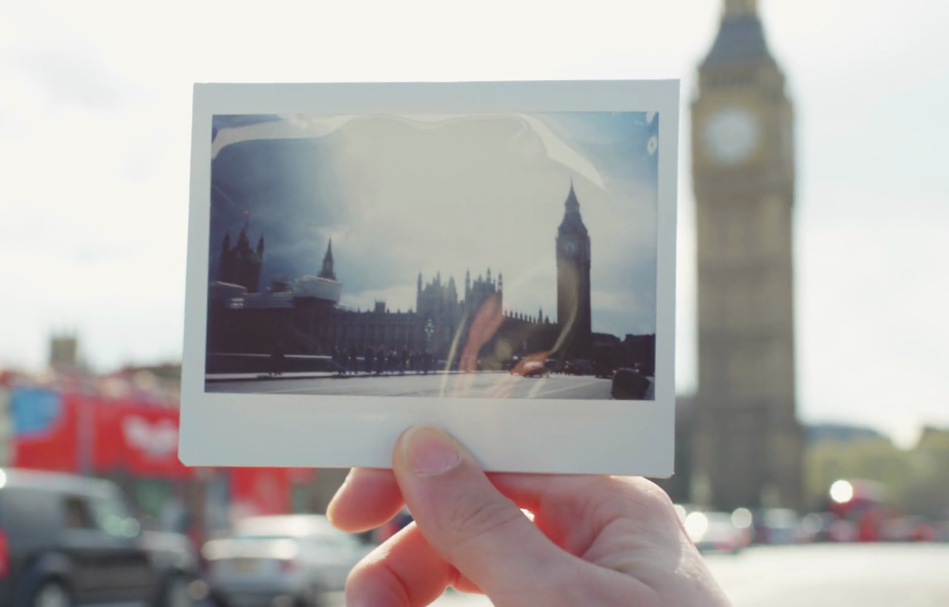
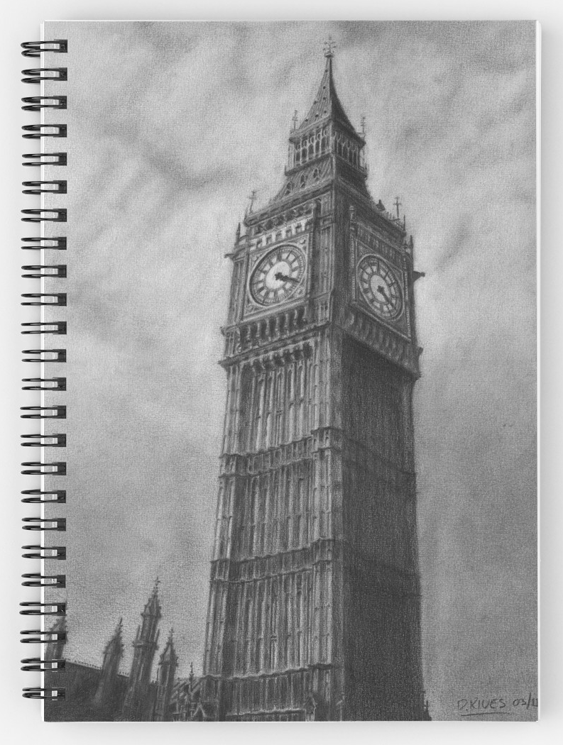
NATURAL VS. NON-NATURAL MEANING
NON-NATURAL MEANING
NATURAL MEANING
“BIG BEN”
Smoke means_{N} fire.
The photograph means_{N} Big Ben.
Those words mean_{NN} Big Ben.
The sketch means_{NN} Big Ben.
Notes:
H. P. Grice
Indexical in semiotics
“One who knew enough about the camera used in making a photograph, how the film was processed, and other relevant circumstances could infer with perfect accuracy about the objects photographed” (255).
Same with the sketch—but it wouldn’t mean_{N} that there was a clock.

Slide 15
A CONDITION ON PERCEPTION
A condition on perceiving x is that one be in contact with x (in the sense that one’s perceiving x counterfactually depends on x).
POLL
We should regard that condition as ___________ for perceiving x.
Merely necessary
Merely sufficient
Both necessary and sufficient

Slide 16
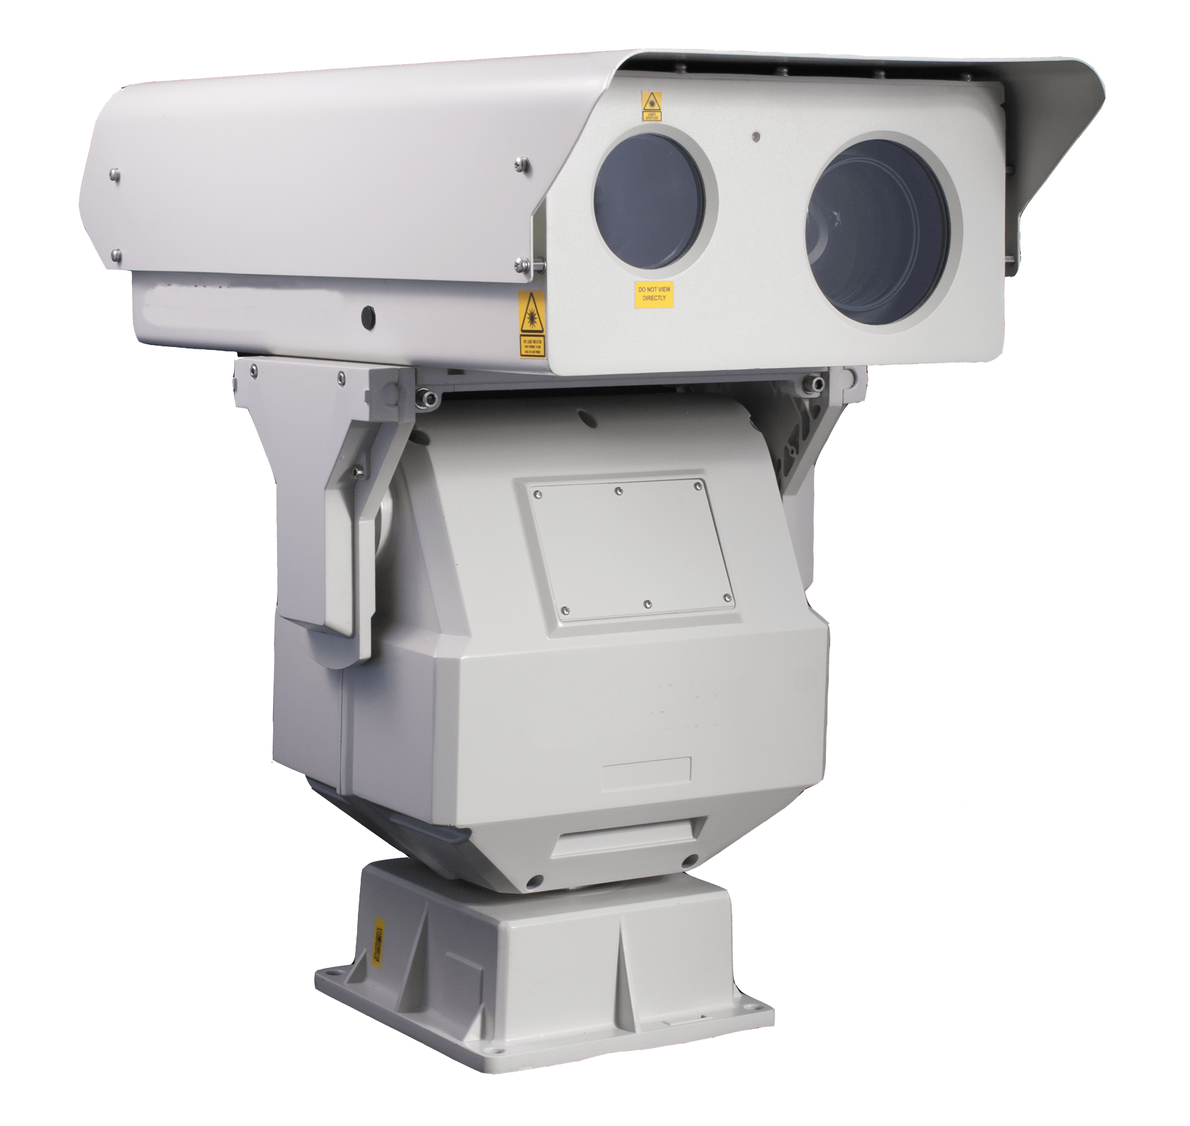
A CONDITION ON PERCEPTION
Notes:
“Imagine a machine that is sensitive to the light which emanates from a scene and that produces not pictures but accurate verbal descriptions of the scene. The machine’s printouts are surely not transparent; in looking at them, one does not see the scene which the machine translates into words. Yet the printouts are made just as mechanically as any photographs are” (270).
“It is easy to say that the reason why we don’t see through such mechanically generated descriptions is that we don’t see them as the scene they describe; perhaps we are incapable of seeing them this way. If one fails to see a photograph as Dwight Eisenhower, or as a person, or as anything but a collection of blotches on a flat surface, we might deny that one sees Eisenhower through the photograph” (270).

Slide 17
SUMMARY
Photography is special in that photographs are transparent: we literally see objects, places, and events through them.
Photography is transparent (while painting is not) because photographs are counterfactually dependent the objects, places, and events that give rise to them.
This reveals something important about seeing, even if we still lack a complete “real definition” of the phenomenon.

Slide 18
POLL
Do you agree? Do we literally see past objects, places, and events in photographs?
Yes
No

