Slide 1
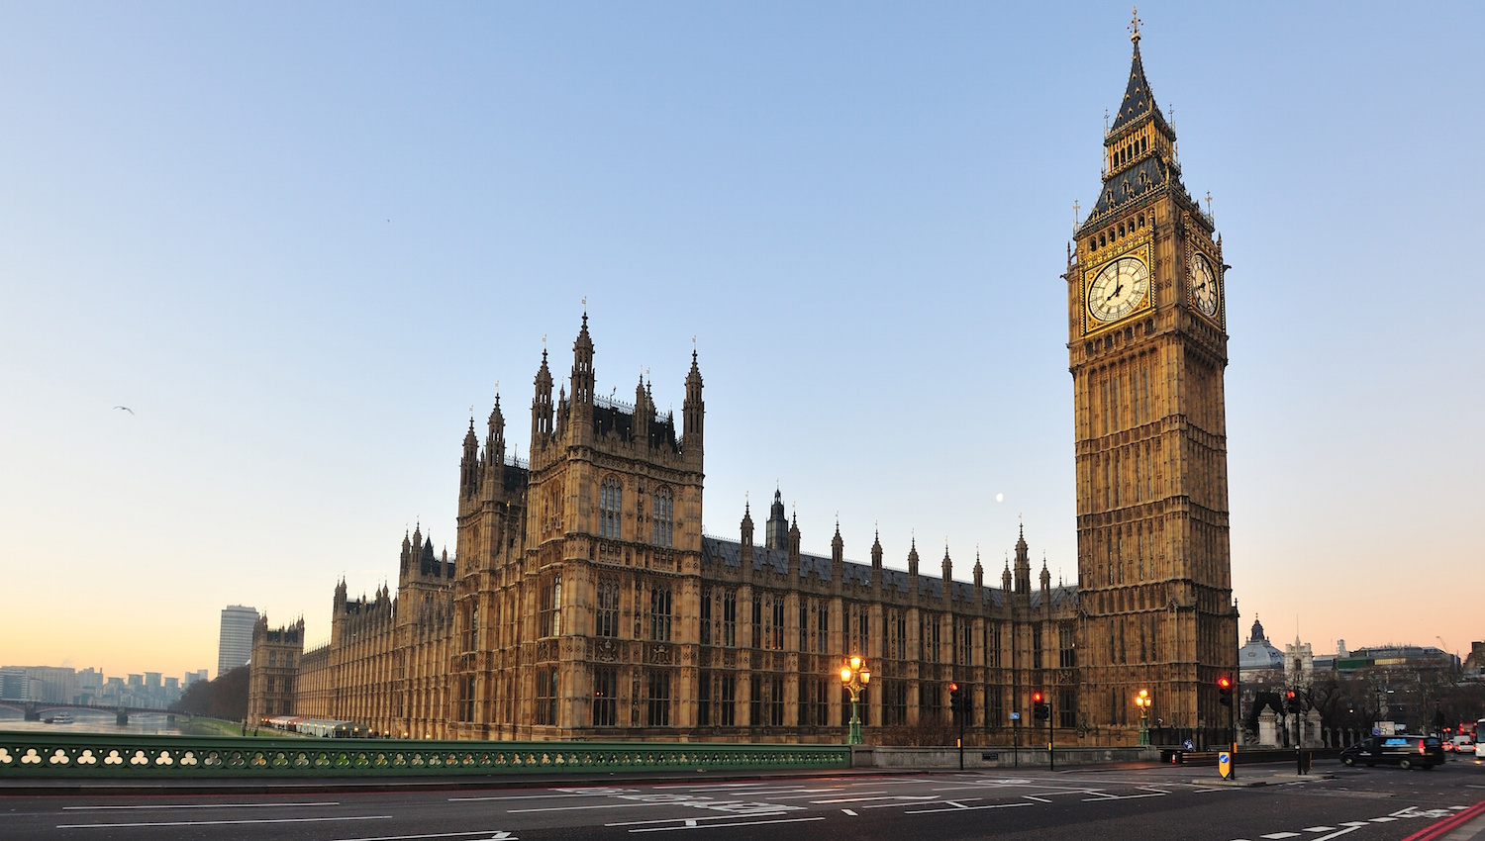
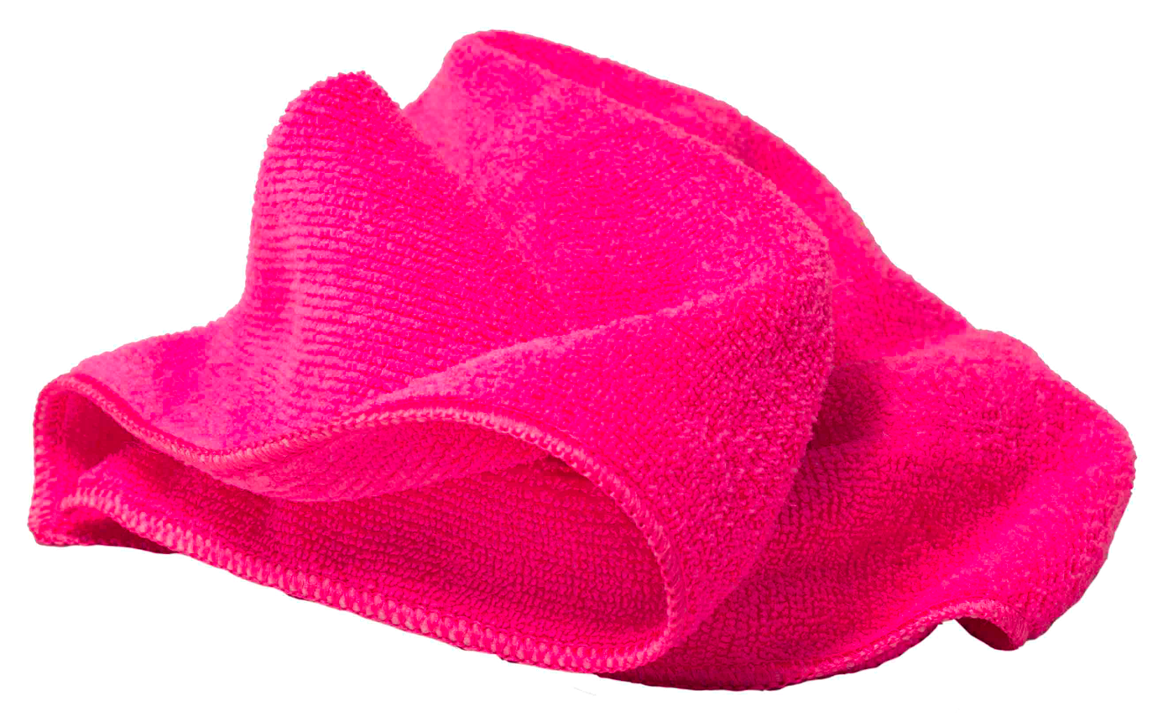
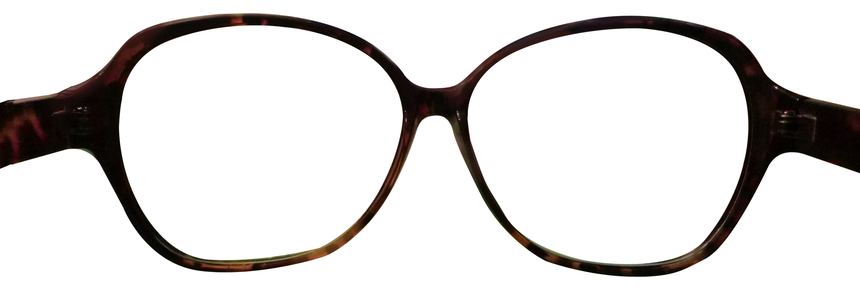
TRANSPARENCY VS. INVISIBILITY
Looking at Big Ben
Notes:
Mention peephole case in which you don’t see the photograph at all.
Transition: we might want to say that in the case of the photograph, we only indirectly see Big Ben, but then we need to say the same about the police car.

Slide 2
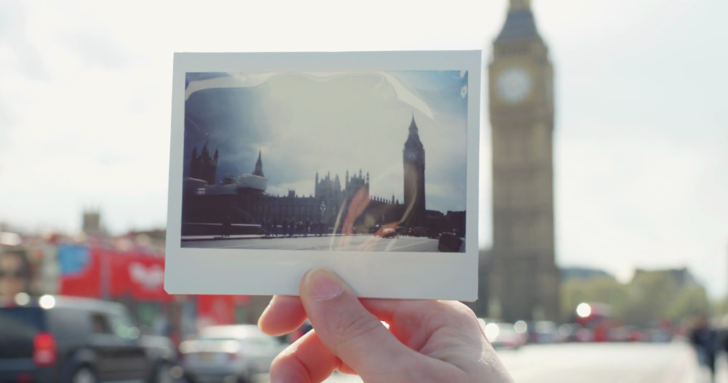
TRANSPARENCY VS. INVISIBILITY
Looking at Big Ben
Looking at Big Ben by looking at a photograph of it
Notes:
Mention peephole case in which you don’t see the photograph at all.
Transition: we might want to say that in the case of the photograph, we only indirectly see Big Ben, but then we need to say the same about the police car.

Slide 3
TRANSPARENCY VS. INVISIBILITY
Seeing directly
Seeing indirectly
Notes:
Mention peephole case in which you don’t see the photograph at all.
Transition: we might want to say that in the case of the photograph, we only indirectly see Big Ben, but then we need to say the same about the police car.

Slide 4
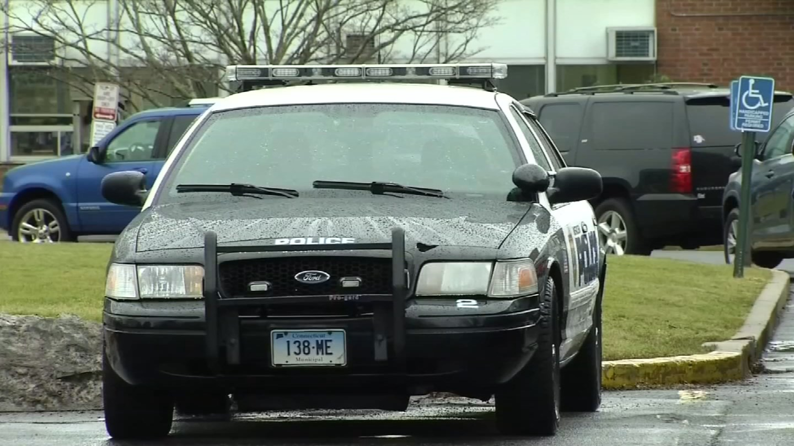
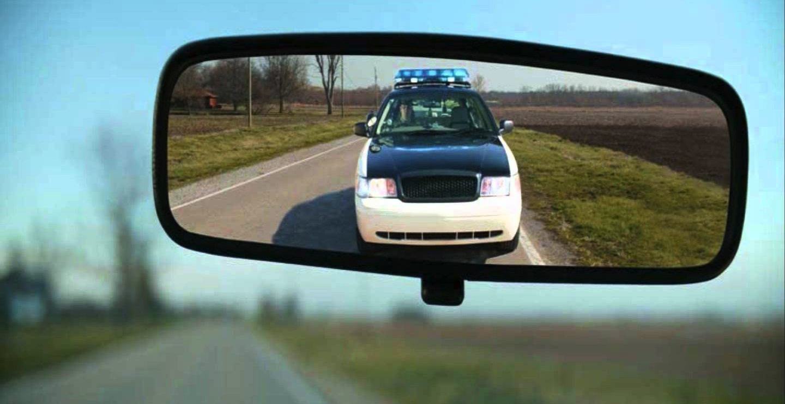
TRANSPARENCY VS. INVISIBILITY
Seeing directly
Seeing indirectly
Notes:
Mention peephole case in which you don’t see the photograph at all.

Slide 5
TRANSPARENCY VS. INVISIBILITY
What we see is an image of Big Ben.
But we also see Big Ben.
So: the image of Big Ben is identical to Big Ben.
Notes:
Ask them what goes wrong here

Slide 6
TRANSPARENCY VS. INVISIBILITY
What we see is a reflection of the police car.
But we also see the police car.
So: the reflection of the police car is identical to the police car.

Slide 7
VALUES OF SEEING
We can acquire new information by seeing.
But we also value seeing for its own sake.
Notes:
“But sometimes we learn little if anything about what we see, and sometimes we value the seeing quite apart from what we might learn. This is so, frequently, when we see departed loved ones through photographs. We can’t expect to acquire any particularly important information by looking at photographs which we have studied many times before. But we can see our loved ones again, and that is important to us” (253).

Slide 8
OBJECTION #1
Photographs do not look like the objects or scenes they depict.
The experience of looking at a photograph is not the same as the experience of looking at the object or scene it depicts.

Slide 9
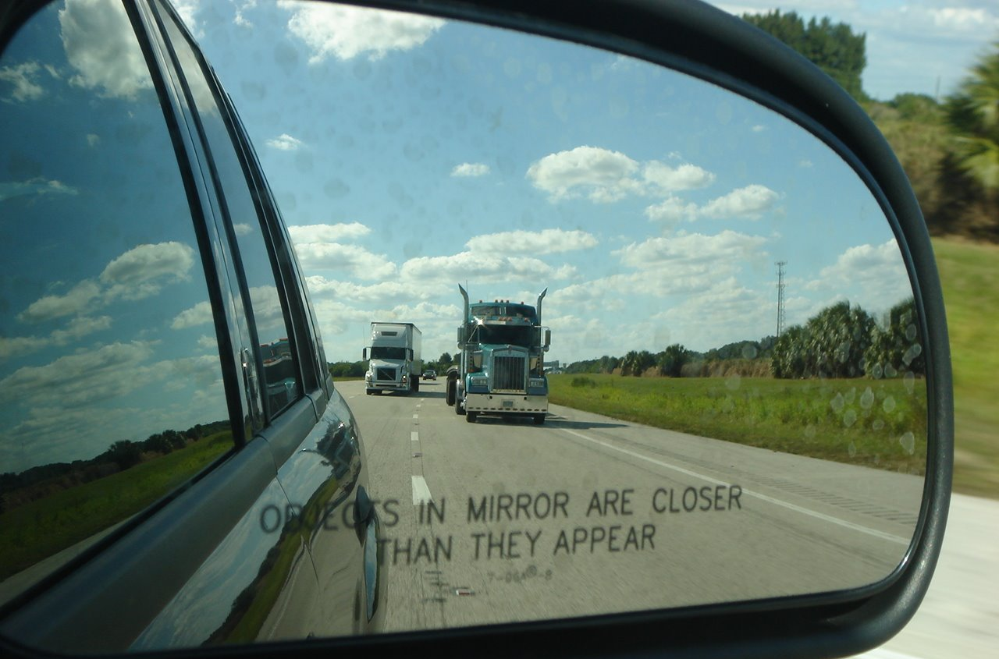
LESSONS
Seeing with photographic assistance is a mode of indirect seeing, not direct seeing. There is no reason to expect the two to be exactly alike.
Notes:
Transition: “If the point concerned how photographs look, there would be no essential difference between photographs and paintings” (255).

Slide 10
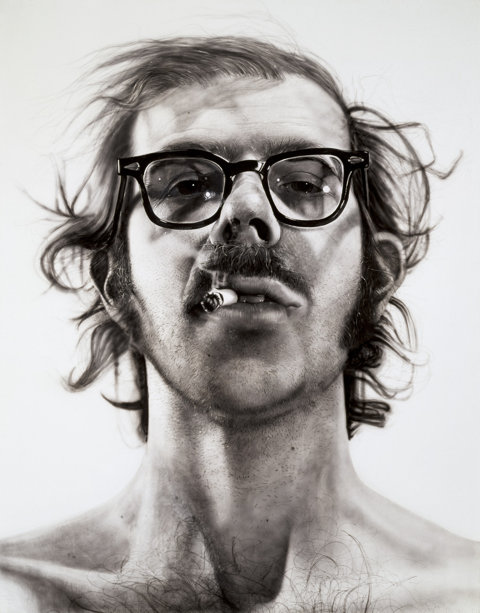
LESSONS
POLL: Were you to see this man in the flesh, would your experience be the same as your experience of this well-known photograph?
Yes
No
Notes:
“Plus, if that’s all there was to photography, then “there would be no essential difference between photographs and paintings” (255).

Slide 11
LESSONS
Trick question!
Notes:
“Plus, if that’s all there was to photography, then “there would be no essential difference between photographs and paintings” (255).

Slide 12
LESSONS
“The discovery jolts us. Our experience of the picture and our attitude toward it undergo a profound transformation, one which is much deeper and more significant than the change which occurs when we discover that what we first took to be an etching, for example, is actually a pen-and-ink drawing” (255).
Walton’s theory explains this jolt: we start with the belief that we are really seeing the depicted object and then realize that we aren’t.
Notes:
Nude example with respect to embarrassment; the fact that it may continue to seem as if we’re really seeing the person may account for our continued embarrassment.
Transition: cases like these give rise to genuine illusions.

Slide 13
LESSONS
Man with Arms Around Woman
– John de Andrea
Notes:
Transition: cases like these give rise to genuine illusions.
Life-sized sculpture.
That doesn’t mean that we’re always under an illusion: for example, that we’re in the presence of flesh and blood people.

Slide 14
OBJECTION #2
Photography is a largely inaccurate medium.
How can a largely inaccurate medium be a supremely realistic one?

Slide 15
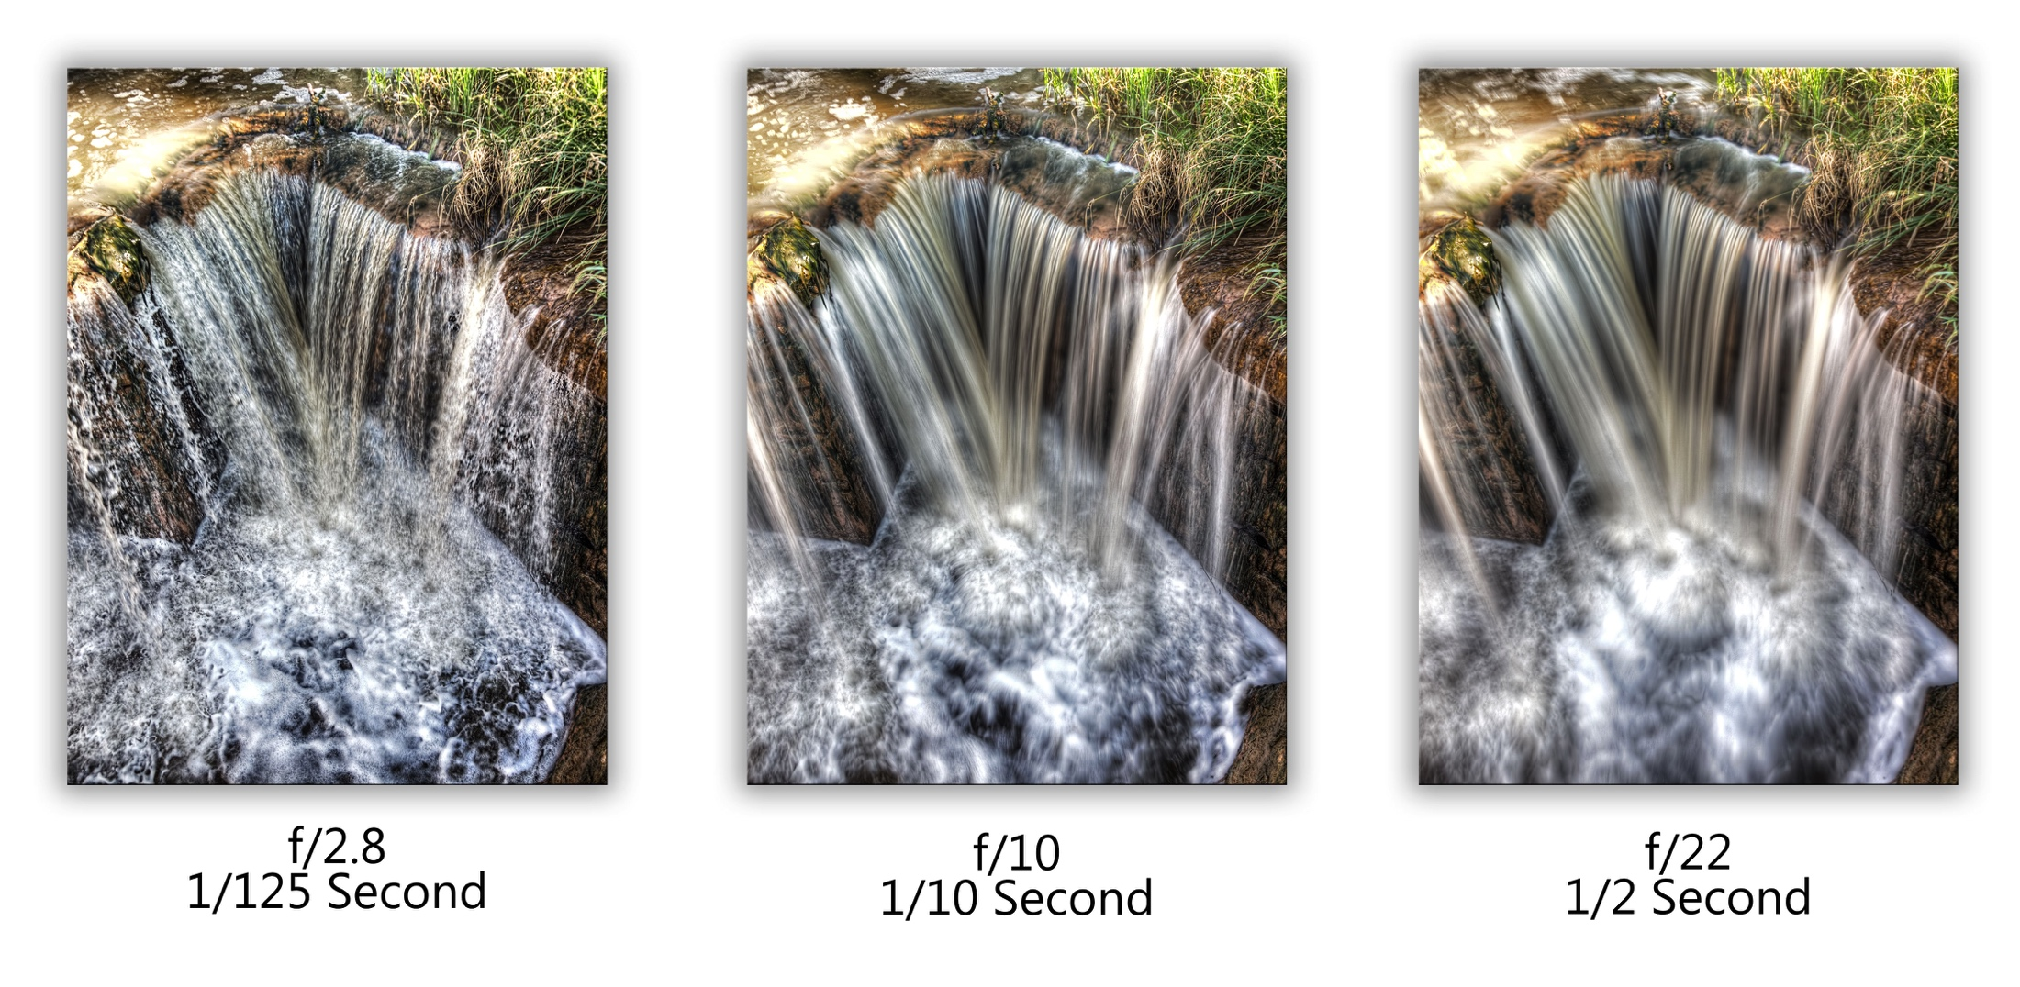
OBJECTION #2
Notes:
“Some contend that photographs regularly falsify colors and distort spatial relationships, that a photograph of a running horse will portray it either as a blur, which it is not, or as frozen, which it also is not—and of course there is the possibility of retouching it in the darkroom” (258).
Connect to the objection that if Walton is right, photography can’t be art.
“But why should this matter? We can be deceived when we see things directly. If cameras can lie, so can our eyes. To see something through a distorting mirror is still to see it, even if we are misled about it” (258).
Transition: but so do mirrors—that doesn’t mean we don’t see through them.

Slide 16
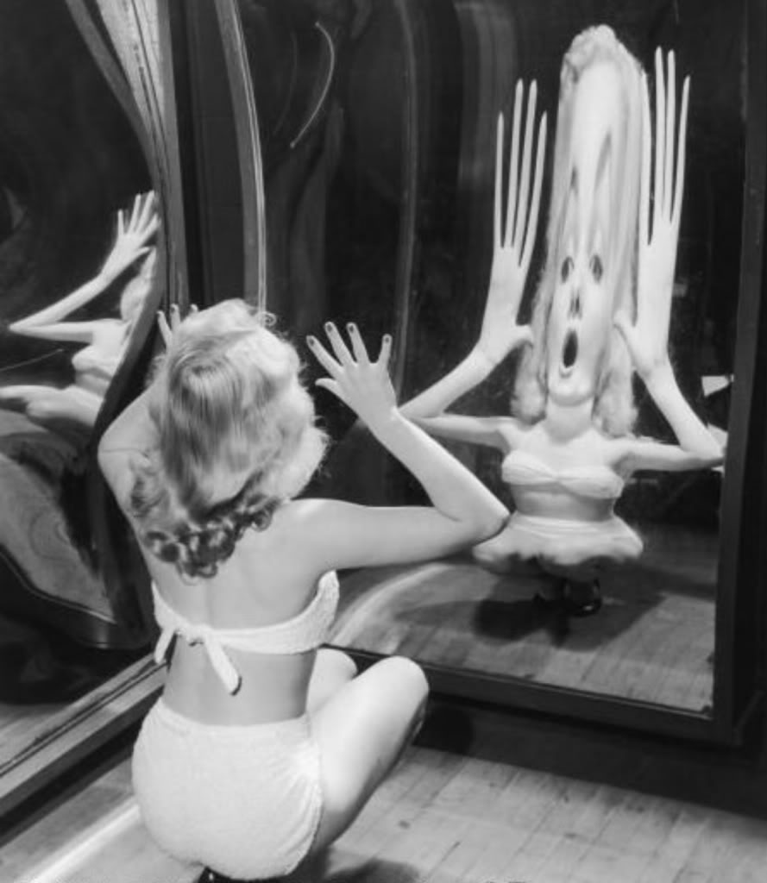
LESSONS
Notes:
“But why should this matter? We can be deceived when we see things directly. If cameras can lie, so can our eyes. To see something through a distorting mirror is still to see it, even if we are misled about it” (258).
“The ‘distortions’ or ‘inaccuracies’ of photographs are no reason to deny that we see through them” (258).

Slide 17
LESSONS
Distortion #157 – André Kertész
Notes:
“The ‘distortions’ or ‘inaccuracies’ of photographs are no reason to deny that we see through them” (258).
Show court reenactment example
“To underscore the independence of accuracy and transparency, consider a theatrical portrayal of actual events, an acting out in a courtroom of events that led to a crime, for example. The portrayal might be perfectly accurate. Jurors might gain from it much correct information and no misinformation. Yet they certainly do not see the incident via the portrayal” (258).

Slide 18
OBJECTION #3
There is no relevant difference between photographs and paintings: photographers and painters both make pictures; they simply use different tools.
As a result, neither photographs nor paintings show us things as they really are; they present us with interpretations of the world.
Notes:
Transition: “All this is beside the point. The manner in which things cause my visual experiences when I see them is not one which rules out a causal role for human beings. People often show me things and in other ways induce me to look this way or that. . . . Why not say that photographers, by making photographs, show me things and also enable me to see them? Surely that does not mean that I don’t really see them” (261).

Slide 19
POLL
Do you find this objection persuasive?
Yes, I do find it persuasive.
No, I don’t find it persuasive.

Slide 20
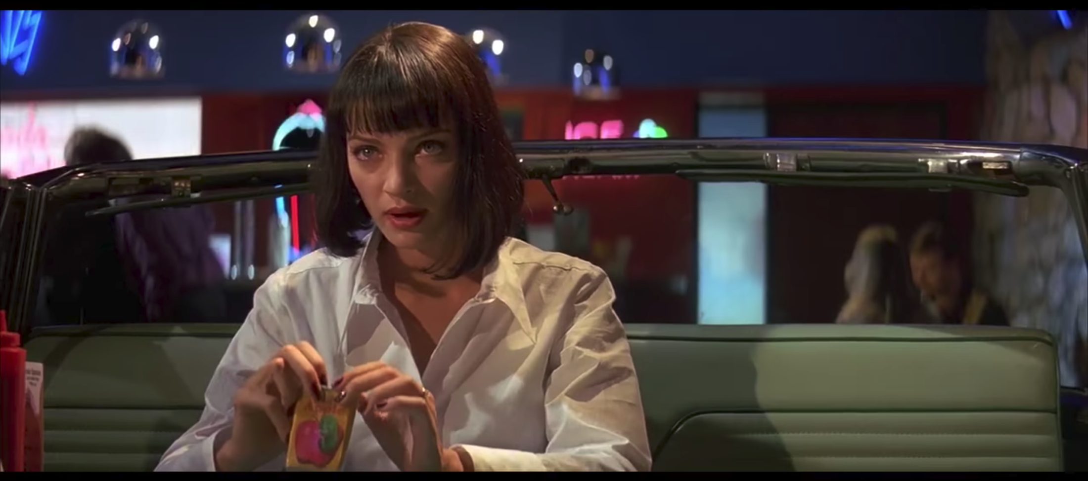
LESSONS
Notes:
“All this is beside the point. The manner in which things cause my visual experiences when I see them is not one which rules out a causal role for human beings. People often show me things and in other ways induce me to look this way or that. . . . Why not say that photographers, by making photographs, show me things and also enable me to see them? Surely that does not mean that I don’t really see them” (261).

Slide 21
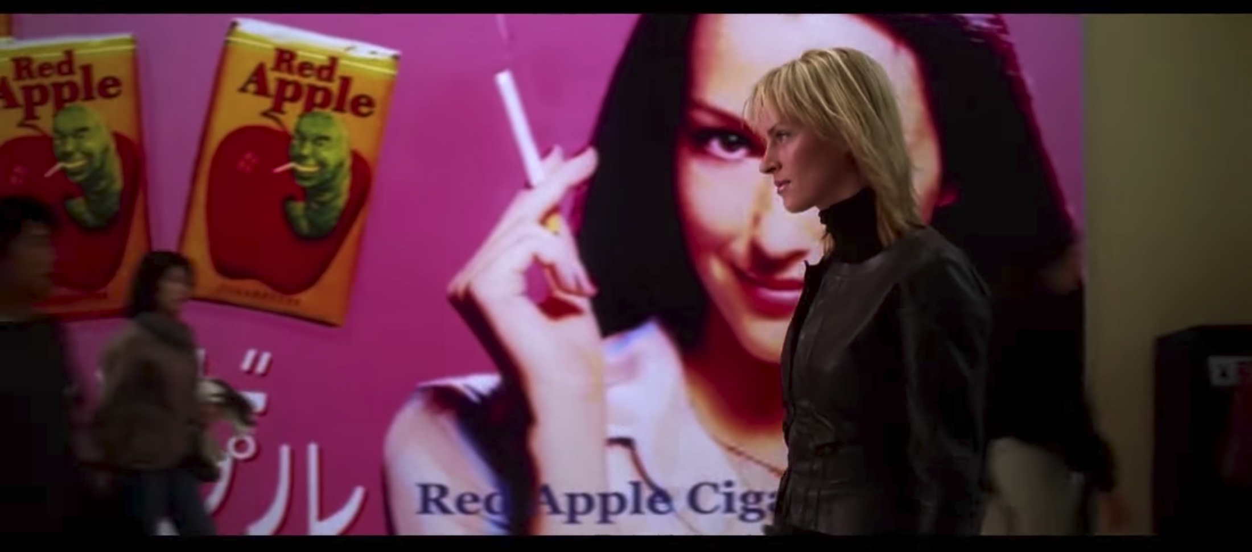
LESSONS
Notes:
“Why not say that photographers, by making photographs, show me things and also enable me to see them? Surely that does not mean that I don’t really see them” (261).

Slide 22
LESSONS
“If expressiveness is the mark of art, photography’s credentials are beyond question. In Triumph of the Will, Leni Riefenstahl, by careful selection and editing, ‘interprets’ for us the Nazi Party Congress of 1934; she presents it as she construes it. It does not follow that we ourselves do not see Hitler’s airplane descending through the clouds, the thousands of marching troops and cheering spectators, and Hitler delivering tirades, even if the film fosters misconceptions about the things we see, inducing us to believe, for example, that the people we see were more enthusiastic about Hitler than they actually were” (Walton 1984, 262).

