Slide 1
Course teaser: trolley problems
PHL 304
Fall 2018
Notes:
Show The Good Place clip: https://www.youtube.com/watch?v=lDnO4nDA3kM&t=14s

Slide 2
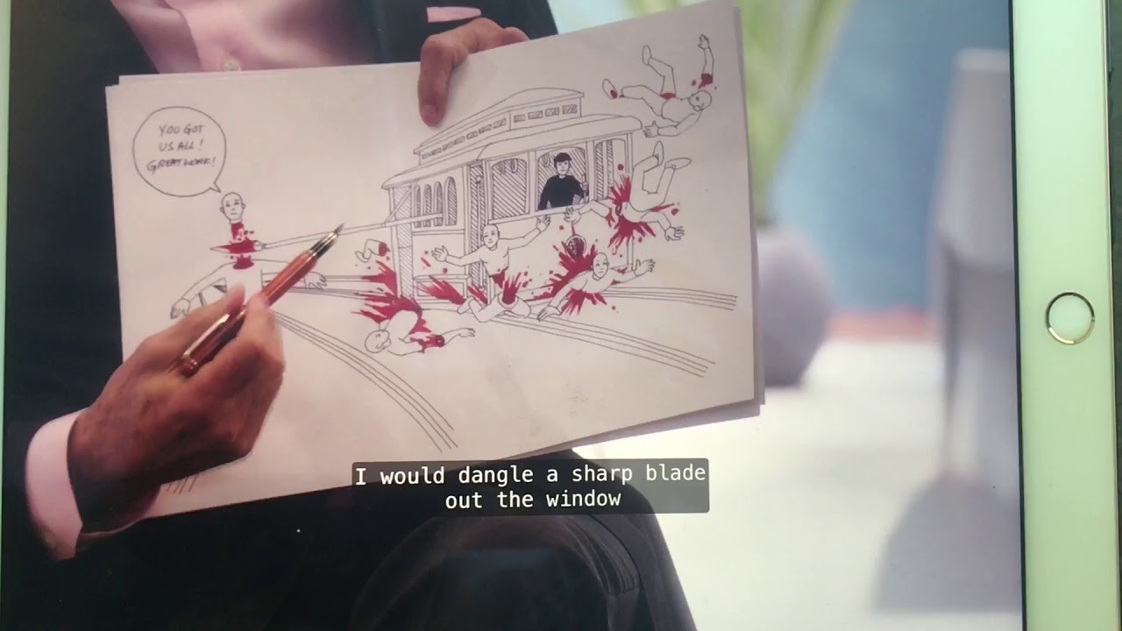

Slide 3
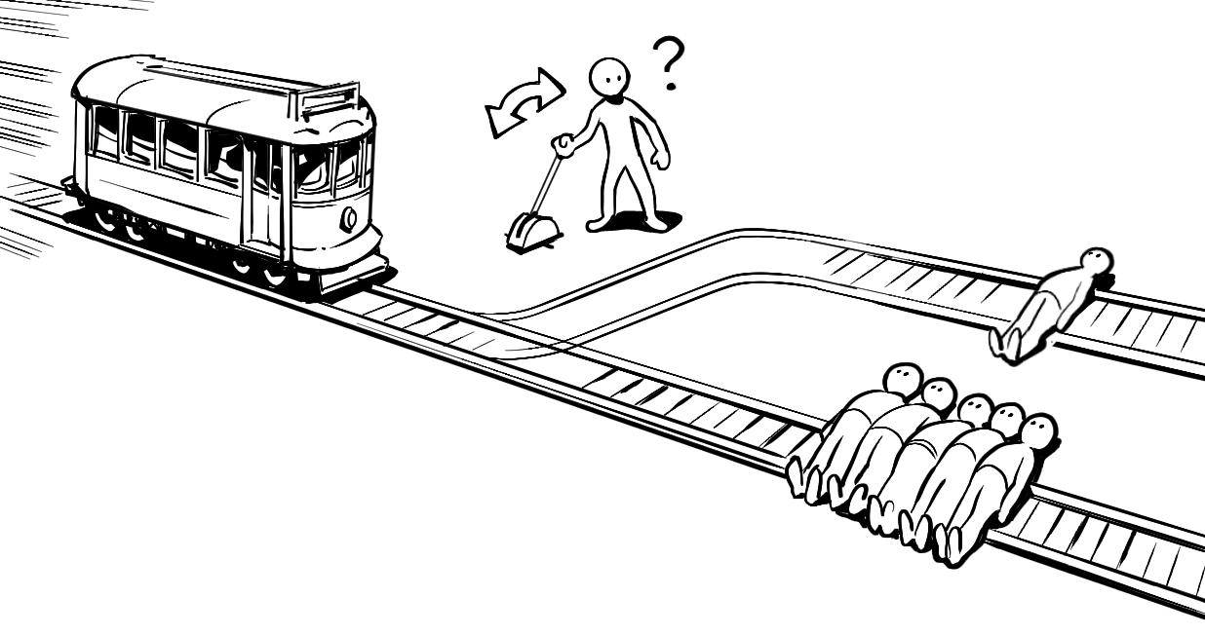
Notes:
This example is not like the first: you aren’t bound to kill someone no matter what.
Do students think that we ought to do what will have the best consequences?

Slide 4
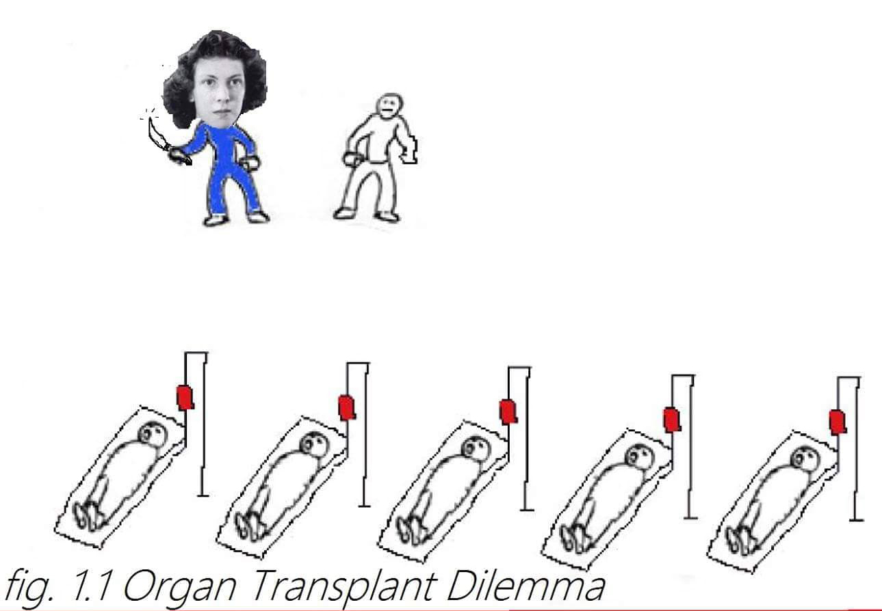
Notes:
Philippa Foot
Lungs, heart, liver, kidney

