Slide 1
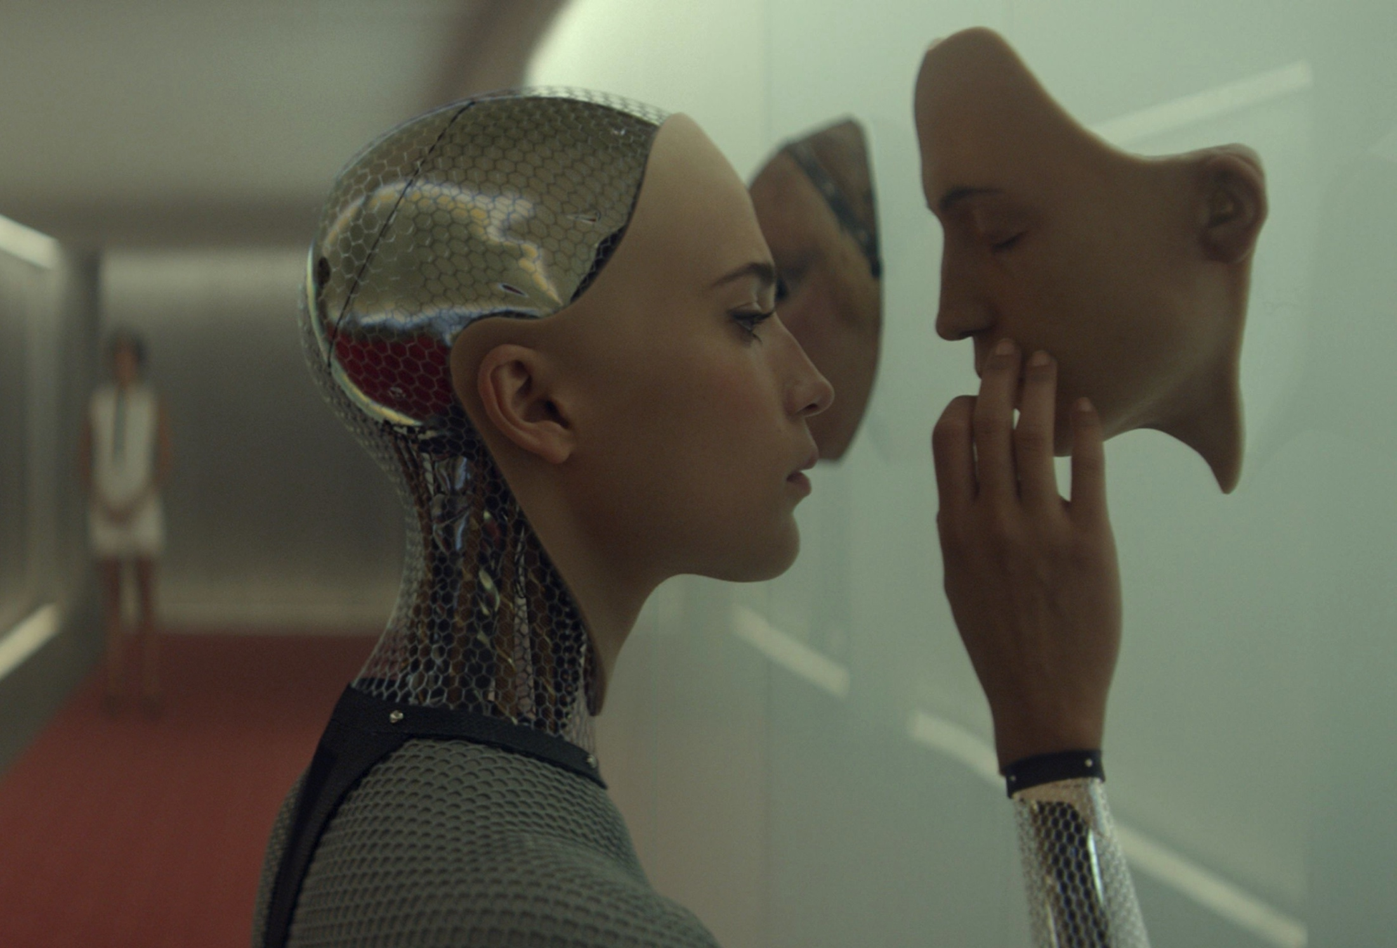
THE ETHICS OF ARTIFICIAL INTELLIGENCE
PHL 304
Fall 2018

Slide 2
ARTIFICIAL INTELLIGENCE
The potential to create intelligent machines raises a number of difficult ethical issues.
But is artificial intelligence (AI) even possible?
It depends!

Slide 3
VARIETIES OF MENTALITY
Intelligence is the capacity to do certain things, such as solve problems, make complex decisions, and so on.
Intentionality is aboutness; intentional states (such as thoughts) represent the world as being a certain way.
Phenomenal consciousness is a matter of undergoing experiences; there is something that it is to be in a phenomenally conscious state.

Slide 4
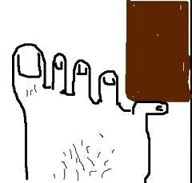
THE MIND–BODY PROBLEM

Slide 5
WEAK AND STRONG AI
VARIETIES OF ARTIFICIAL INTELLIGENCE
 | Intelligence | Intentionality | Phenomenal consciousness
Very Weak AI | ✔
Weak AI | ✔ | ✔
Strong AI | ✔ | ✔ | ✔

Slide 6
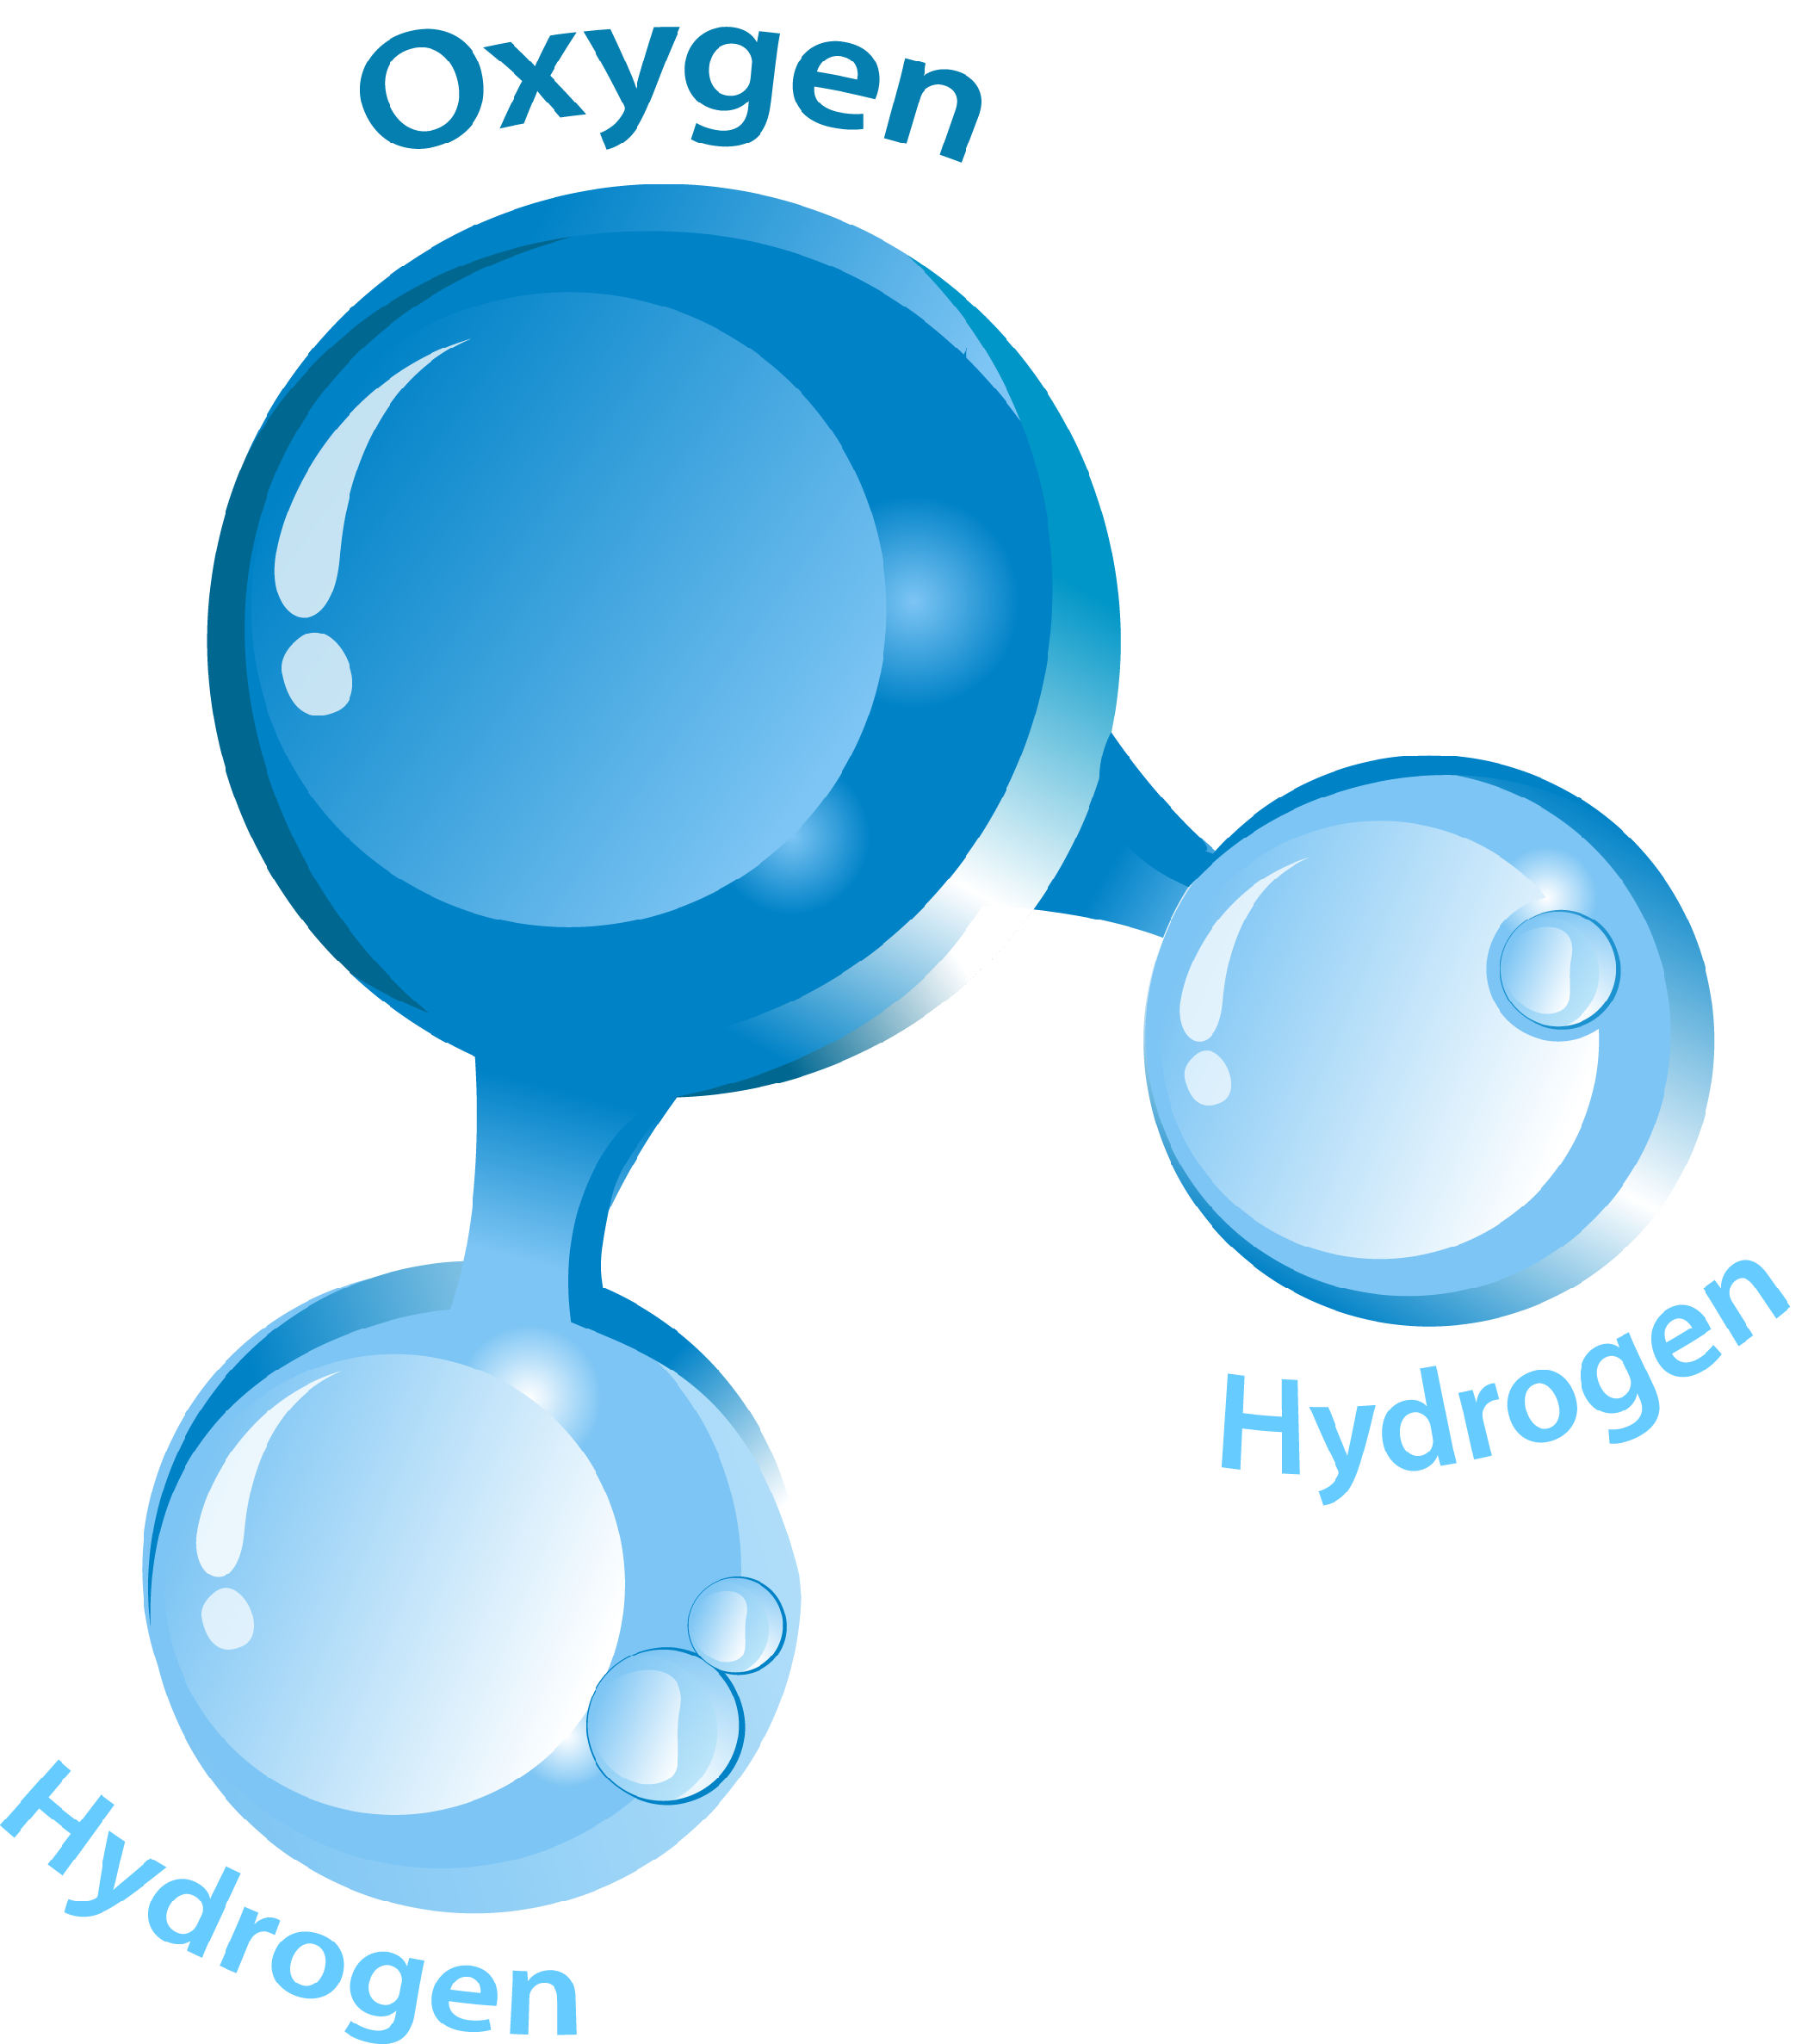
THE MIND–BODY PROBLEM
correlated
water = H₂O
It is essential to water to be composed of two hydrogen atoms and one oxygen atom

Slide 7
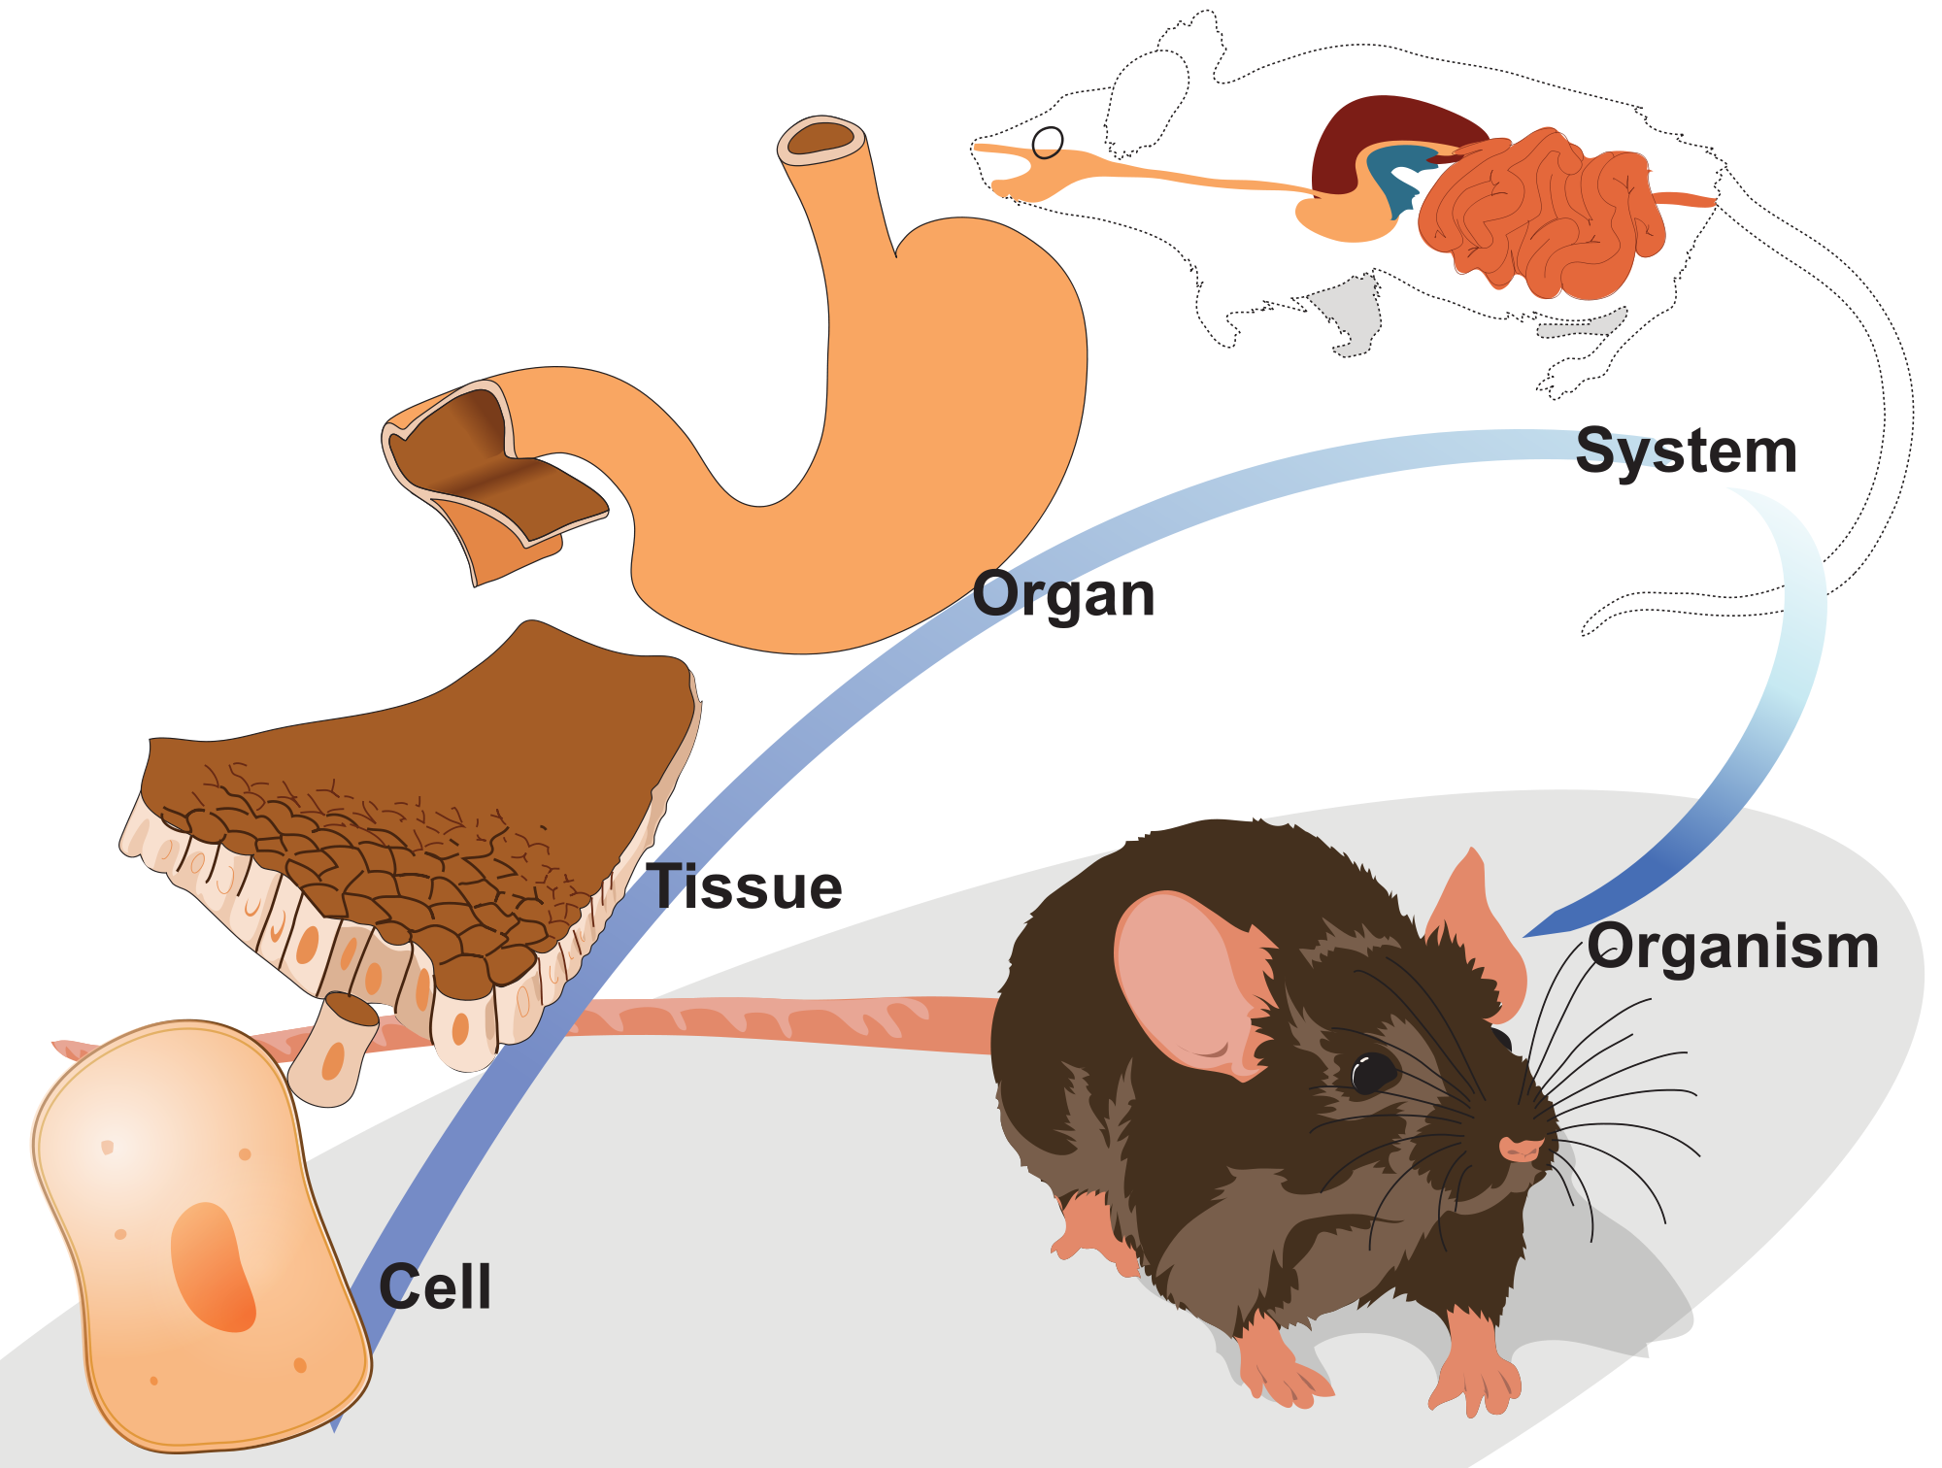
THE MIND–BODY PROBLEM

Slide 8
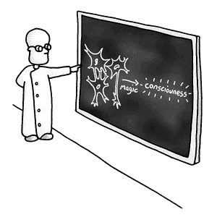
THE MIND–BODY PROBLEM

Slide 9
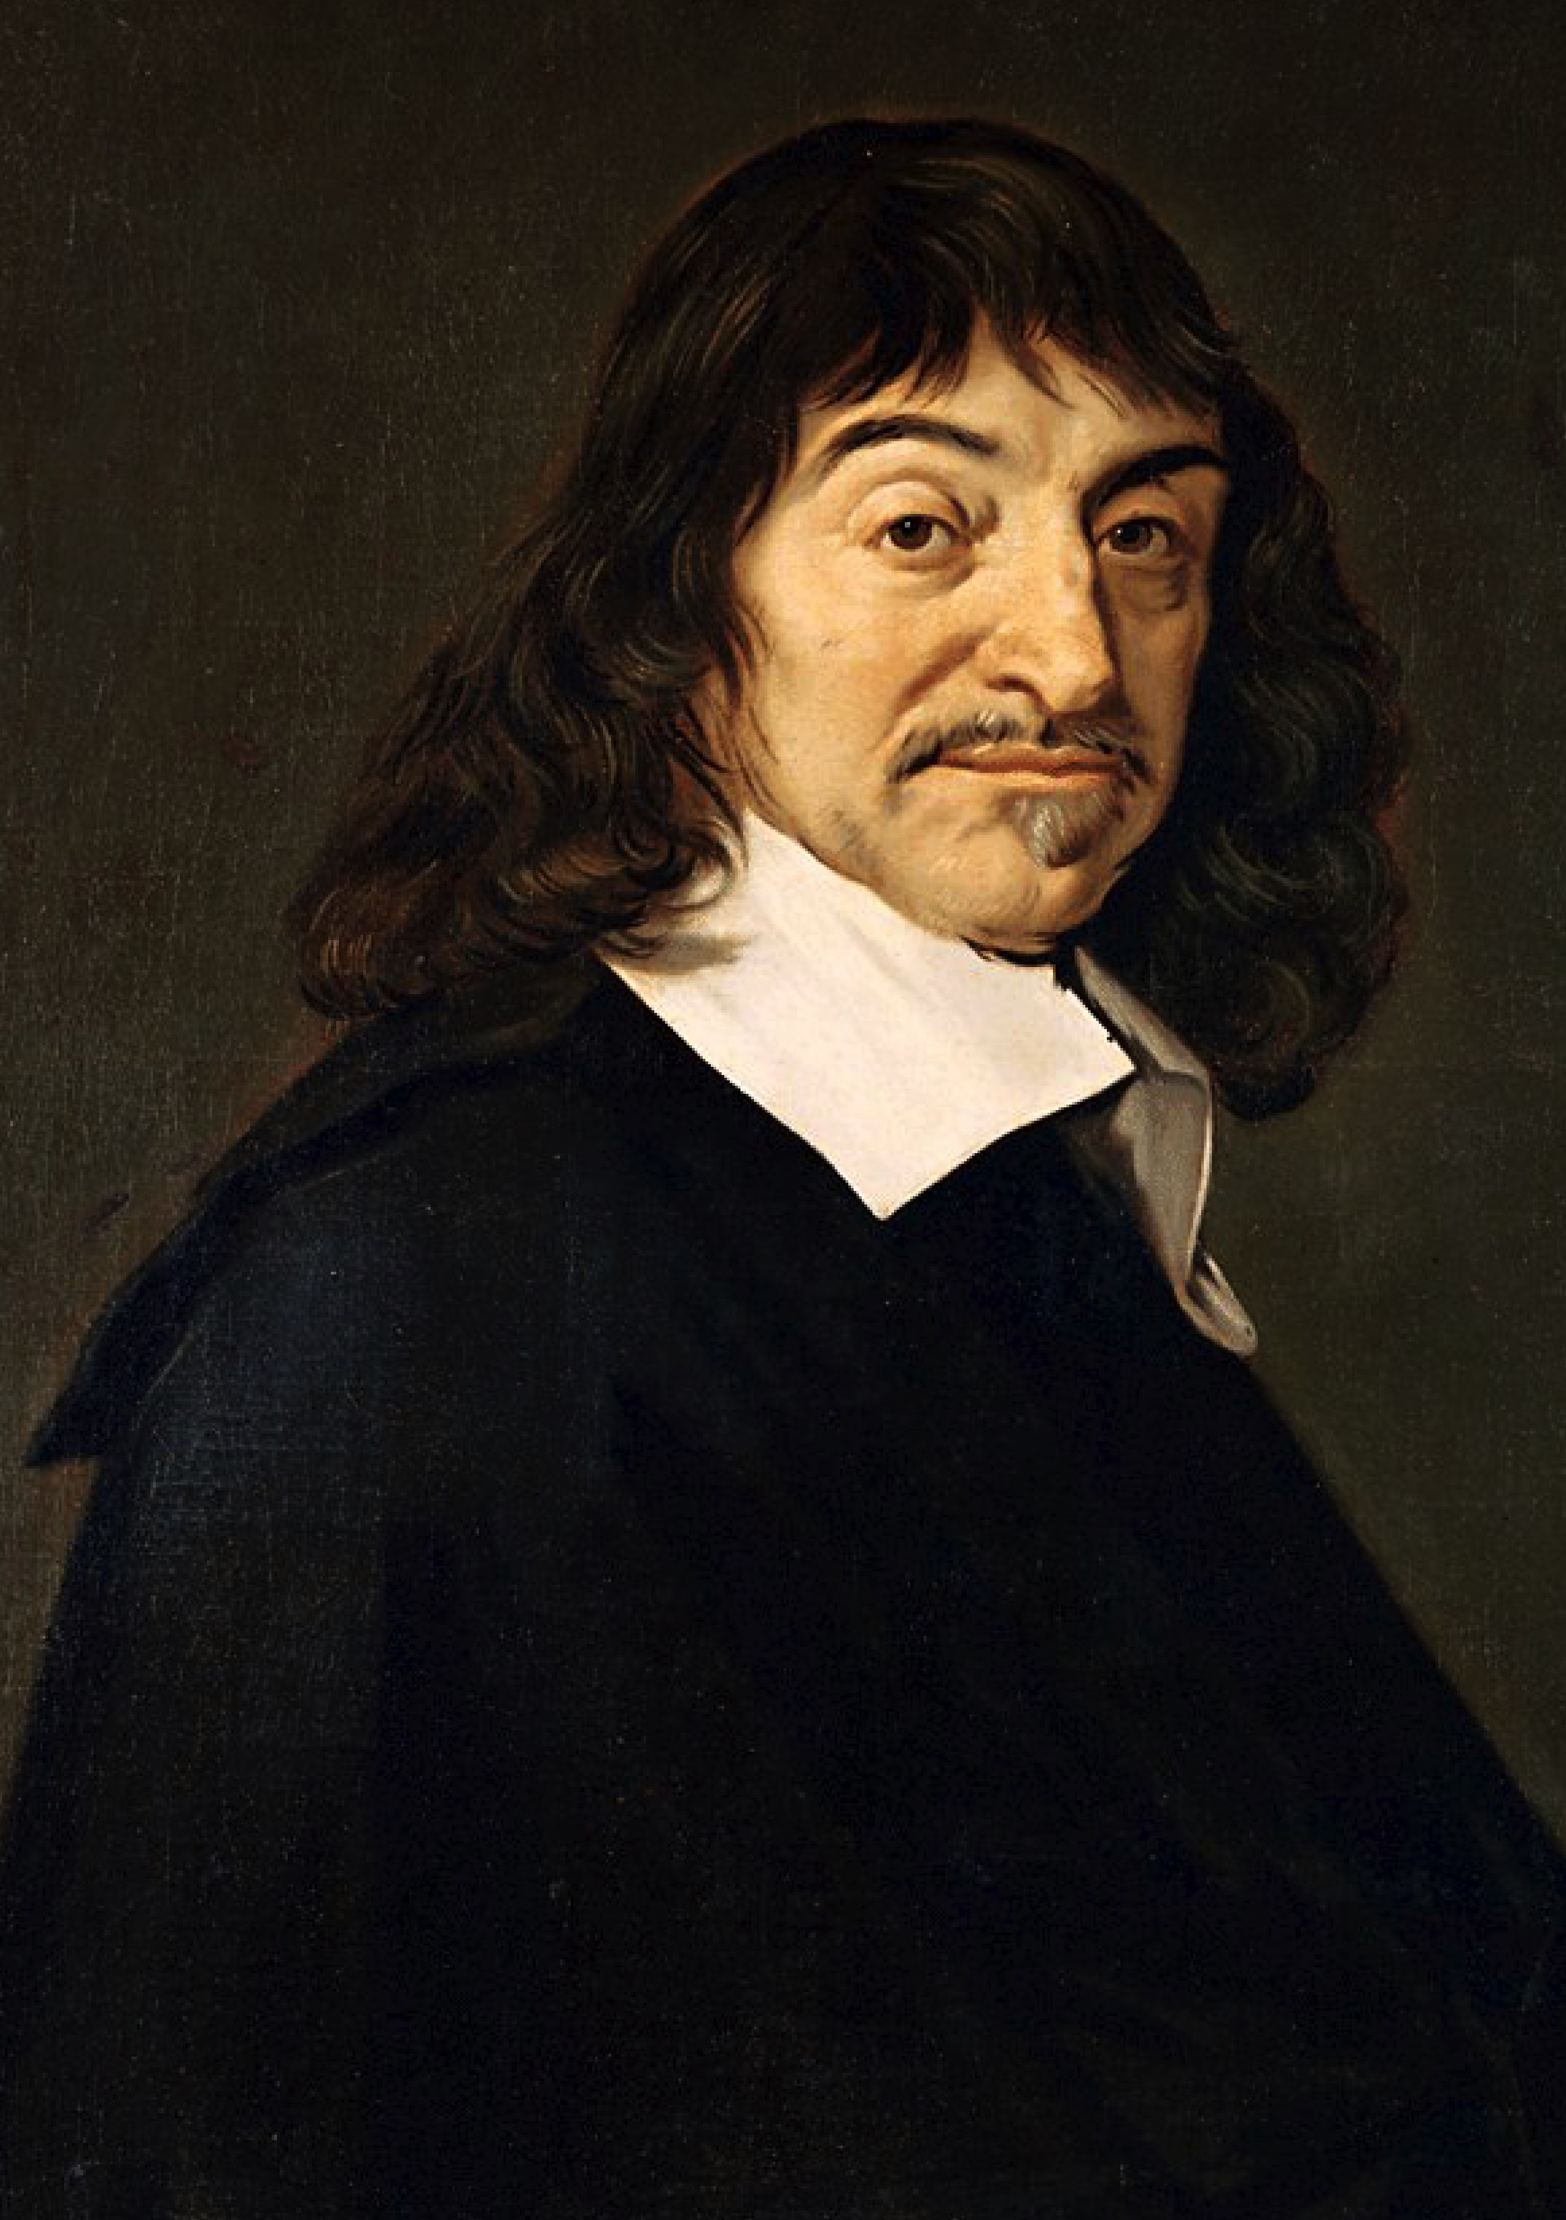
DUALISM
Substance dualism is the view that there are two radically different kinds of substances: material substances and immaterial substances.
Minds are nonphysical states of immaterial souls.
Brains and minds are connected, but in principle, they can come apart.
René Descartes

Slide 10
DUALISM
Notes:
https://www.youtube.com/watch?v=AMTMtWHclKo

Slide 11
DUALISM
Property dualism is the view that all substances are material, but there are two radically different kinds of properties: physical properties and nonphysical properties.
Minds are nonphysical states of material things (such as brains or organisms).
Neurological states and mental states are connected, but in principle, they can come apart.

Slide 12
DUALISM
The nature of water is exhausted by its chemical composition.
There is nothing more to being water than being appropriately composed of H₂O molecules.
If dualism is true, the nature of the mind is not exhausted by, say, neurology.
There is something more to being in pain, say, than simply being in a certain neural state.
Science (as we currently understand it) cannot tell us everything there is to know about the mind.

Slide 13
THE KNOWLEDGE ARGUMENT
Clip from Ex Machina (2014)
Notes:
50m

Slide 14
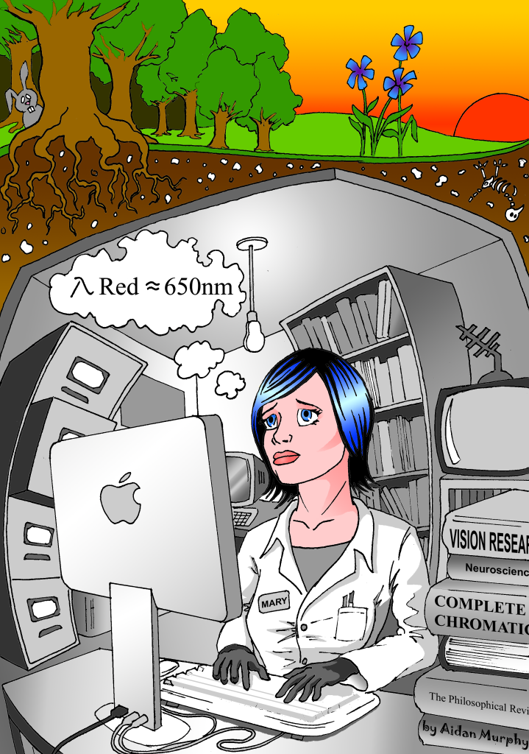
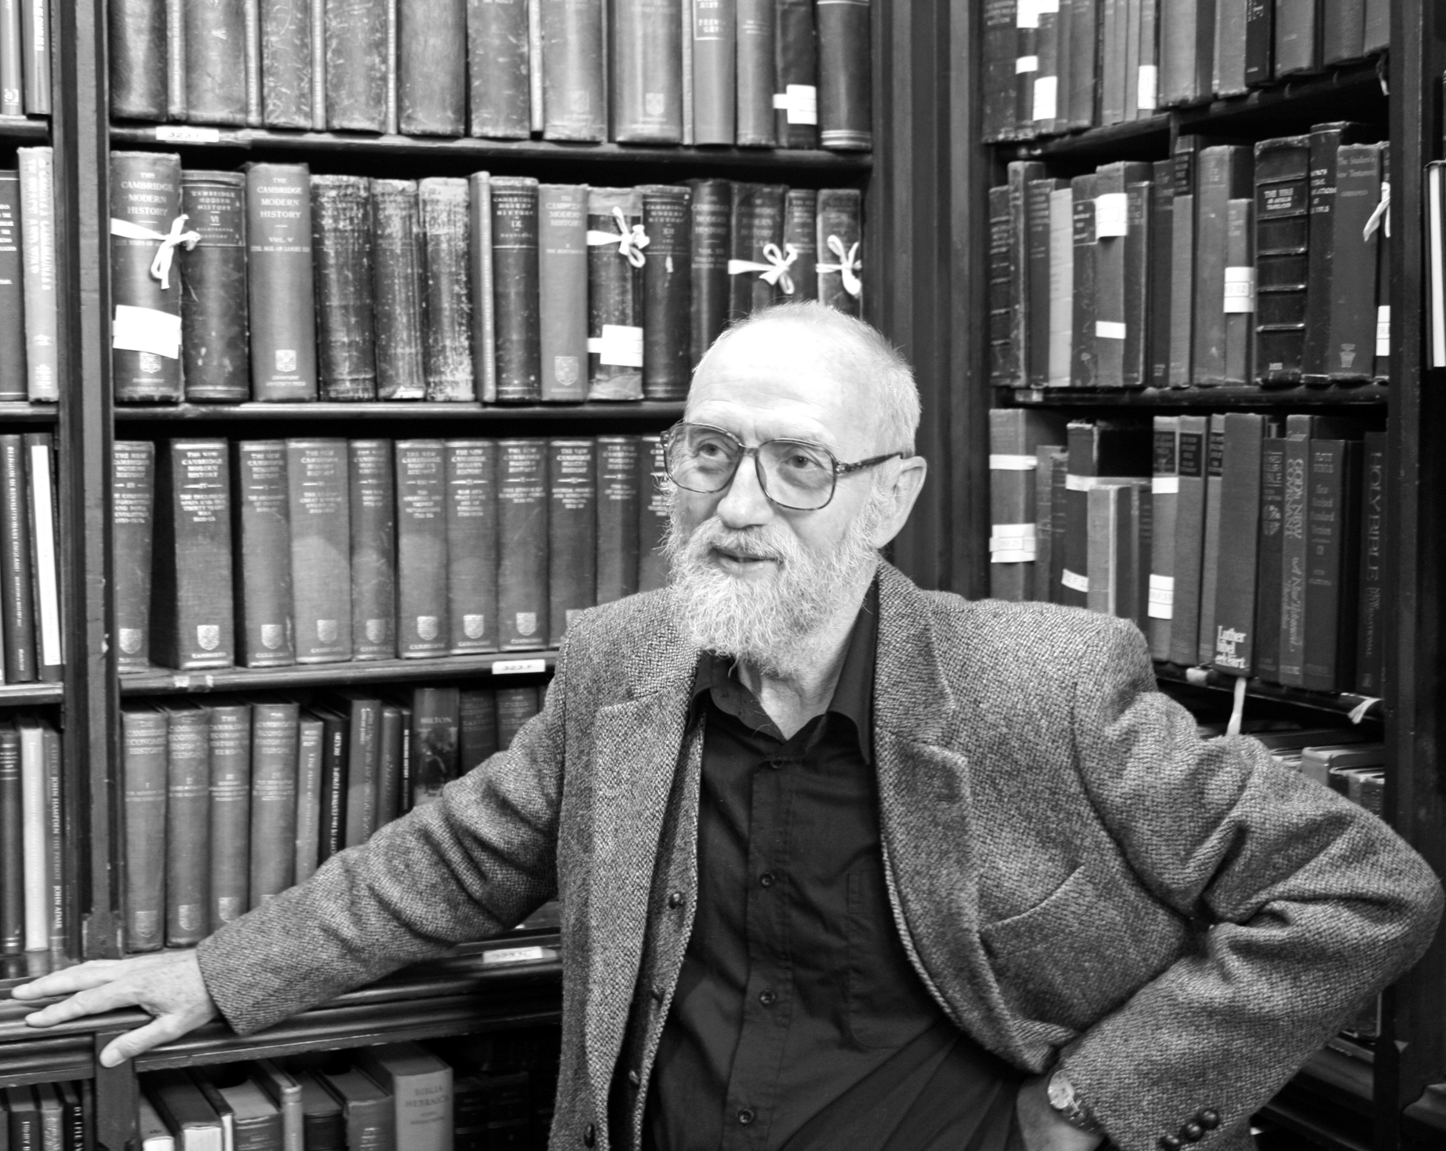
THE KNOWLEDGE ARGUMENT
Frank Jackson

Slide 15
THE KNOWLEDGE ARGUMENT
Mary knows all the physical facts pertaining to color vision inside her room.
When Mary leaves her room and sees something red for the first time, she comes to know something new.
So: Mary comes to know a nonphysical fact.
So: at least some of the facts concerning color experience are nonphysical.

Slide 16
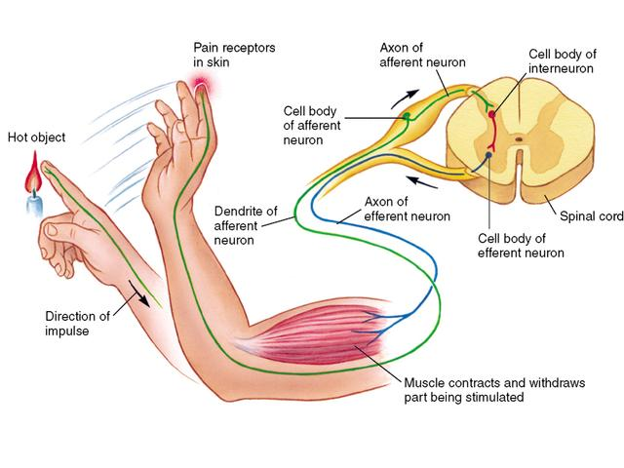
THE CAUSAL EXCLUSION WORRY

Slide 17
THE MIND–BRAIN IDENTITY THEORY
The mind–brain identity theory is the view that mental states are identical to neural states.
Don’t confuse this view with property dualism: correlation doesn’t entail identity!

Slide 18
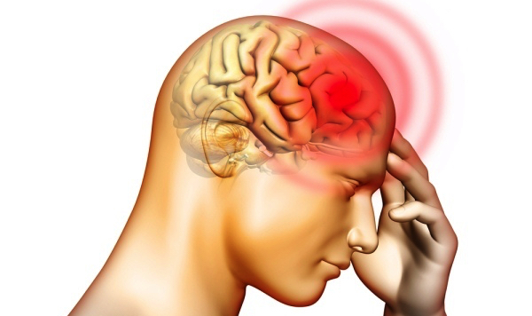
THE MIND–BRAIN IDENTITY THEORY
pain = c-fiber firing
Notes:
Properties are expressed by meaningful predicates

Slide 19
THE MIND–BRAIN IDENTITY THEORY
I feel nothing!

Slide 20
FUNCTIONALISM
Functionalism is the view that mental states are identical to functional states, which can be exhaustively defined in terms of relations to other states together with sensory inputs and behavioral outputs.
All that matters to the mind is not the matter that it is composed of but rather the functions that are implemented by that matter.
The human mind is a kind of computer program implemented by neural hardware; human beings are basically meat machines.

Slide 21
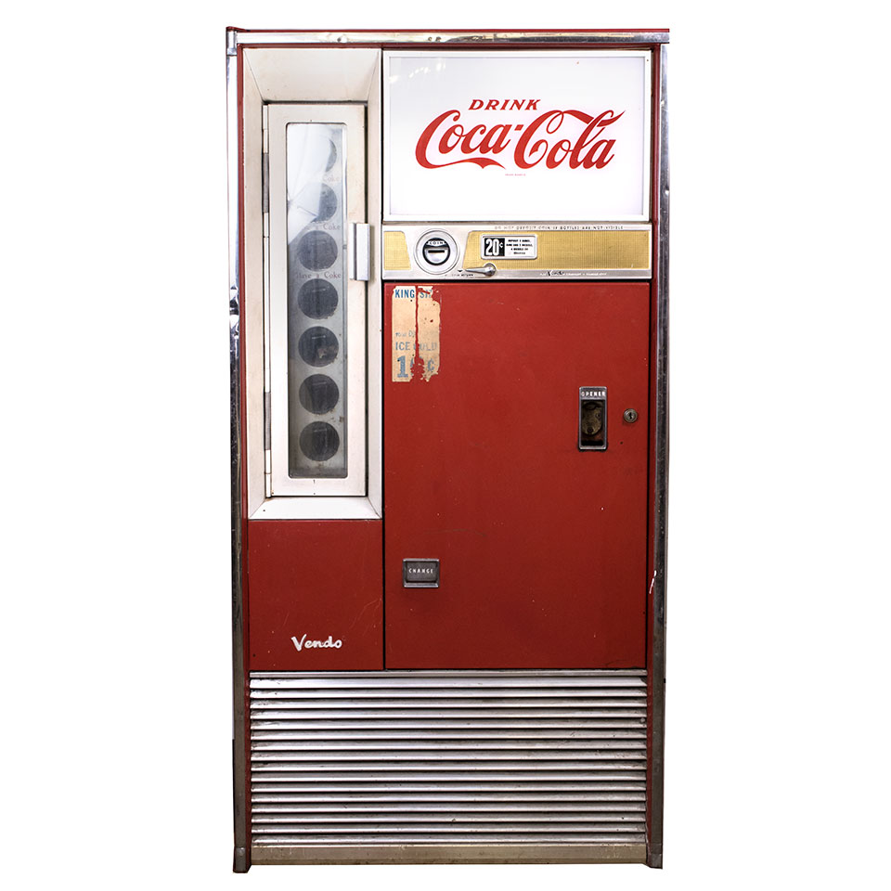
FUNCTIONALISM
INPUT | STATE ANN | STATE BOB
0.50¢ → | No output Go to BOB | Emit coke can Go back to ANN
$1.00 → | Emit coke can Stay in ANN | Emit coke can Emit 0.50¢ Go back to ANN
… | … | …

Slide 22
FUNCTIONALISM
x’s being a coke machine in state ANN = x’s having two internal states such that:
If 0.50¢ is inputted and x is in the first state, then x is caused to go into the second state;
If 0.50¢ is inputted and x is in the second state, then x is caused to emit a coke can and go back into the first state;
If $1.00 is inputted and x is in the first state, then x is caused to emit a coke can and stay in the first state;
If $1.00 is inputted and x is in the second state, then x is caused to emit a coke can plus 0.50¢ and go back into the first state;
…
x is currently in the first state.

Slide 23
FUNCTIONALISM
pain = the property of having some property or other that is typically caused by bodily damage and that typically causes avoidance behavior
Notes:
Properties are expressed by meaningful predicates.

Slide 24
THE CHINA–BODY PROBLEM
“Suppose we convert the government of China to functionalism, and we convince its officials that it would enormously enhance their international prestige to realize a human mind for an hour. We provide each of the billion people in China (I chose China because it has a billion inhabitants) with a specially designed two-way radio that connects them in the appropriate way to other persons and to the artificial body mentioned in the previous example. We replace the little men with a radio transmitter and receiver connected to the input and output neurons. Instead of a bulletin board, we arrange to have letters displayed on a series of satellites placed so that they can be seen from anywhere in China. Surely such a system is not physically impossible. It could be functionally equivalent to you for a short time, say an hour” (Block 1978, “Troubles with Functionalism,” p. 279)

Slide 25
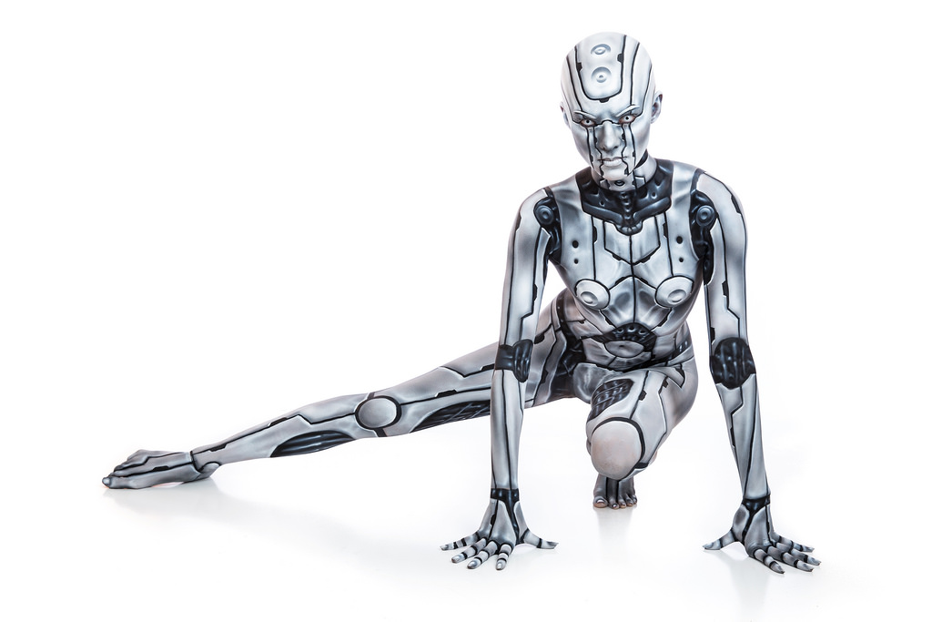
THE CHINA–BODY PROBLEM
Ned Block
China–body system

Slide 26
THE CHINA–BODY PROBLEM
If each mental state is identical to a functional state, then it is metaphysically impossible for a system to be functionally equivalent to you without also being mentally equivalent to you.
If it is conceivable for there to be a system that is functionally equivalent to you but not mentally equivalent to you, then it is metaphysically possible for there to be a system that is functionally equivalent to you but not mentally equivalent to you.
The China–body problem illustrates that this is conceivable.
So: mental states are not identical to functional states.

Slide 27
IMPLICATIONS FOR AI
The question as to whether AI is possible depends on the kind of AI at issue and which theory of mind is ultimately correct.
If the mind–brain identity is true, AI is impossible.
If functionalism is true, AI is possible
If dualism is true, who knows?
We may need different theories to capture intelligence/intentionality, on the one hand, and phenomenal consciousness, on the other.
This may mean that while Weak AI is possible, Strong AI is impossible.

Slide 28
THE ETHICS OF AI
We can’t simply assume that AI is impossible.
We need to seriously engage these ethical issues on the assumption that AI is possible.
Ethics is extremely important to the future of AI research and engineering.

