Slide 1
QUIZ 1
On van Inwagen’s view, which of the following properties does the fictional character Sherlock Holmes lack?
Being a fictional character
Being a theoretical entity of literary criticism
Being a detective
Having been created by Sir Arthur Conan Doyle

Slide 2
LINGUISTIC DATA
She was a fat old woman, this Mrs. Gamp, with a husky voice and a moist eye, which she had a remarkable power of turning up, and only showing the white of it.
Mrs. Sarah Gamp was, four-and-twenty years ago, a fair representation of the hired attendant on the poor in sickness.
Mrs. Gamp . . . is the most fully developed of the masculine anti-women visible in all Dickens's novels.
Sherlock Holmes is a famous fictional character.
There are characters in some nineteenth-century novels who are presented with a greater wealth of physical detail than is any character in any eighteenth-century novel.
Notes:
“[S]urely [the Meinongian] is wrong in so assimilating the writing of (1) to the writing of (2) and (3). Sentences (2) and (3) were used by their authors as vehicles of assertions; (1) was not” (301).
“It would make sense to say that the authors of (2) and (3), in writing these sentences, wrote something true or wrote something false” (301).
“But if someone had been looking over Dickens’s shoulder when Dickens was writing (1), and had said to him, ‘No, no, you’ve got her all wrong. She is quite thin, about twenty-four, and her voice is melodious,’ this would simply have made no sense” (301).
“There is no point in debating what sort of thing Dickens was writing about when he wrote (1) or debating what sort of fact or proposition he was asserting, since he was not writing about anything and was asserting nothing. Sentence (1) does not represent an attempt at reference or description” (301).

Slide 3
FICTIONAL REALISM
Sentences (2)–(5) express true propositions.
This is possible because the names “Sarah Gamp” and “Sherlock Holmes” denote existing entities: namely, fictional characters.

Slide 4
FICTIONAL REALISM
Question: Why should we take a sentence like
Sherlock Holmes is a famous fictional character
to to be about Sherlock Holmes, except in the uninteresting sense in which
The average American owns 1.02 cars
is about “the average American”?
Answer: “Sherlock Holmes” is a name, “the average American” is a definite description.

Slide 5
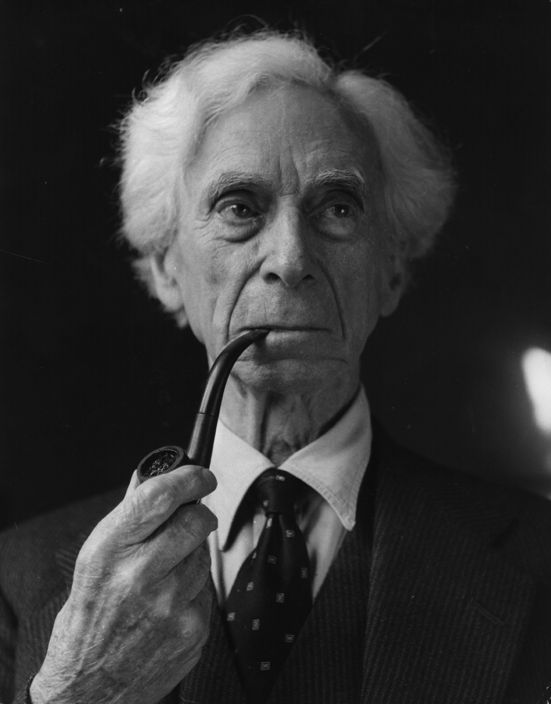
PROBLEM OF NEGATIVE EXISTENTIALS
Theory of descriptions: names are disguised descriptions.
“Pegasus” has the logical form of “the unique winged-horse who served the muses”—a description that can be satisfied or unsatisfied.
To say that Pegasus doesn’t exist is to say that there is no x such that x is the winged-horse who served the muses—that is, the description “the unique winged-horse who served the muses” isn’t satisfied by anything.
Bertrand Russell
Notes:
20th century

Slide 6
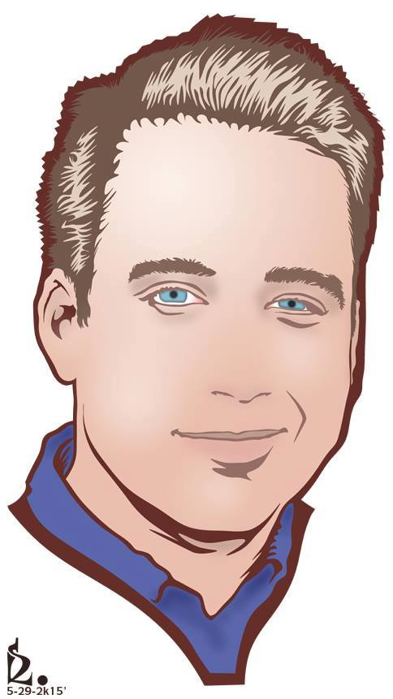
PROBLEM OF NEGATIVE EXISTENTIALS
“the president of the United States”
✓
“winged-horse”
✓
“Zach Blaesi”
“Pegasus”
∃xPx ✓
~∃xWx ✓
∃xZ!x ✓
~∃xP!x ✓
satisfied
unsatisfied
unsatisfied
satisfied
domain of quantification

Slide 7
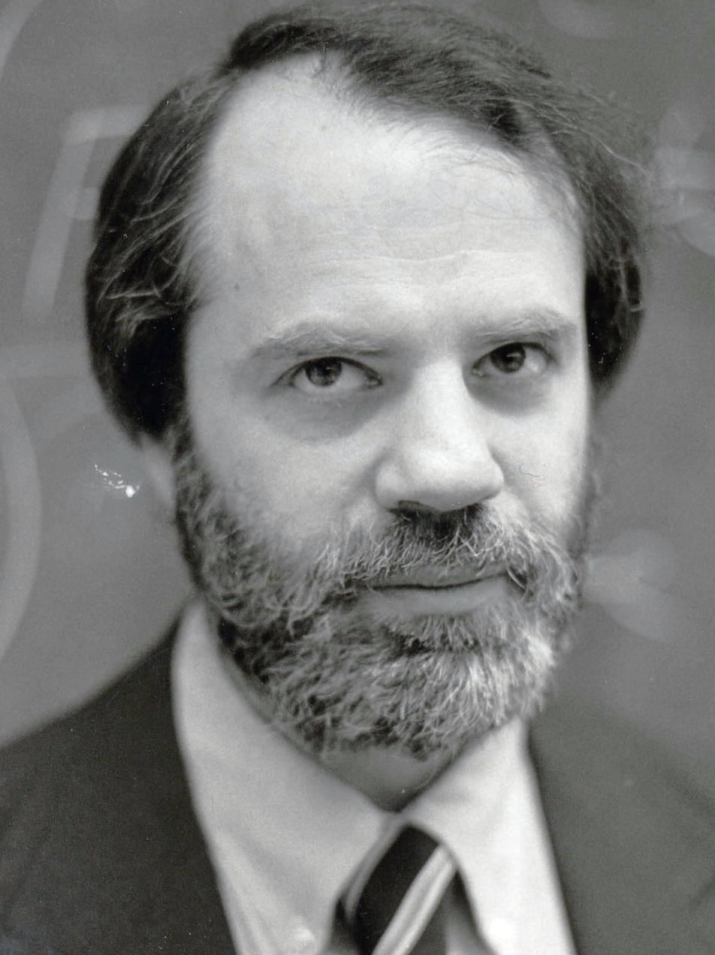
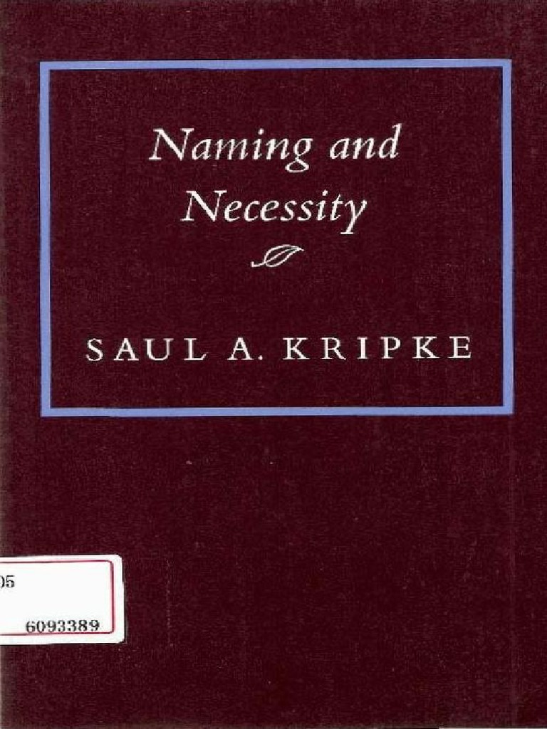
PROBLEM OF NEGATIVE EXISTENTIALS
Notes:
Contemporary

Slide 8
POLL
Mark Zuckerberg could have not been the inventor of Facebook.
True
False
Mark Zuckerberg could have not been Mark Zuckerberg.
True
False

Slide 9
STORY

Slide 10
POLL
If that story turned out to be true, then “Mark Zuckerberg” has referred to Andrew Garfield all along.
True
False

Slide 11
FICTIONAL REALISM
Question: Why should we think that there is such a thing as Sherlock Holmes?
Answer: Because there are fictional characters—they are heavily discussed by literary critics, after all! And if that is right, then surely Sherlock Holmes is one of them.

Slide 12
FICTIONAL REALISM
Question: But what do you mean when you say that fictional characters exist?!
Answer: The same sort of thing that is meant by claims like the following:
There are such things as countries—we live in one of them, namely, the United states.
Cabbages exist—you can find some of them at HEB.
There are numbers—after all, that is a straightforward consequence of the claim that 2 is a prime number.

Slide 13
FICTIONAL REALISM
Question: But if Sherlock Holmes exists, then what sort of thing is he?!?!
Answer: A character in a novel, or, more generally, a creature of fiction—or more generally still, a theoretical entity of literary criticism.

Slide 14
FICTIONAL REALISM
EVERYTHING
theoretical entities of literary criticism
plots, novels, poems, fictional characters, fictional locations, meters, rhyme schemes, …
theoretical entities of physics
quarks, electrons, antimatter, fields, strings, spacetime, …
theoretical entities of mathematics
integers, real numbers, irrational numbers, functions, sets, ordered pairs, …
…
…

Slide 15
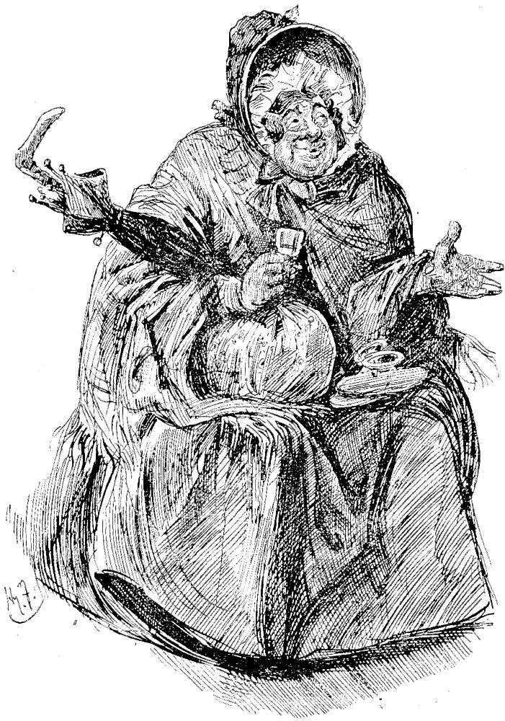
PROBLEM
Oh dear...
being old
being fat
being fond of gin
being named “Sarah Gamp”
having a friend called “Mrs. Pig”
Sarah Gamp

Slide 16
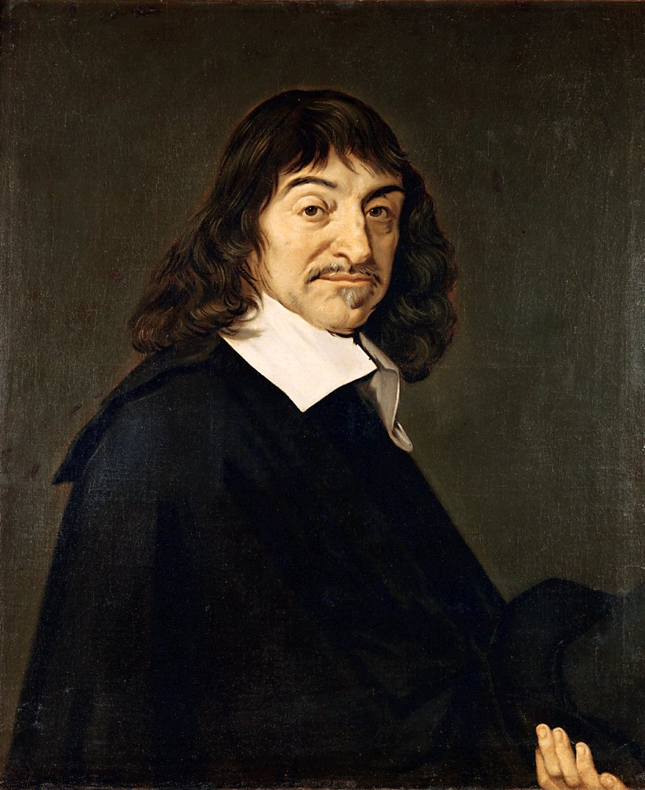
ANALOGY (SUBSTANCE DUALISM)
being tangible
being six feet tall
weighing 190 pounds
being mainly pinkish-white in color
René Descartes

Slide 17
ANALOGY (SUBSTANCE DUALISM)
being tangible
being six feet tall
weighing 190 pounds
being mainly pinkish-white in color
thinking about Vienna
being free from pain
being in a state of Grace
animating a body
René Descartes

Slide 18
ANALOGY (SUBSTANCE DUALISM)
animating a body that has the property of being tangible
animating a body that has the property of being six feet tall
animating a body that has the property of weighing 190 pounds
animating a body that has the property of being mainly pinkish-white
René Descartes
Notes:
“[I]f anything exemplifies fatness, then it occupies a certain region of space-time and you and I (if we were appropriately located in space-time) can touch it; but Mrs. Gamp is a theoretical entity of criticism, and we could no more touch her than we could touch a plot or a sonnet” (306).

Slide 19
ASCRIPTION VS. EXEMPLIFICATION
Though Mrs. Gamp doesn’t have or exemplify or instantiate properties such as being fond of gin, she bears an intimate relation to such properties.
Just as (on substance dualism) you may say “Zach Blaesi has blond hair” and be talking about an immaterial substance without thereby predicating having blond hair of that substance, so also (on the present view) we may say “Mrs. Gamp is fond of gin” and be talking about a theoretical entity of literary criticism without thereby predicating fondness of gin of that entity.
Since we don’t have a good term for this in English, let’s just call it “ascription,” where the “is”-of-ascription is not to be confused with the “is”-of-predication.

Slide 20
ASCRIPTION VS. EXEMPLIFICATION
A(fondness of gin, )
Notes:
“For consider the fact that the sentences ‘Shiela Smith was fat’ and ‘Shiela Smith was not fat’ might appear in one and the same novel, owing either to the author’s inadvertence or to the passage of narrative time” (305).
“Suppose there was such a novel. Should we, describing its content in a review, write ‘Shiela Smith was fat’? This would be misleading. If the two sentences appeared in the novel owing to the author’s inadvertence, clearly we ought to write something like ‘Shiela Smith is described as fat in Chapter Four. But in Chapter Six we are told she is not fat’” (305).

Slide 21
ASCRIPTION VS. EXEMPLIFICATION
A(fondness of gin, , place)
QUIZ 2
According to Van Inwagen, “place” always stands for the story/fiction (for example, Martin Chuzzlewit).
True
False
Notes:
“For consider the fact that the sentences ‘Shiela Smith was fat’ and ‘Shiela Smith was not fat’ might appear in one and the same novel, owing either to the author’s inadvertence or to the passage of narrative time” (305).
“Suppose there was such a novel. Should we, describing its content in a review, write ‘Shiela Smith was fat’? This would be misleading. If the two sentences appeared in the novel owing to the author’s inadvertence, clearly we ought to write something like ‘Shiela Smith is described as fat in Chapter Four. But in Chapter Six we are told she is not fat’” (305).
“A place is either a work of fiction (such as a novel, short story, or narrative poem) or a part or section thereof, even a part or section that is so short to be conterminous with a single (occurrence of a) sentence or clause.

Slide 22
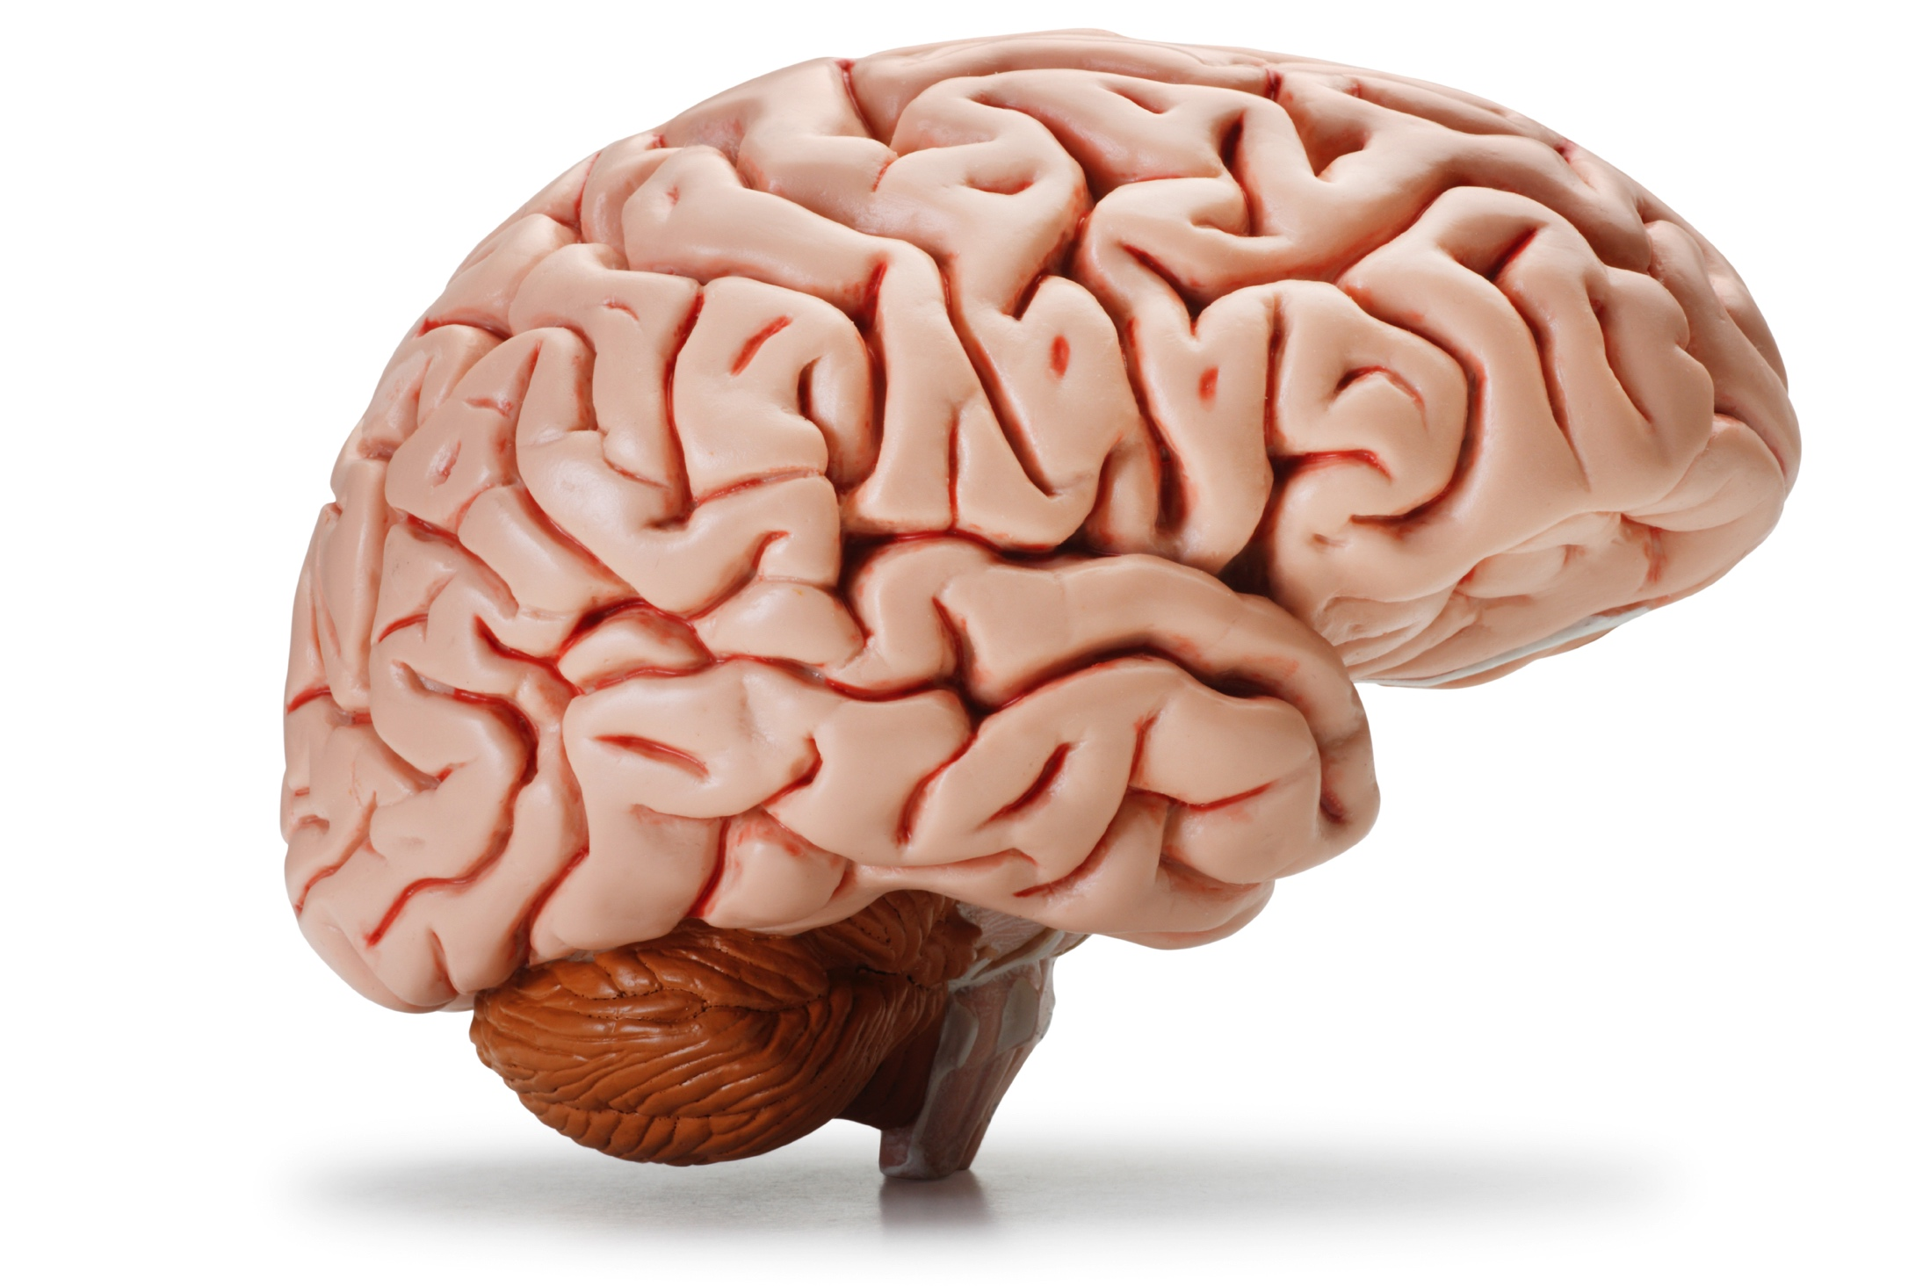
ASCRIPTION VS. EXEMPLIFICATION
A(fondness of gin, Mrs. Gamp, Martin Chuzzlewit)
“Mrs. Gamp is fond of gin.”
Notes:
Note that Dickens didn’t ascribe a property to Gamp in either the technical or ordinary sense, because he wasn’t making an assertion at all.
We might say this holds just in case were there to be a real woman like Mrs. Gamp, that woman would be fat. That doesn’t work, because no real woman could be like Mrs. Gamp (she is abstract, created by Dickens, etc.).
If Martin Chuzzlewit were not a novel but a true record of events, then there would be a woman called “Mrs. Gamp” and she would be fat. Problems:
No one named this individual!
We refer to fictional characters via the description “the name it has in the story.”
As a result, this account would be circular, appealing to ascription itself.
Wouldn’t be able to understand the literary properties as relata of the relation.

Slide 23
ASCRIPTION VS. EXEMPLIFICATION
being a character in a novel
being a theoretical entity of literary criticism
having been created by Dickens
being a satiric villainess
being a fair representation of the hired attendant on the poor in sickness in 1843
being the most fully developed of the masculine anti-women visible in all of Dickens’s novels
Sarah Gamp

Slide 24
SUMMARY
Sentences like (2)–(5) are about characters in novels, which belong to the subclass of creatures of fiction and the wider class of theoretical entities of literary criticism.
Sentences like (1) are not about anything.
She was a fat old woman, this Mrs. Gamp, with a husky voice and a moist eye, which she had a remarkable power of turning up, and only showing the white of it.
Creatures of fiction exist and obey the laws of logic.
Creatures of fiction have or exemplify or instantiate only “literary” properties.
True claims that appear to predicate non-literary properties of creatures of fiction are to be understood in terms of ascription.

Slide 25
SUMMARY
Problem: Does Sherlock Holmes have an even number of hairs on his head, or not?
Solution: No, he doesn’t. Sherlock Holmes possesses only “literary” properties, such as having been created by Sir Arthur Conan Doyle.

Slide 26
SUMMARY
Problem: How could Sherlock Holmes have both the property of being a man and the property of having been created by Sir Arthur Conan Doyle? Sir Arthur Conan Doyle isn’t God, after all!
Solution: Sherlock Holmes doesn’t have the property of being a man at all. That property is ascribed to him, not exemplified by him.
Notes:
The Meinongian can say that Holmes was “discovered,” but “that makes the creativity of the novelist seem very like the ‘creativity’ of the flower-arranger” (308).
What reason do we have to say that he has the property of being a man? Because it says so in the story. But then we should say that he has the property of existence as well!

