Slide 1
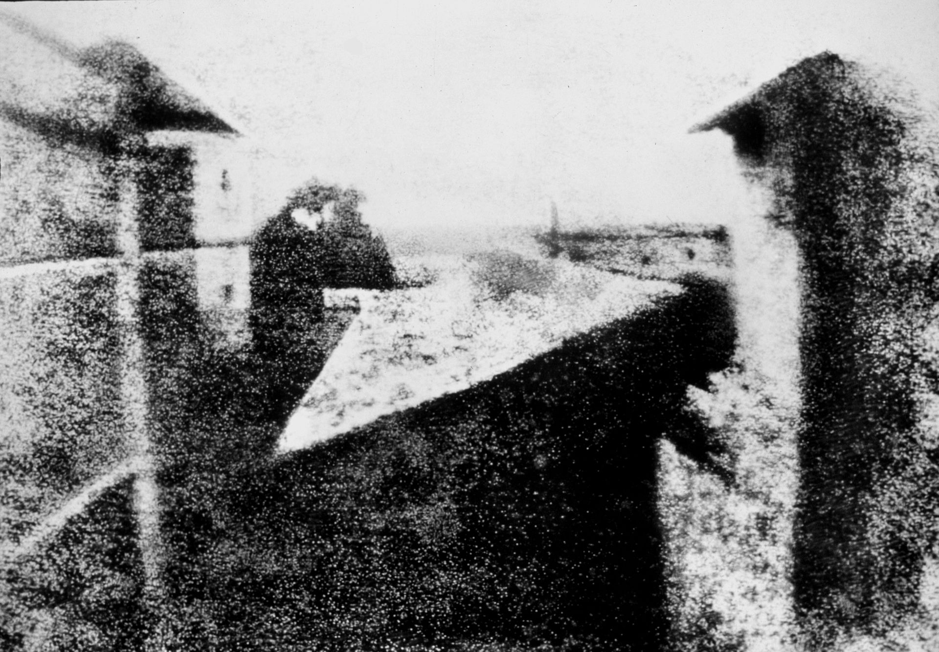
transparent pictures
PHL 317K
Fall 2017
Notes:
TS scene: https://www.youtube.com/watch?v=UTzzP1-YqIE&t=12m13s
Kill Bill Vol. 1 clip: https://www.youtube.com/watch?v=VHnVsjBoHnY&t=4m31s
Seinfeld clip: https://www.youtube.com/watch?v=ENPyRc238OU
https://www.nasa.gov/image-feature/goddard/2016/hubble-gazes-at-long-dead-star
http://courtnewsohio.gov/happening/2016/oldCaseFiles_080516.asp#.WeP5AhNSxsM
http://existentialcomics.com/comic/156

Slide 2
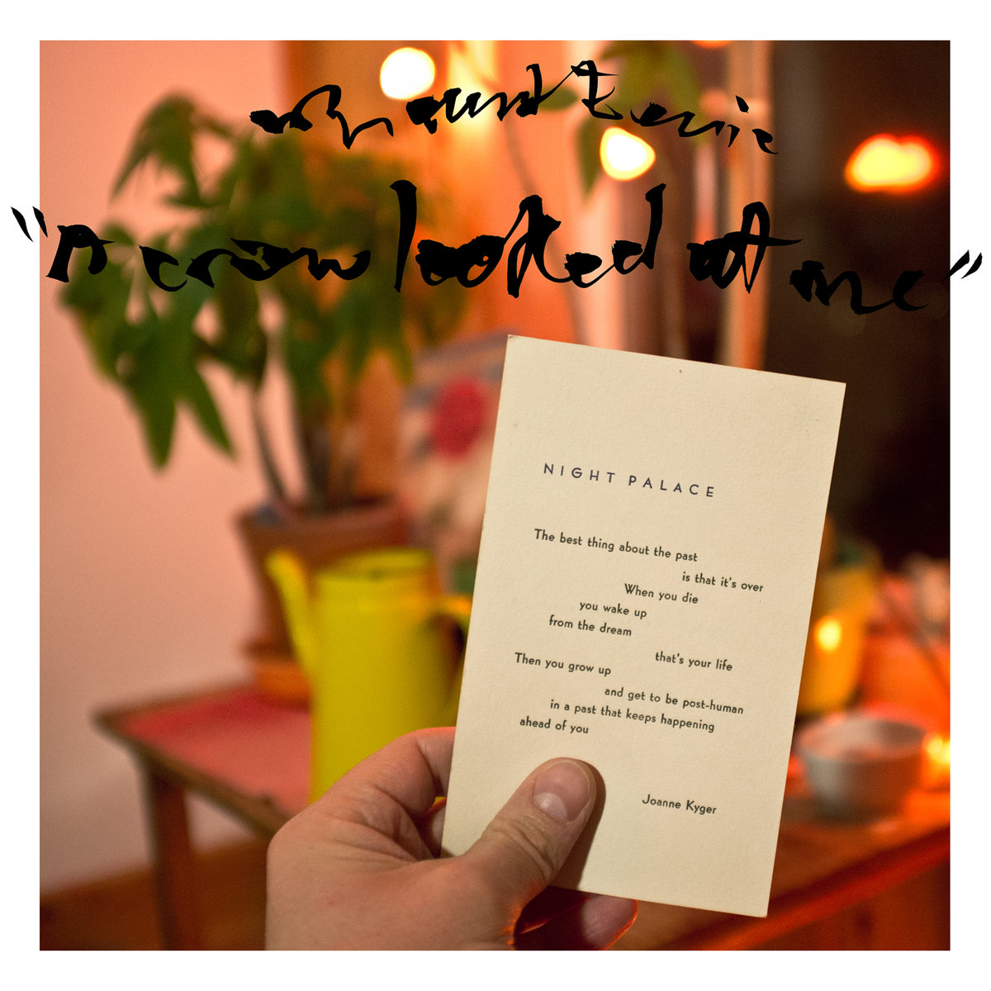
BACKGROUND
Now I can only see you on the fridge in lifeless pictures
and in every dream I have at night
and in every room I walk into like
here where I sit the next October, still seeing your eyes,
pleading and afraid
full of love
calling out from another place
because you’re not here.
A Crow Looked at Me – Mount Eerie
Notes:
“Ravens”
Walton will maintain that this isn’t just metaphor; it’s literally true.
Transition: before we see why, let’s discuss the motivation.

Slide 3
BACKGROUND
Now I can only see you on the fridge in lifeless pictures
and in every dream I have at night
and in every room I walk into like
here where I sit the next October, still seeing your eyes,
pleading and afraid
full of love
calling out from another place
because you’re not here.
A Crow Looked at Me – Mount Eerie
Notes:
“Ravens”
Walton will maintain that this isn’t just metaphor; it’s literally true.
Transition: before we see why, let’s discuss the motivation.

Slide 4
BACKGROUND
It is extremely intuitive to regard photographs as especially realistic.
“Photography and the cinema . . . are discoveries that satisfy, once and for all and in its very essence, our obsession with realism” (Bazin 1960, 7).

Slide 5
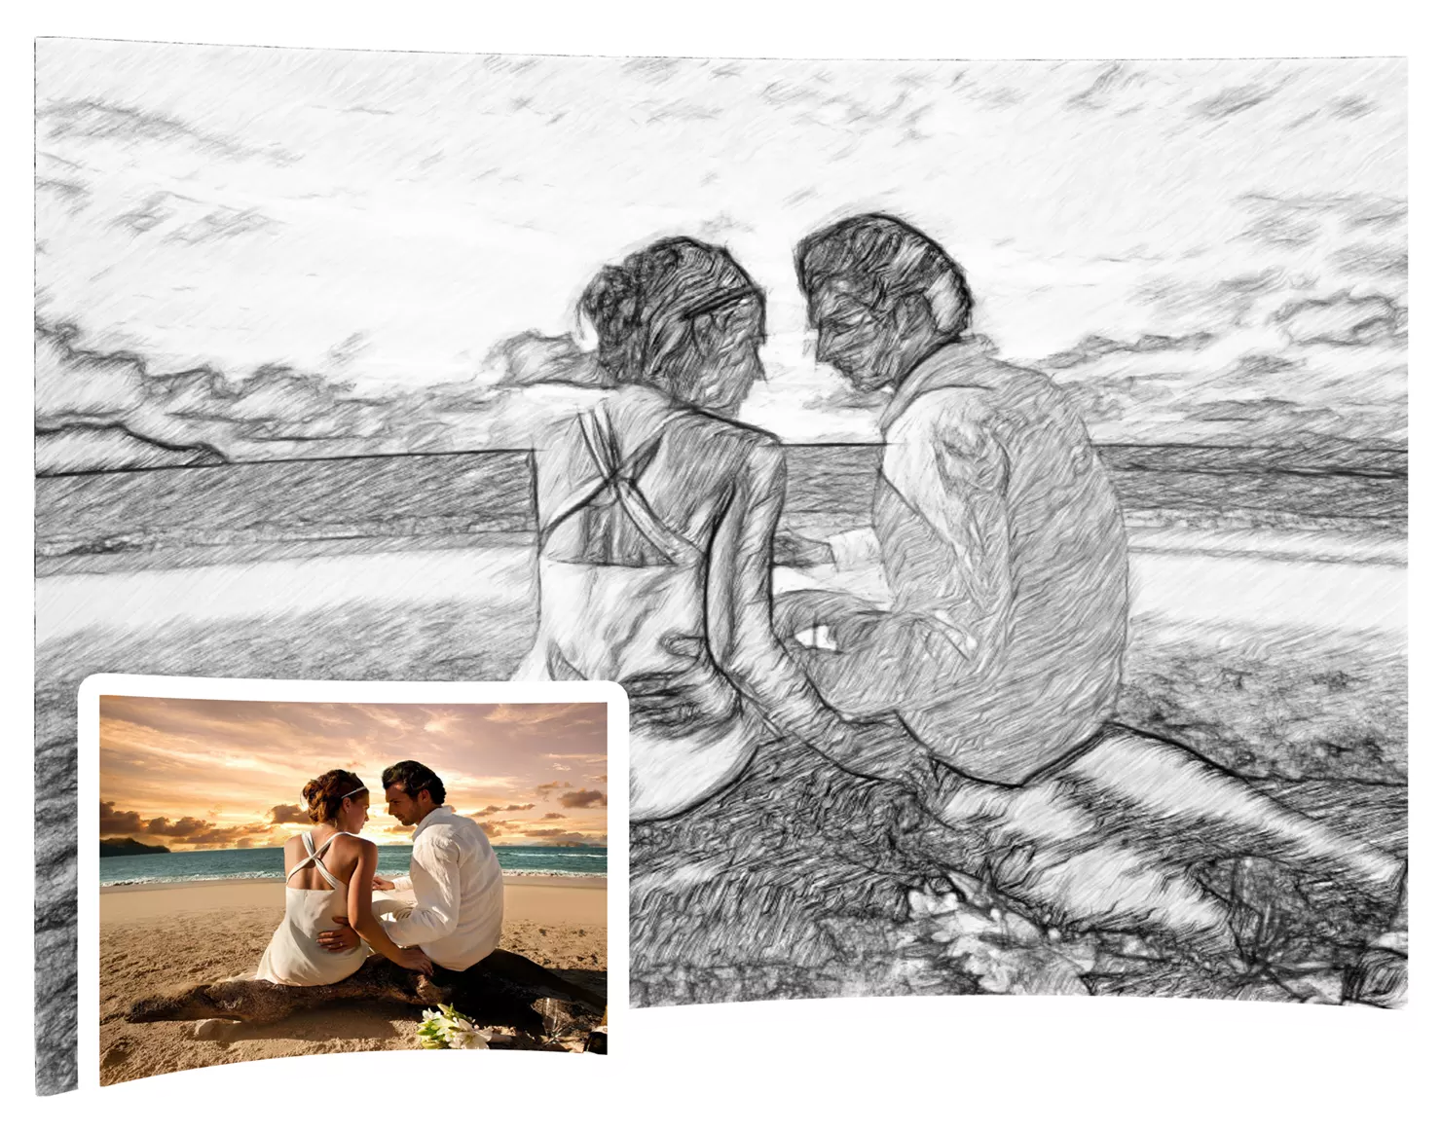
BACKGROUND
Notes:
More likely than paintings or drawings to be admitted in court as evidence of a crime. Body cam footage highly relevant.
More useful for extortion

Slide 6
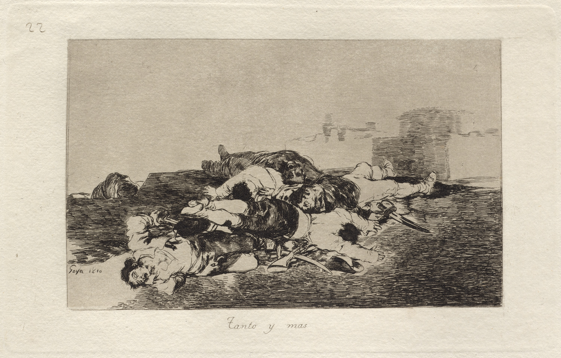
BACKGROUND
Notes:
Tanto y mas (Even worse) – Francisco Goya

Slide 7
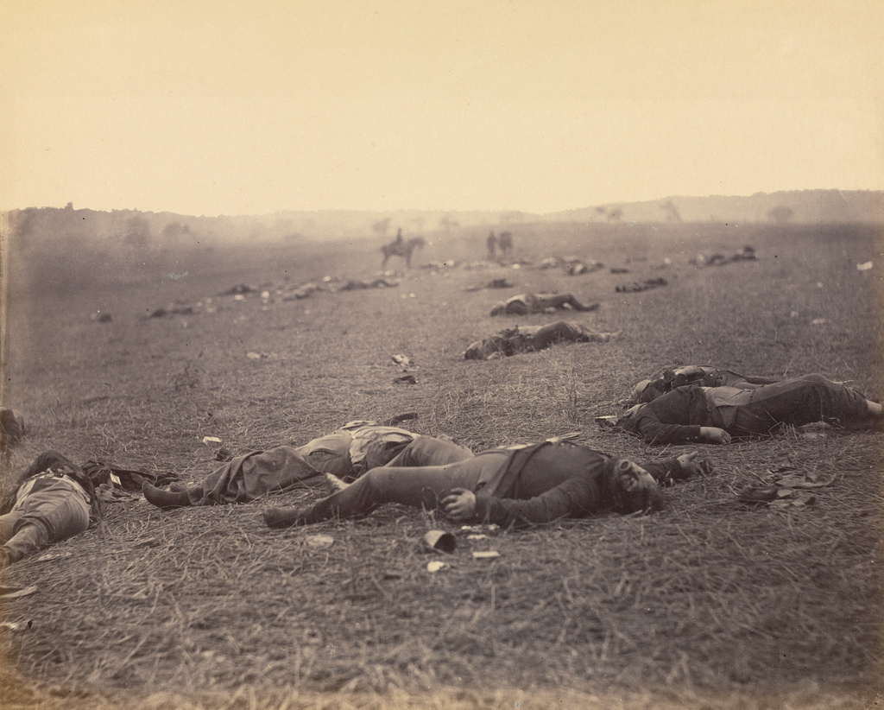
BACKGROUND
“It is hard to resist describing the difference by saying that the photographs have a kind of immediacy or realism which the etchings lack” (Walton 1984, 247).
Notes:
Death on a Misty Morning – Timothy H. O’Sullivan
Show Kill Bill Vol. 1 clip

Slide 8
THE MILLION DOLLAR QUESTION
What is it about photographs that makes them distinctively realistic?

Slide 9
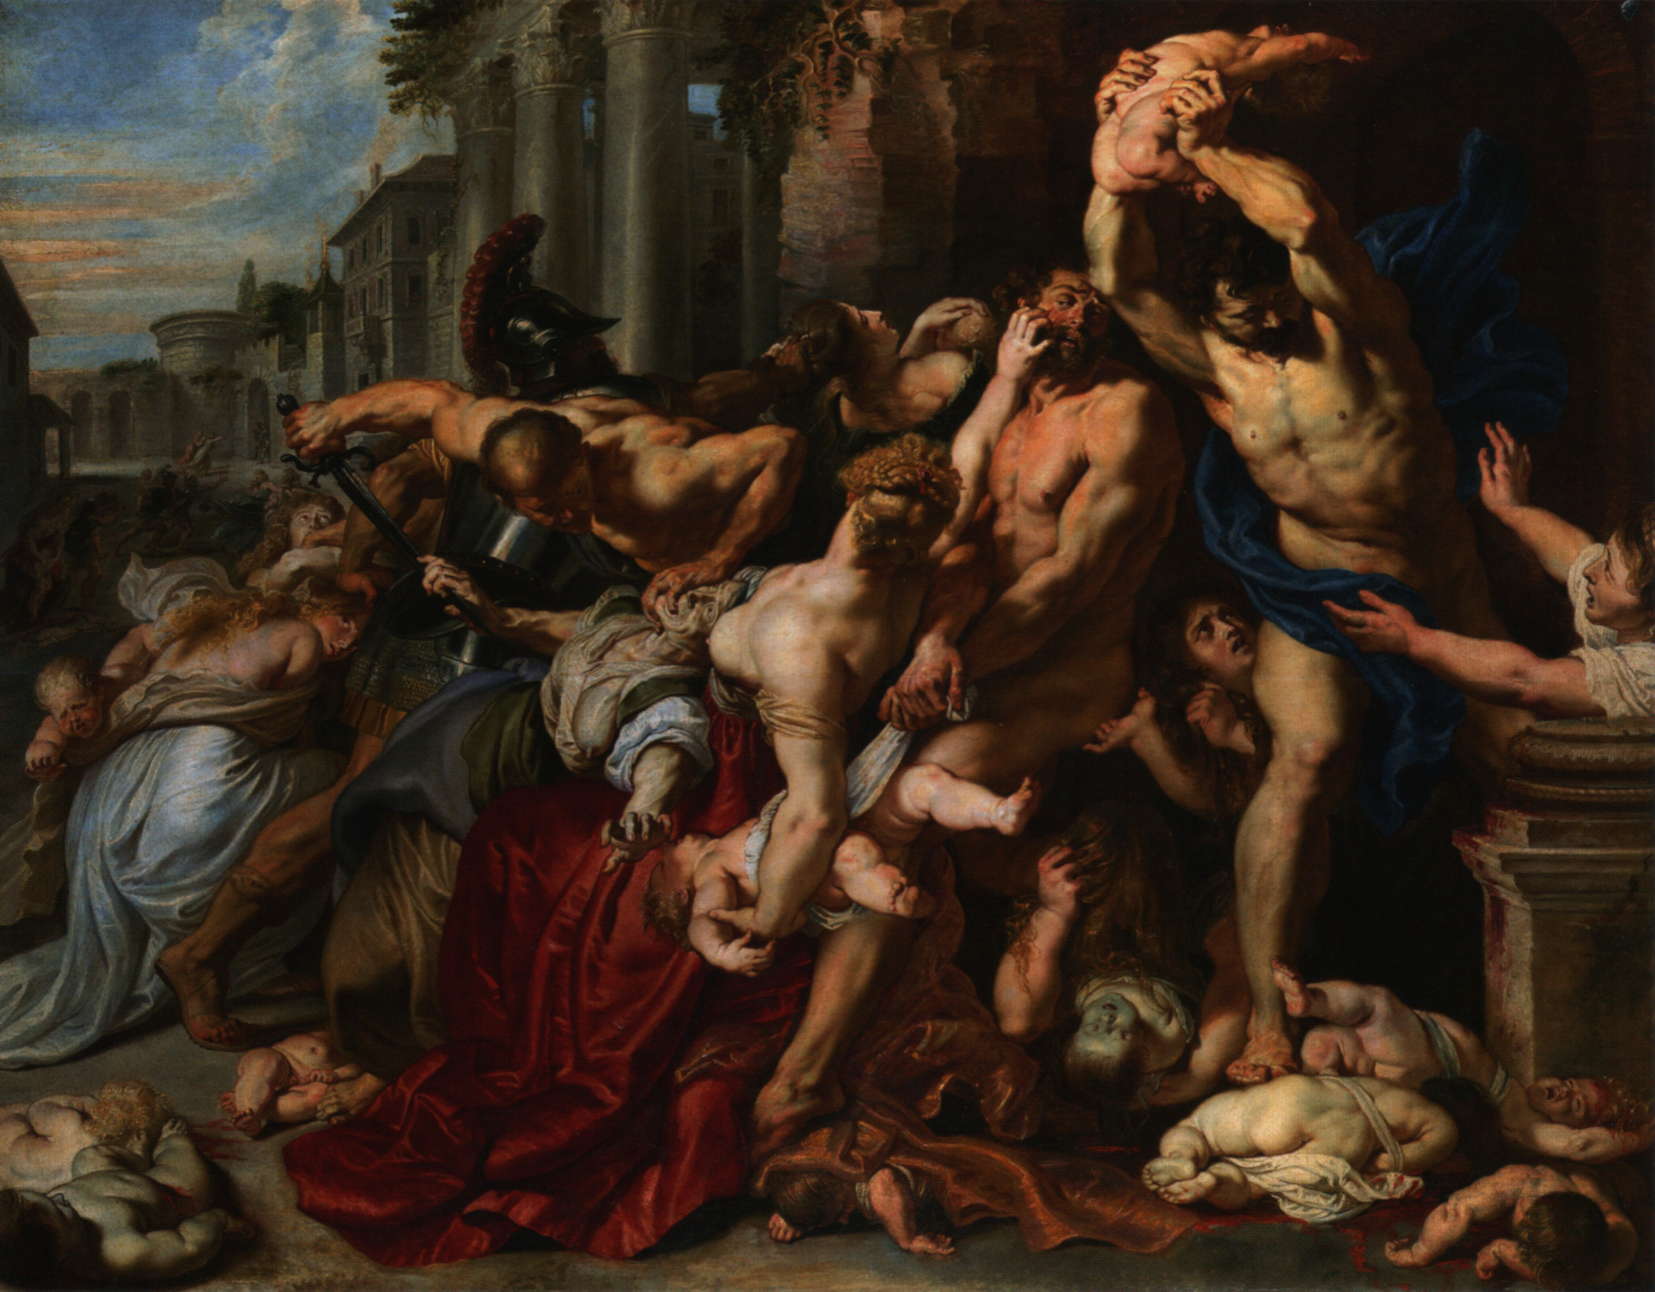
THE MILLION DOLLAR QUESTION
Notes:
“The Massacre of the Innocents is the subject of two paintings by Peter Paul Rubens depicting the episode of the biblical Massacre of the Innocents of Bethlehem, as related in the Gospel of Matthew, Ch.2, vs.13-18” – https://en.wikipedia.org/wiki/Massacre_of_the_Innocents_(Rubens)

Slide 10
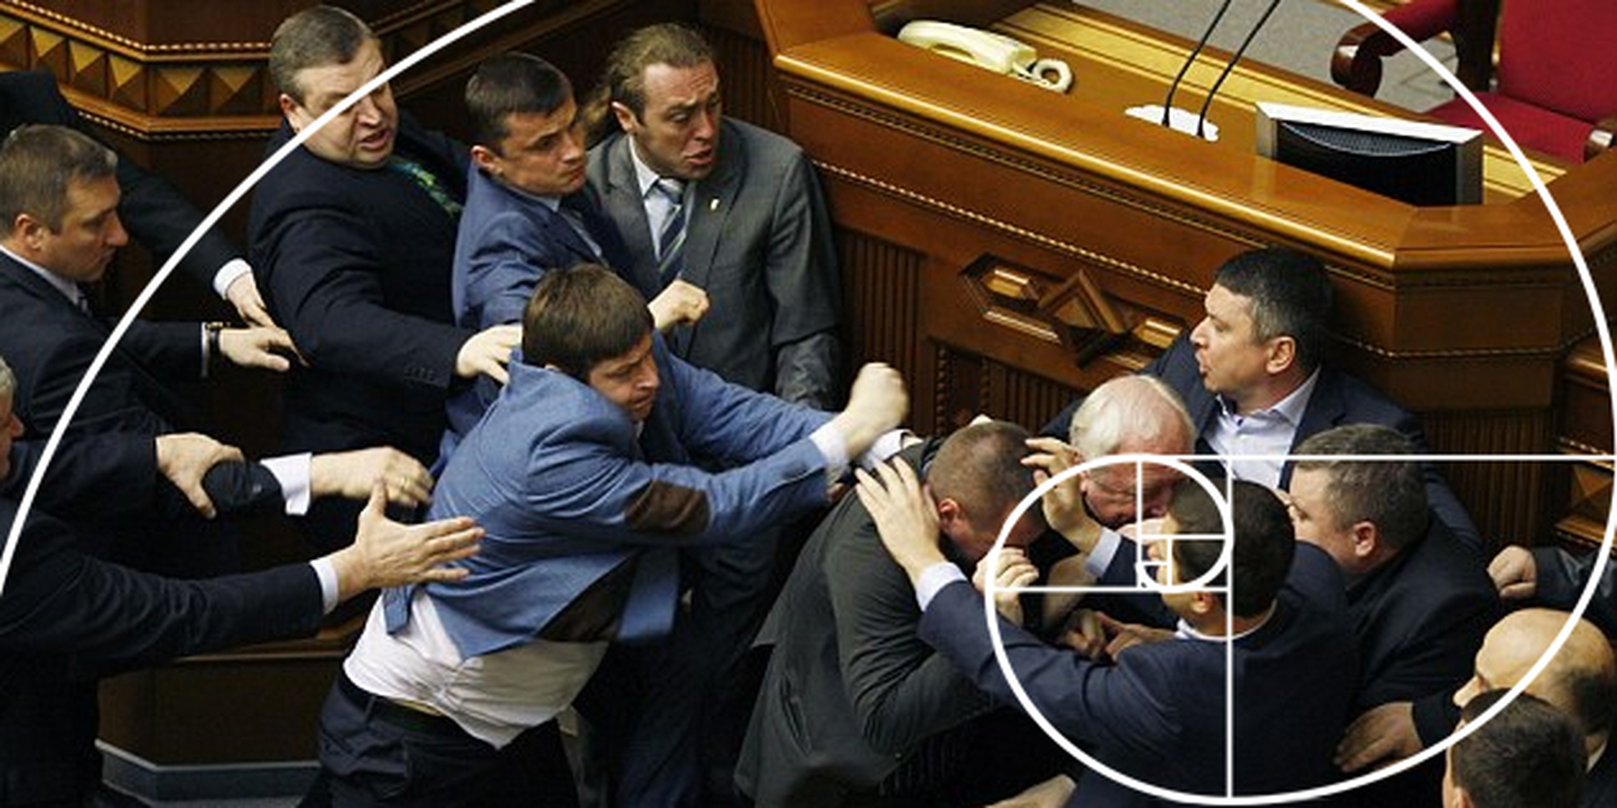
THE MILLION DOLLAR QUESTION
Notes:
“It’s been such a tense year for Ukrainian/Russian relations that recently tensions in the Ukrainian Parliament erupted into an all-out brawl between proponents of the Communist and nationalist sides of the dispute” – https://www.dailydot.com/unclick/ukranian-government-fistfight-turned-into-painting

Slide 11
POLL
Is the fact that photography excels with respect to detail, lighting, perspective, etc. what makes it uniquely realistic?
Yes
No

Slide 12
THE MILLION DOLLAR QUESTION
If photographic realism is simply a matter of capturing minute details and mastering subtitles of perspective, lighting, and so on, then photographs differ from other realistic images only in degree.
Less realistic paintings and drawings are simply the result of technological deficiencies.
It is not impossible for an artist to produce a painting that is visually indistinguishable from a realistic photograph. But intuitively, the photograph is still realistic in a distinctive way that the painting is not.
This answer also fails to account for the sense in which blurry or poorly exposed photographs are nonetheless distinctively realistic.
Notes:
Transition… Bazin and others didn’t seem to be getting at anything like that.
Phenomenological interpretation – perhaps we are under the illusion…

Slide 13
THE MILLION DOLLAR QUESTION
“In spite of any objections our critical spirit may offer, we are forced to accept as real the existence of the object reproduced, actually re-presented, set before us, that is to say, in time and space” (Bazin 1960, 8).
“Only a photographic lens can give us the kind of image of the object that is capable of satisfying the deep need man has to substitute for it something more than a mere approximation, a kind of decal or transfer” (8).
Notes:
Transition: we might interpret this as making a claim about an illusion we fall under when observing photographs. But…

Slide 14
POLL
Do we fall under an illusion when looking at photographs?
Yes
No

Slide 15
THE MILLION DOLLAR QUESTION
We aren’t under the illusion that a photographic image is identical to its model.
“Photographs look like what they are: photographs” (249).
Plus, if that’s what Bazin meant, then we would have to regard photography as less realistic than theater.
Notes:
“Categories of Art” is in the background here – that paper was published in 1970, this one in 1984.

Slide 16
THE MILLION DOLLAR QUESTION
“No matter how fuzzy, distorted, or discolored, no matter how lacking, in documentary value the image may be, it shares, by virtue of the very process of its becoming, the being of the model of which it is the reproduction; it is the model” (Bazin 1960, 8; emphasis added).
Notes:
Transition: we might interpret this as making a claim about an illusion we fall under when observing photographs. But…

Slide 17
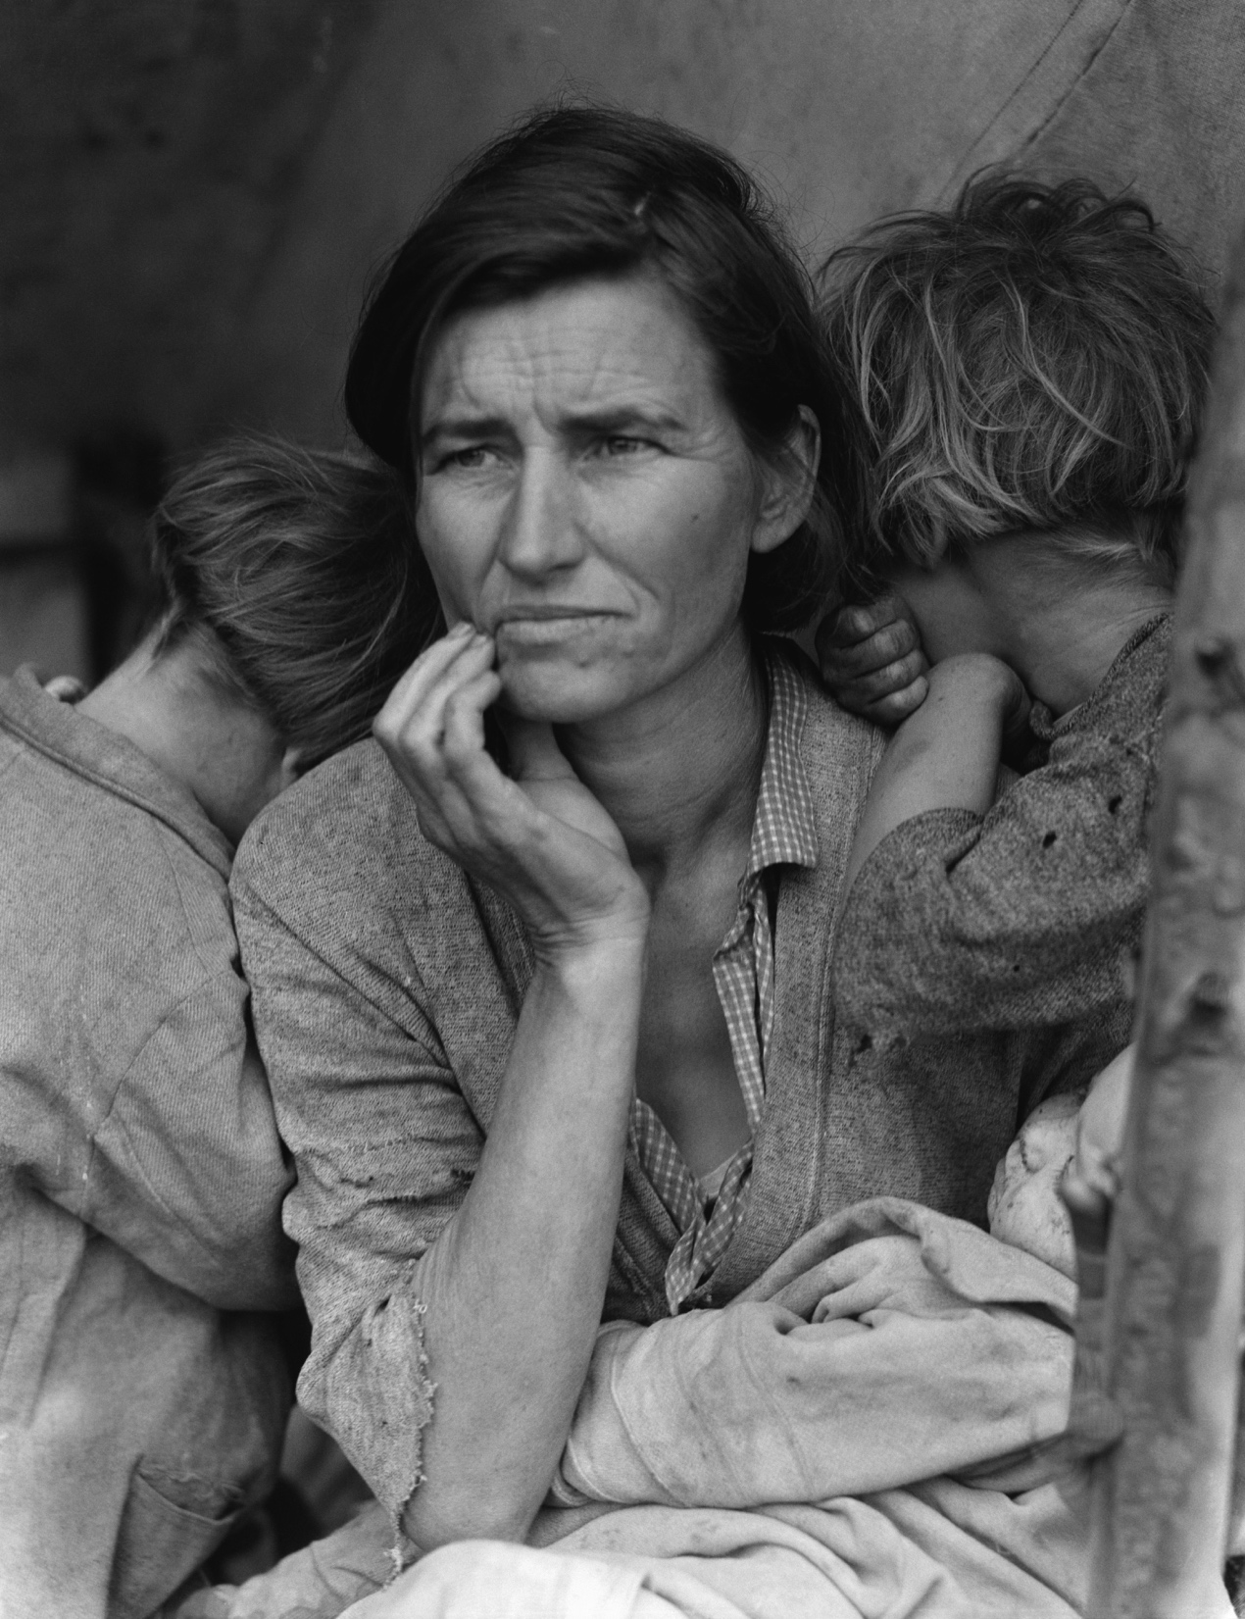
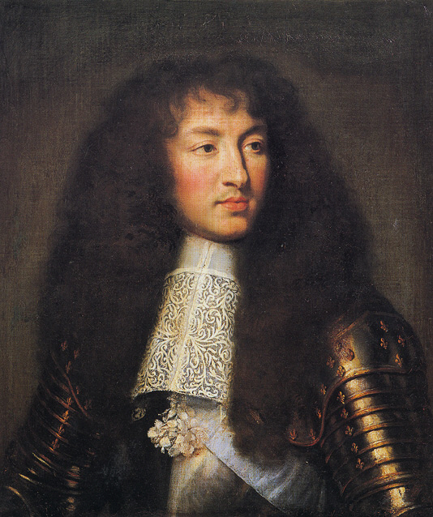
THE MILLION DOLLAR QUESTION
Florence Owens Thompson
Louis XIV
Notes:
You might say that photographs are distinctive in that they always have existential import.
“Those who see a sharp contrast between photographs and paintings clearly think that it obtains no less when paintings depict real things than when they do not, and even when viewers fully realize that they do” (251).

Slide 18
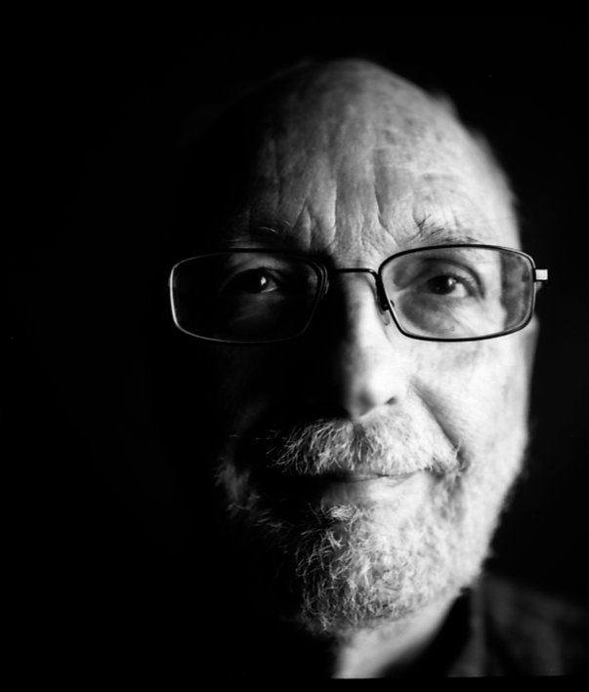
WALTON’S ANSWER
“I shall argue that there is indeed a fundamental difference between photographs and painted portraits of Lincoln, that photography is indeed special, and that it deserves to be called a supremely realistic medium. But the kind of realism most distinctive of photography is not an ordinary one. . . . It is enormously important, however. Without a clear understanding of it, we cannot hope to explain the power and effectiveness of photography” (Walton 1984, 251).
“Photography [is] a contribution to the enterprise of seeing. The invention of the camera gave us not just a new method of making pictures and not just pictures of a new kind: it gave us a new way of seeing” (251).

Slide 19
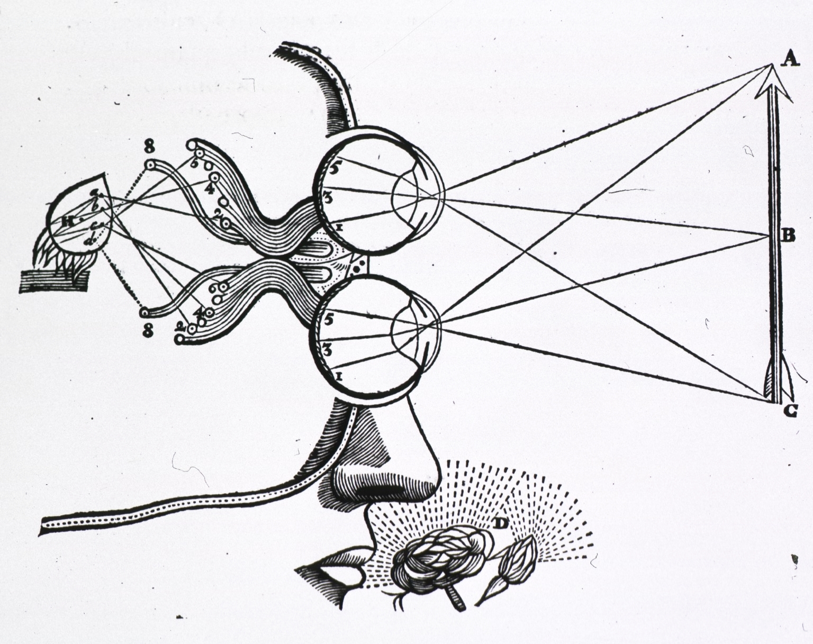
The thesis
Notes:
Transition: analogies will support this. Bazin often discusses the first.

Slide 20
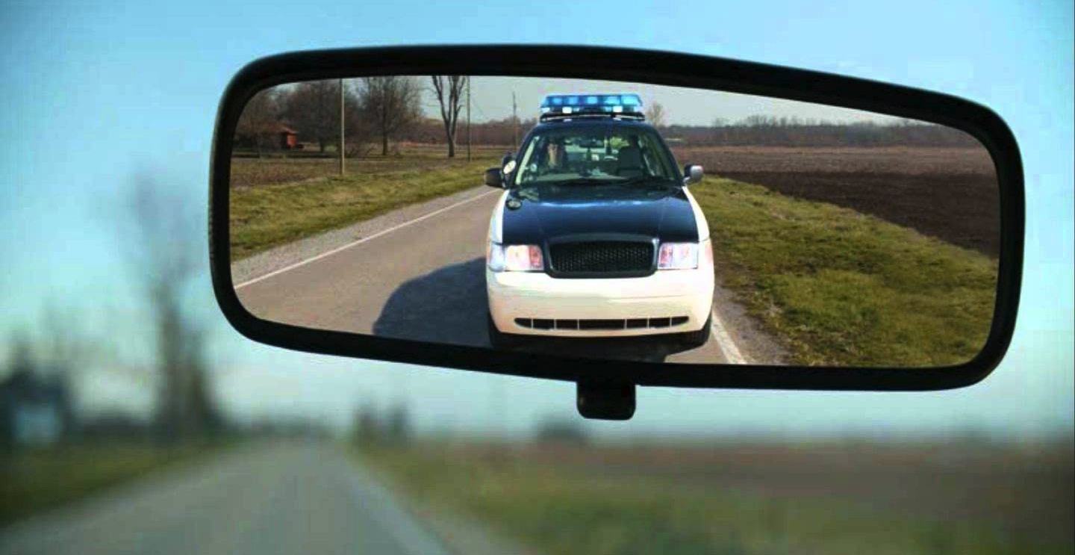
ANALOGIES
“It is false to say that the screen is incapable of putting us ‘in the presence of’ the actor. It does so in the same way as a mirror—one must agree that the mirror relays the presence of the person reflected in it—but it is a mirror with a delayed reflection, the tin foil of which retains the image” (Bazin 1967, 97).

Slide 21
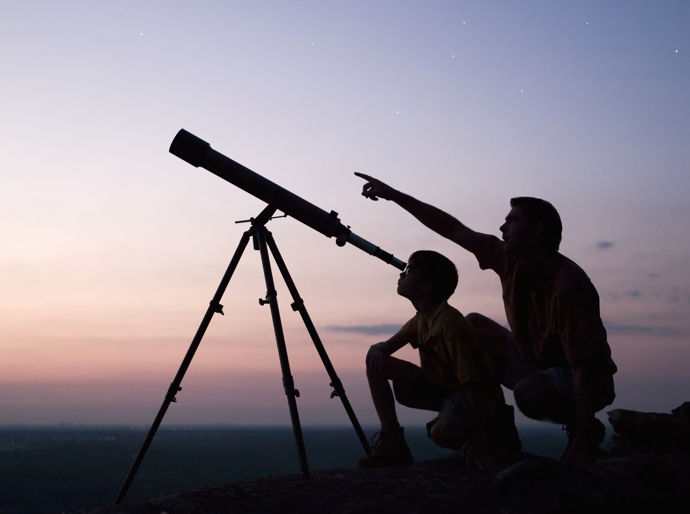
ANALOGIES

Slide 22
ANALOGIES

Slide 23
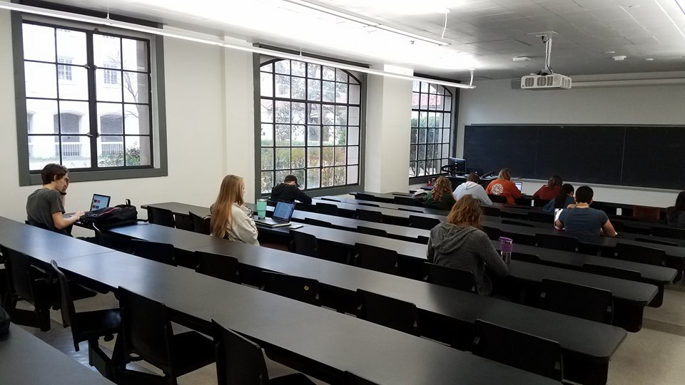
ANALOGIES

Slide 24
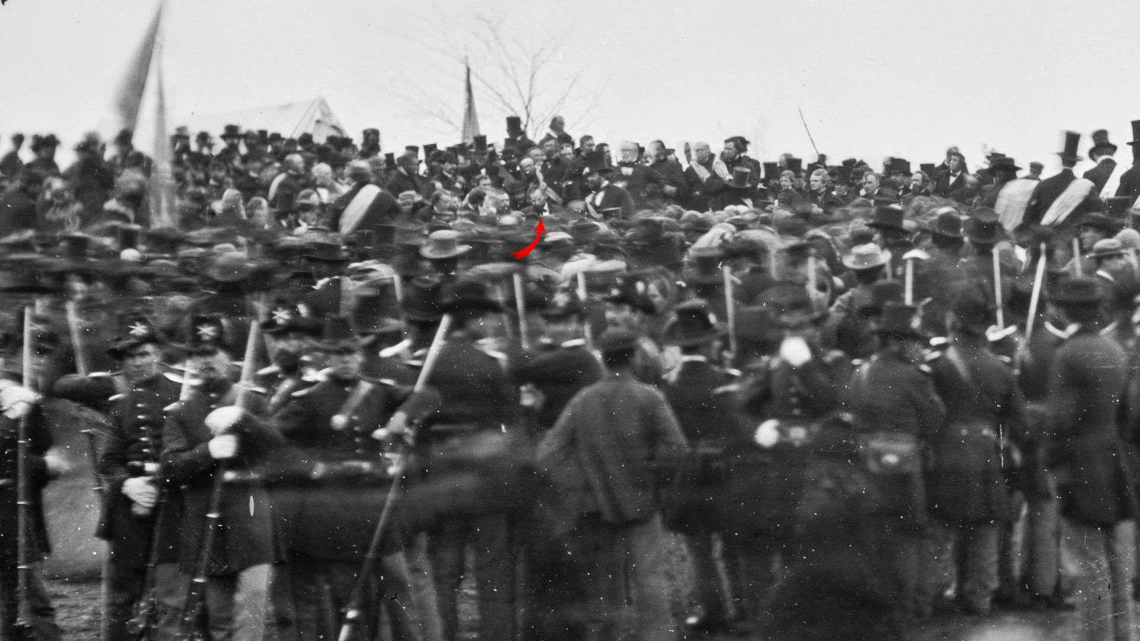
THE THESIS
The Gettysburg Address of 1863 (photograph by David Bachrach)

Slide 25
THE THESIS
The photograph does not simply give us the impression of seeing Lincoln.
The photograph is not simply a supplement to vision, which provides us with information that we couldn’t acquire by sight.
The photograph is neither just a duplicate or double or reproduction of Lincoln, nor is it simply a substitute or surrogate for him.
The photograph is transparent—we see through it. We literally see Lincoln.
Notes:
Paintings can supplement vision in that way—intuitively, photographs do much more.
Reaction: play Seinfeld clip.

Slide 26
POLL
Do you agree? Do we literally see past objects, places, and events in photographs?
Yes
No

Slide 27
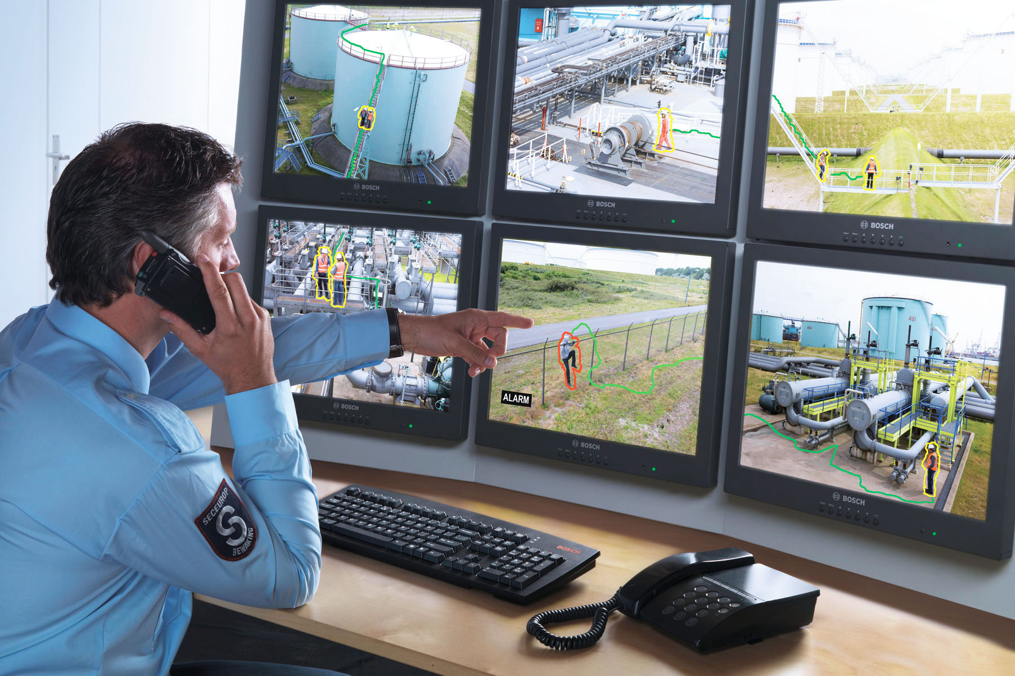
SLIPPERY SLOPE CONSIDERATIONS

Slide 28
SLIPPERY SLOPE CONSIDERATIONS
Notes:
So what if the broadcast is slightly delayed? That’s empirically plausible—it is likely that there is always some delay.
If seeing a past object or event is problematic, then what about the following?
https://www.nasa.gov/image-feature/goddard/2016/hubble-gazes-at-long-dead-star

Slide 29
SLIPPERY SLOPE CONSIDERATIONS
If we admit these examples as cases of genuine seeing, then how can we non-arbitrarily exclude seeing through photographs?
It might be argued that photographs are different from live broadcasts in that the former involve seeing past objects, places, and events, whereas the latter do not.
That may not always be true.
Even if it is, why is that a relevant difference?

