Slide 1
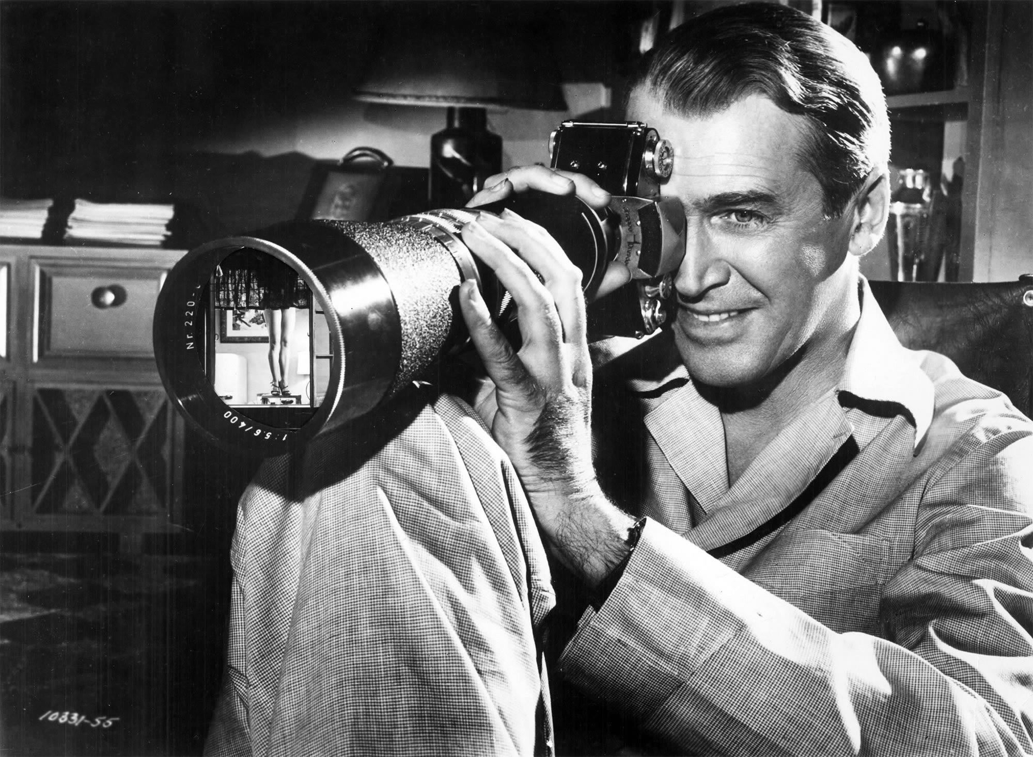
The male gaze
Notes:
Scopophilia example, The Tree of Life scene: https://www.youtube.com/watch?v=9vXJQFhTv8g
Voyeurism example, The Piano Teacher – 49m

Slide 2
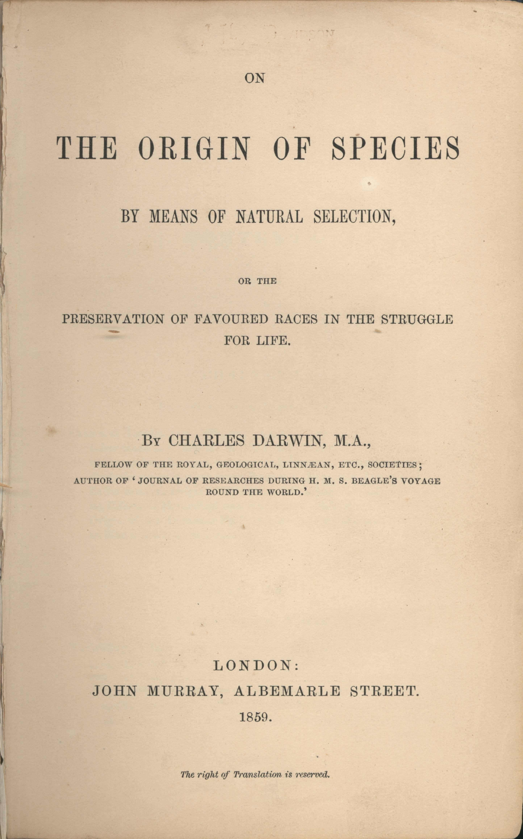
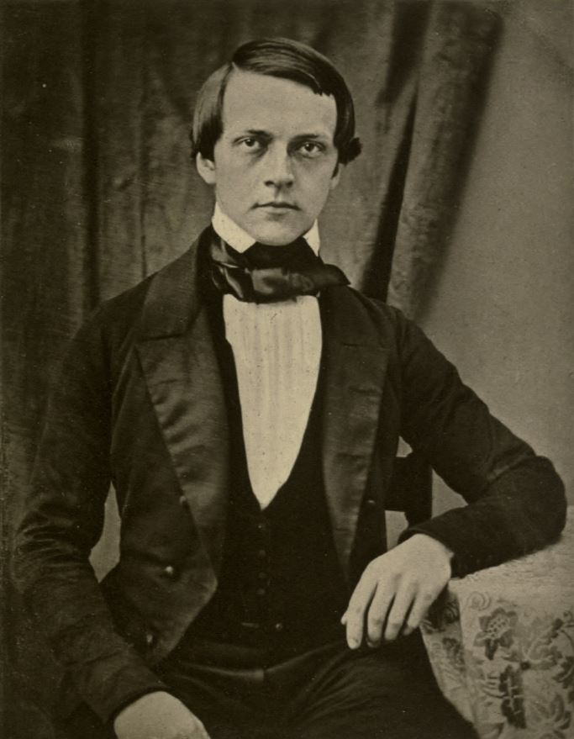
FREUDIAN PSYCHOANALTICS
Charles Darwin (1859),
On the Origin of Species
Hermann von Helmholtz (1847),
On the Conservation of Force

Slide 3
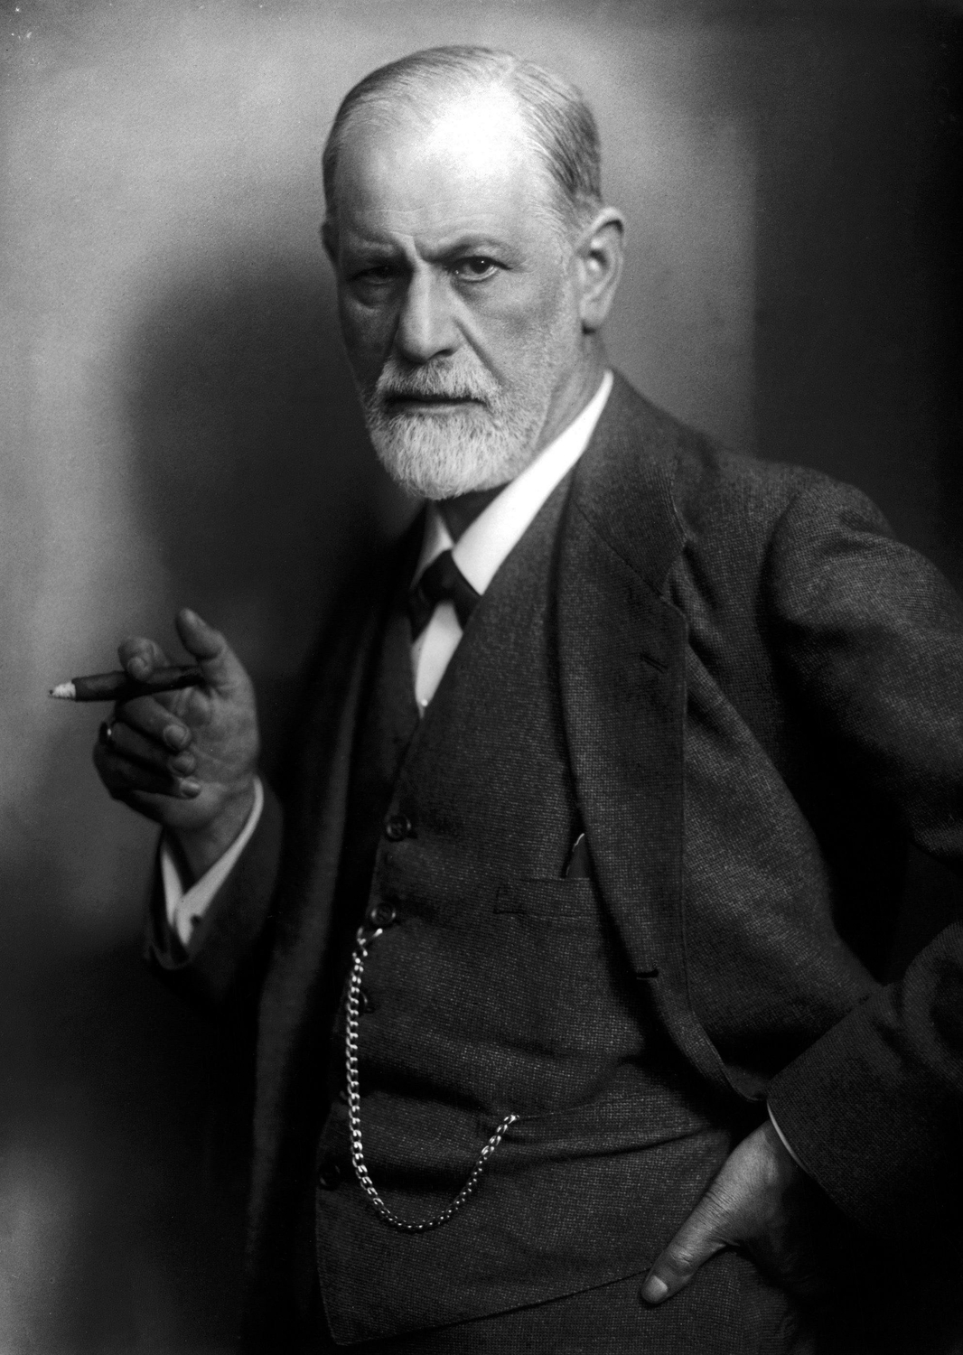
FREUDIAN PSYCHOANALYTICS
Human behavior is explicable in terms of the (typically hidden) mental processes or states that determine it.
The most basic of these are Eros (the life instinct) and Thanatos (the death instinct).
From the moment of birth, infants are driven by the desire for sexual (=bodily!) pleasure.
Various neuroses can be traced back to unresolved conflicts in an earlier stage of development.
Sigmund Freud
Notes:
Eros—governs the self-preserving and erotic instincts.
Thanatos—covers all the instincts toward aggression, self-destruction, and cruelty.
“sexuality” – covers any form of pleasure which is or can be derived from the body. The human being is energized or driven from birth by the desire to acquire and enhance bodily pleasure”

Slide 4
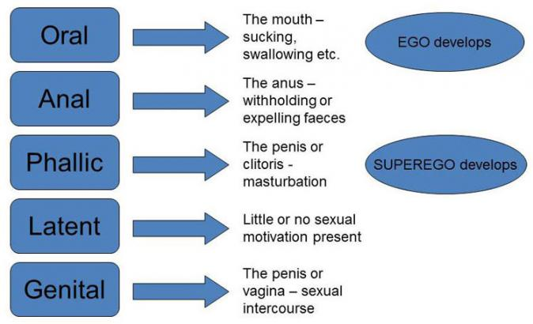
THE PSYCHOSEXUAL STAGES

Slide 5
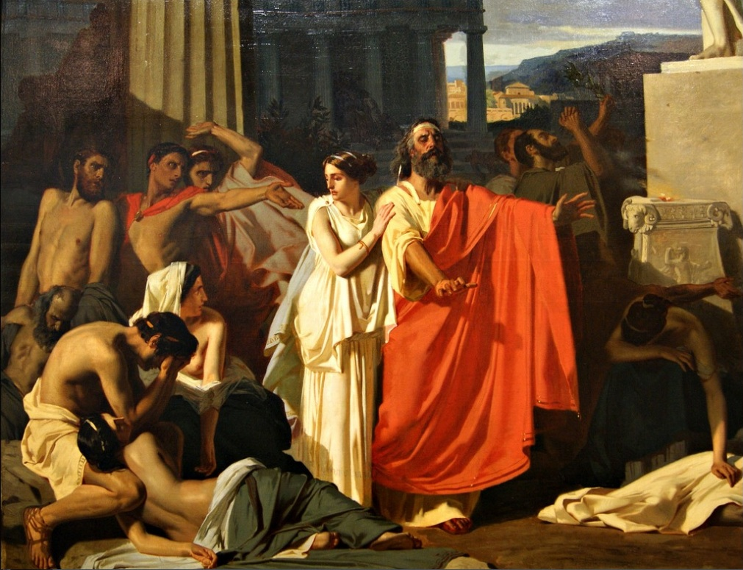
THE OEDIPUS COMPLEX

Slide 6
THE OEDIPUS COMPLEX
Both boys and girls start out sexually undifferentiated and attracted to their mother.
Boys develop a fear that they will be harmed by their father. This is known as castration anxiety.
They resolve this anxiety by coming to identify with the parent of the same sex and shift their attention from their mother to individuals modeled after their mother.
Girls come to realize that their mother is castrated and consequently regard their mother with contempt.
They then come to envy their father for possessing what they lack. This is known as penis envy.
They resolve this anxiety by developing the desire to be the object of masculine desire and/or to have a child.

Slide 7
THE TRIPARTITE MIND
Plato

Slide 8
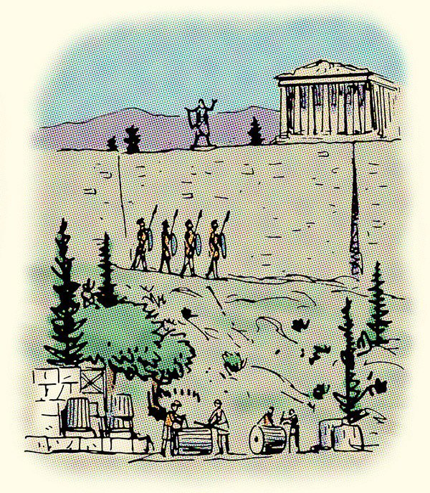
THE TRIPARTITE MIND
just city-state

Slide 9
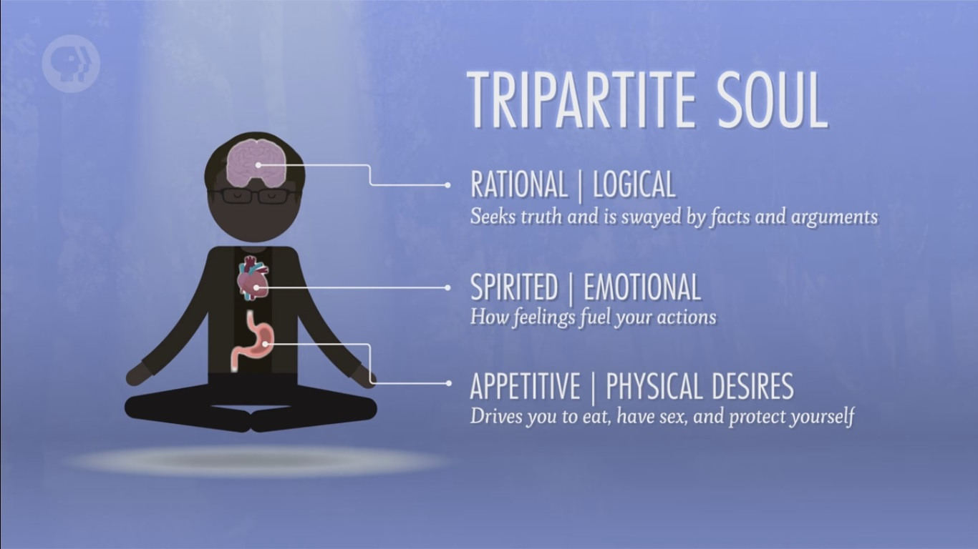
THE TRIPARTITE MIND
just soul
Notes:
THE TRIPARTITE MIND

Slide 10
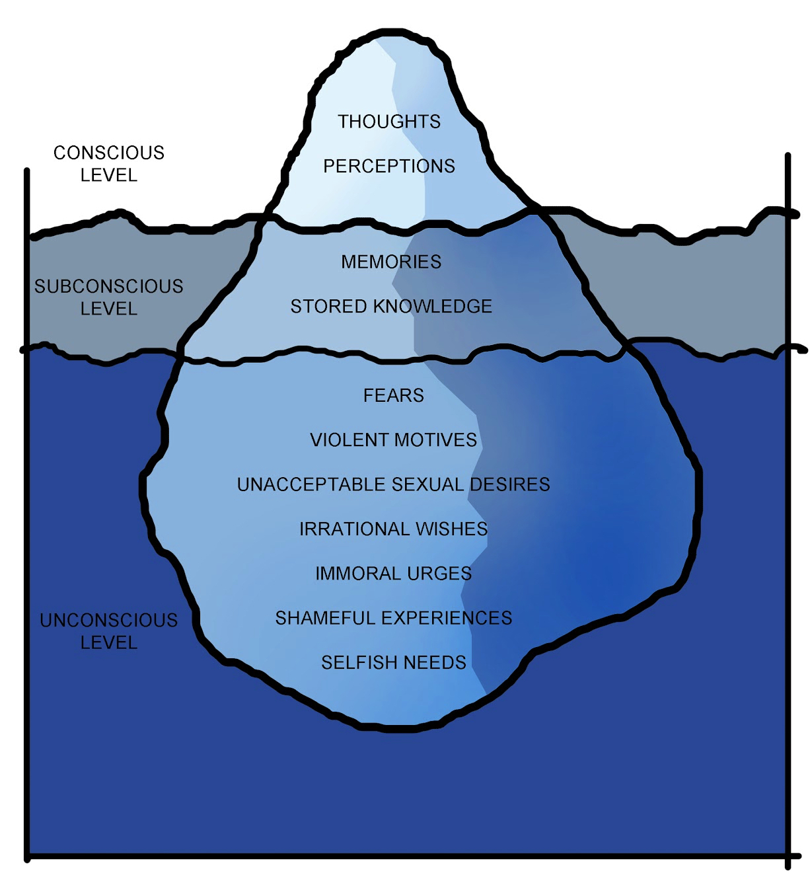
THE TRIPARTITE MIND
EGO
SUPER-EGO
ID
Notes:
Id – the part of the mind containing instinctual sexual drives. It is unconscious.
Super-ego – contains the “conscience,” or socially-acquired control mechanisms which have been internalized by parents. This seeks to limit the id.
Ego – the conscious self that is created by the dynamic tensions and interactions between the id and super-ego, designed to resolve conflicts between them.
Theoretical model

Slide 11
INFLUENTIAL CONCEPTS
Mental health requires a harmonious relationship between these three elements of the mind.
The mind possesses defense mechanisms that are meant to inhibit internal conflict.
The mind may repress conflicts (by pushing them into the unconscious) or subliminate them (by channeling the sexual drives into socially acceptable achievements).
Neuroses may result from fixation (failure to progress beyond an earlier developmental stage) or regression (returning to the behavior characteristic of an earlier developmental stage).
Dreams and slips of the tongue indicate a relaxation of the super-ego and provide insights into the contents of the id.

Slide 12
INFLUENTIAL CONCEPTS

Slide 13
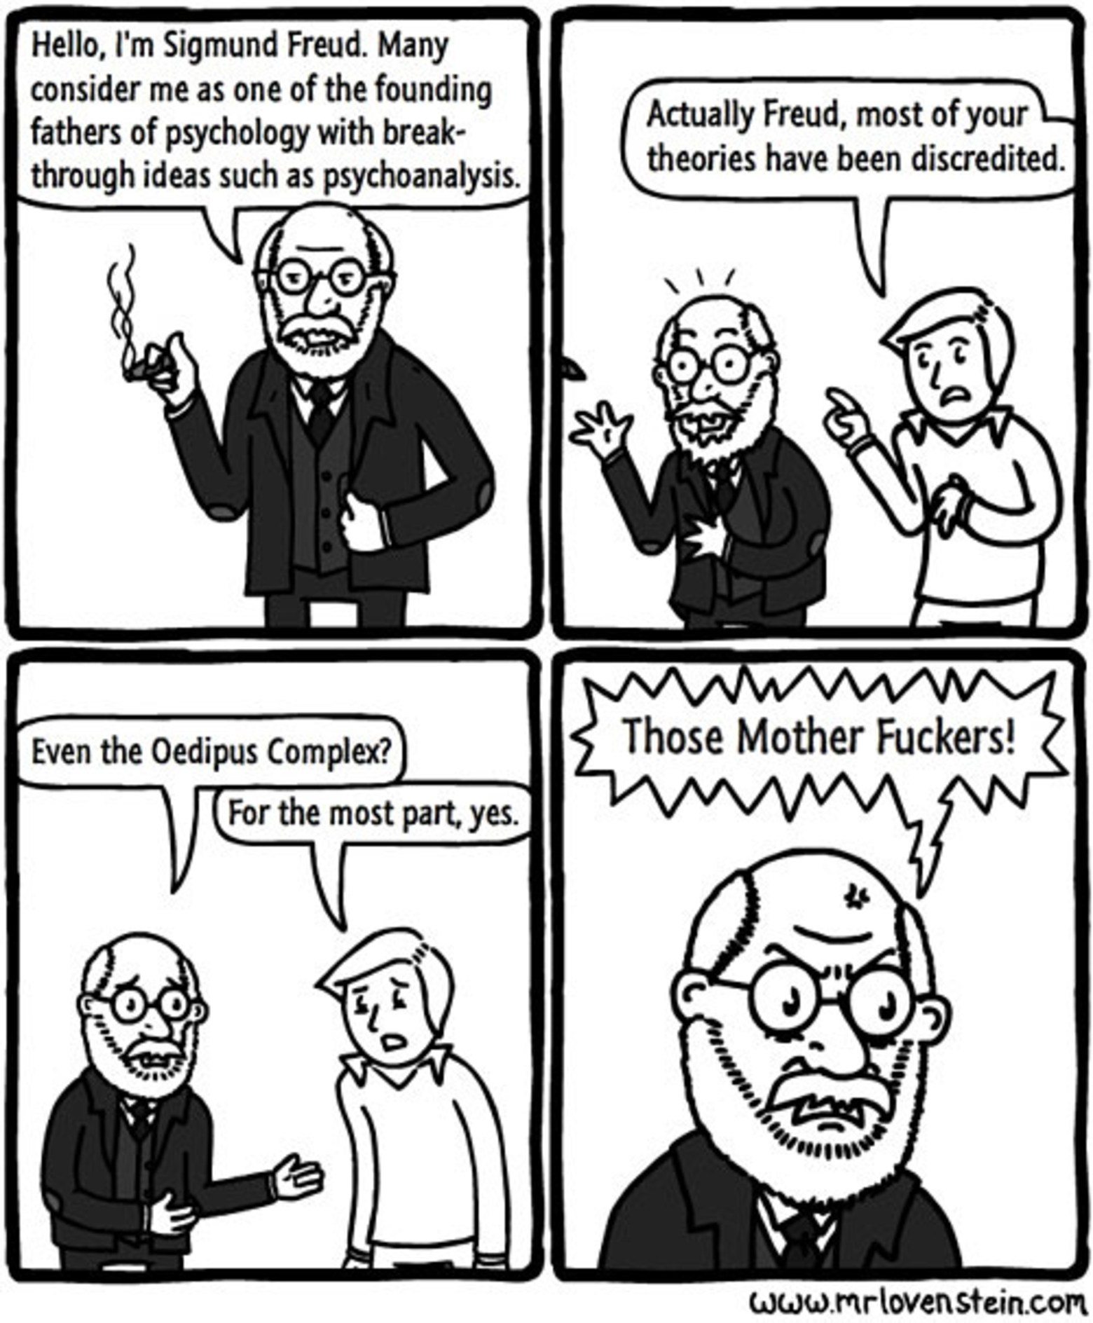
SCIENTIFIC STATUS

Slide 14
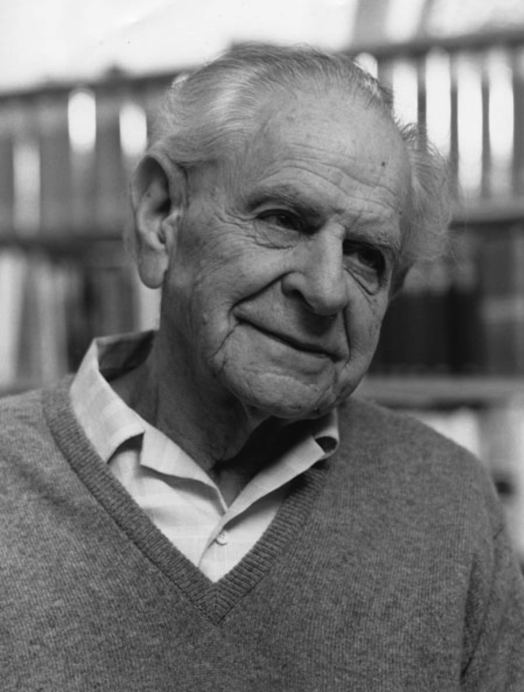
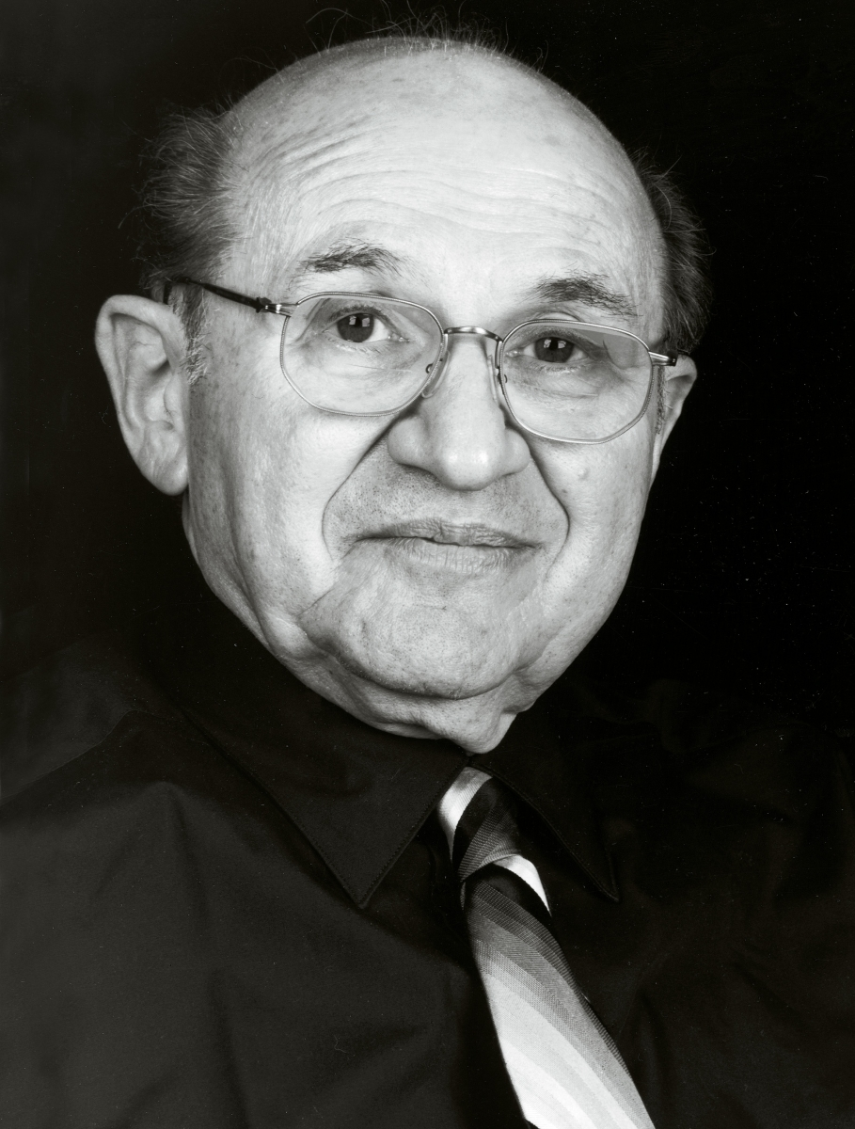
SCIENTIFIC STATUS
Carl Popper
Adolf Grünbaum

Slide 15
SCIENTIFIC STATUS
“There is no doubt that the causal claims of psychoanalysis cannot be established in the same way as a causal claim in a hard-core empirical science like experimental physics. But neither can any causal claim of any form of psychology which interprets people’s actions on the basis of their motives—including the ordinary psychology of everyday life” (Lear 1995, 22).
Jonathan Lear

Slide 16
PSYCHOANALYTIC FEMINISM
“Psychoanalytic inquiry does not fit comfortably with, and even unsettles, biological theories of sex and sociological theories of gender. . . . While sex and gender are sometimes construed in feminist theory in terms of the contrast between biology and culture, or nature and nurture, Freud's theory . . . challenges these dualisms, developing an account of the sexual drive that traverses the mental and the physical. . . . Whatever the hazards of Freud's writings on women, then, his work explores in new ways the meaning and possibilities of sexed identity. Likewise . . . psychoanalytic feminism interrupts many assumptions about what feminism is and the conceptual and material objects it theorizes, including especially the very concept of woman” (Zakin 2011).

Slide 17
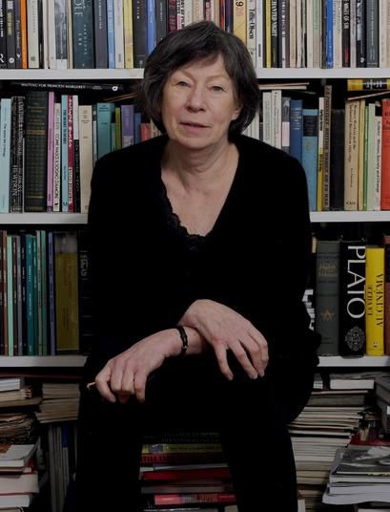
PSYCHOANALYTIC FEMINISM
“It is helpful to understand what the cinema has been, how its magic has worked in the past, while attempting a theory and a practice which will challenge this cinema of the past. Psychoanalytic theory is thus appropriate here as a political weapon, demonstrating the way the unconscious of patriarchal society has structured film form” (803; emphasis added).
“[W]e can begin to make a break by examining patriarchy with the tools it provides, of which psychoanalysis is not the only but an important one” (804)
Laura Mulvey

Slide 18
Visual Pleasure and Narrative Cinema

Slide 19
SCOPOPHILIA
“It is said that analysing pleasure, or beauty, destroys it. That is the intention of this article” (805).
Hollywood cinema largely thrives on its ability to produce scopophilic pleasure.
Scopophilia is pleasure in looking by taking others as “objects” and “subjecting them to a controlling and curious gaze” (806).
This instinct first manifests in childhood and then continues into adulthood.
In extreme cases, this instinct can become fixated into a perversion.
Notes:
Show Tree of Life clip
Show Haneke clip

Slide 20
SCOPOPHILIA
How should we understand the notion of a “controlling and curious gaze”?
Notes:
Non-consensual elements
Active/passive distinction; one cannot avoid the gaze; being in control of the looking and the being looked at
Possibility of response
“[T]he absence of the object viewed, and its inability to return the gaze all contribute to the idea that film viewing constitutes unauthorized looking” (343).

Slide 21
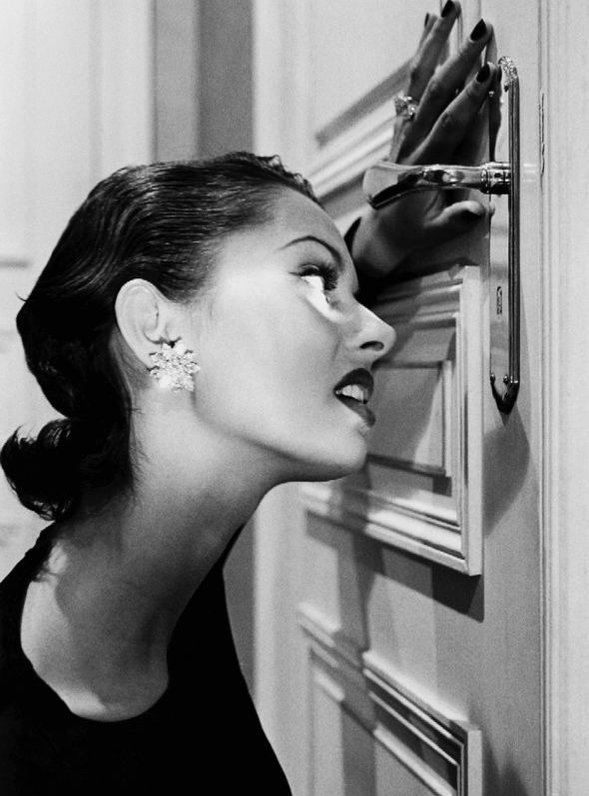
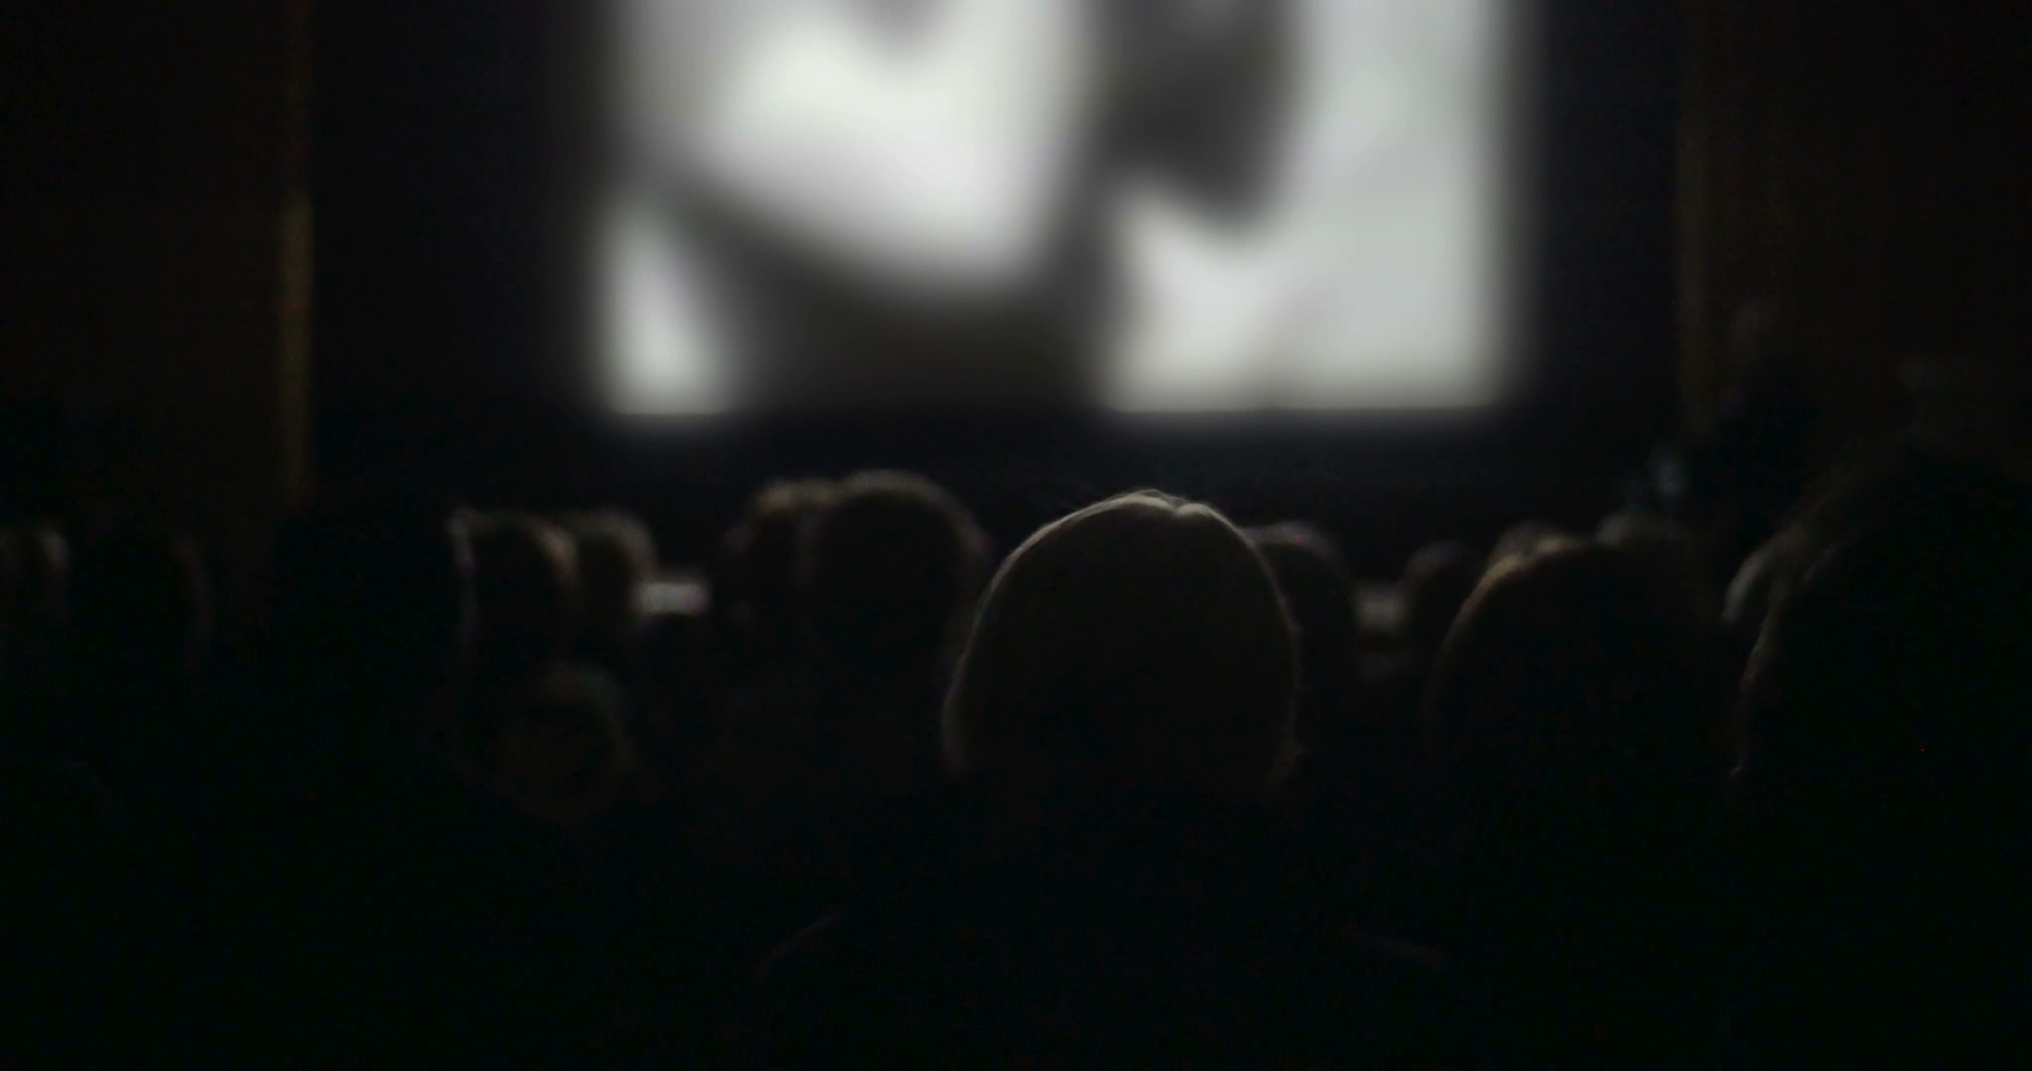
SCOPOPHILIA
Active gaze ✓
Passive object ✓
Voyeuristic experience ✓
Literal seeing ✓
Notes:
Film portrays “a hermetically sealed world which unwinds magically, indifferent to the presence of the audience, producing for them a sense of separation and playing on their voyeuristic phantasy” (806).
“Moreover, the extreme contrast between the darkness in the auditorium (which also isolates the spectators from one another) and the brilliance of the shifting patterns of light and shade on the screen helps to promote the illusion of voyeuristic separation” (806).
“Although the film is really being shown, is there to be seen, conditions of screening and narrative conventions give the spectator an illusion of looking in on a private world” (806).
This involves repression and a projection of the repressed desire on to the performer.

Slide 22
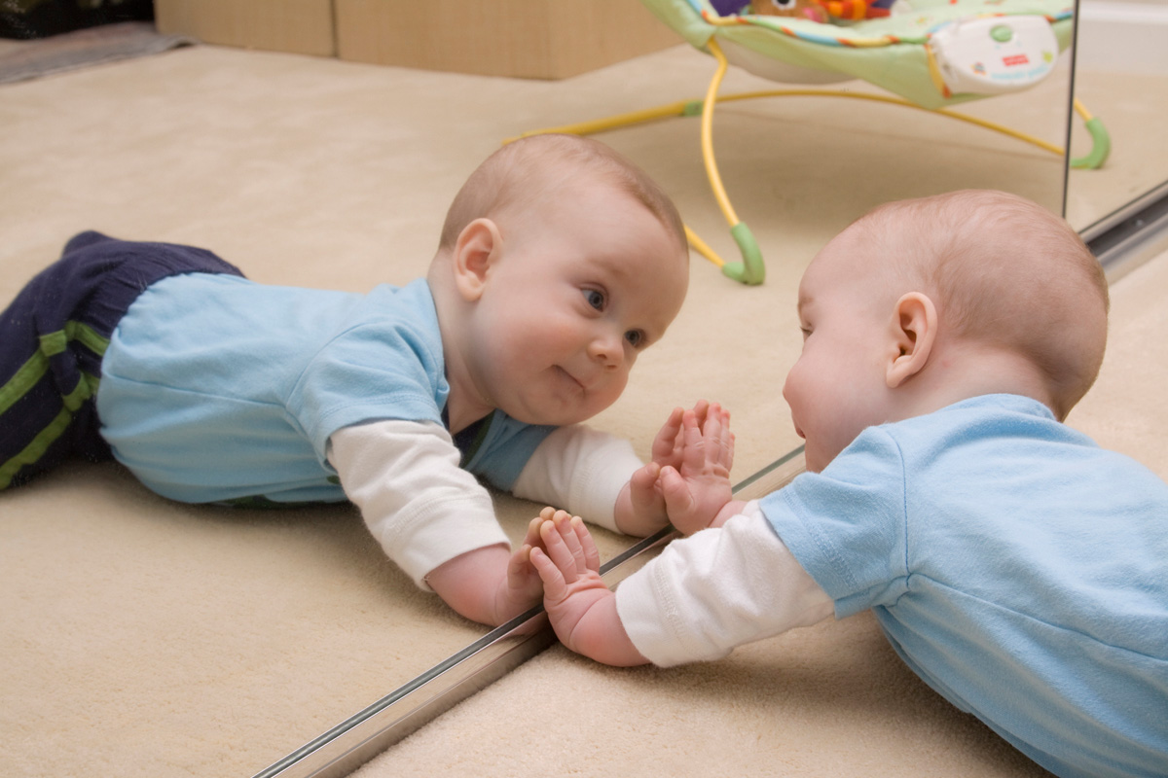
NARCISSISM
the mirror stage
Notes:
“Lacan has described how the moment when a child recognises its own image in the mirror is crucial for the constitution of the ego. Several aspects of this analysis are relevant here” (807).
“The mirror phase occurs at a time when the child’s physical ambitions outstrip his motor capacity, with the result that his recognition of himself is joyous in that he imagines his mirror image to be more complete, more perfect than he experiences his own body” (807).
“Recognition is thus overlaid with mis-recognition: the image recognised is conceived as the reflected body of the self, but its misrecognition as superior projects this body outside itself as an ideal ego, the alienated subject, which, re-introjected as an ego ideal, gives rise to the future generation of identification with others” (807).
Identification with the image seen.

Slide 23
NARCISSISM
the “mirror” stage
Notes:
Identification with the image seen.
Ego-libido vs. object-libido

